Slide 1

Welcome!
May 2026 Meeting
May 12, 2026
Networking Hour & Dinner
Announcements
Presentation
  Welcome, Emily Stock, AICP!
  Virginia Department of Rail and Public Transportation (DRPT)
  Chief of Rail Transportation

Slide 2
Announcements
Upcoming Events:
    September 10, 2026 – Golf Outing at Musket Ridge
    November 2026 (Balt)
      Delta Railroad Service on the East River Tunnel in NYC
    January 2027 (DC)
      TBD
News!
  Exclusive Firm Memberships
    Support the Scholarship Fund!
  Newsletter
    Coming this Summer!
    Highlighting members, projects, sponsor companies, and more
  Become a 2026 sponsor through membership
  Come present to WARES!
    Availability for all 2027 Events
      Contact Alex Bachy (VP & Program Chair) Email: alex.bachy@kimley-horn.com

Slide 3
2026 Membership
Gold
  $1,500 annually
    2 passes to each presentation event
      (Jan, Mar, May, Nov)
      25% off all additional attendees
Silver
  $1,000 annually
    1 pass to each presentation event
      (Jan, Mar, May, Nov)
      25% off all additional attendees
Bronze
  $500 annually
    Sponsorship of WARES for calendar year (2025)
      All goes toward scholarship funds
Non-Member Attendance
  Option to purchase single passes to all events
Events always half-price for public agency employees

Slide 4

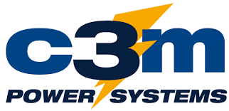



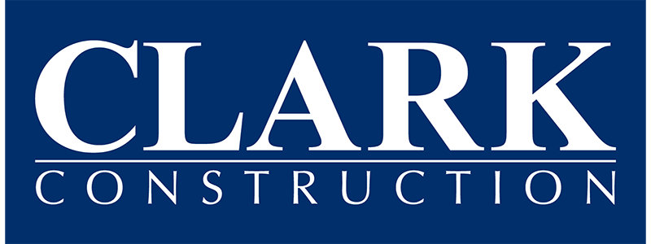











Thank you to our 2026 Sponsors!
GOLD
SILVER
BRONZE

Slide 5
Great Start to 2026…
Sponsorship
  Supporting our Rail Engineering Scholarships and events/initiatives
  Raised over $14,500 so far in 2026!
    Up from $11,000+ in 2025
    Thank you Sponsors!
Scholarship Update
  Rail Engineering Program Scholarships (4)
  $10,000 total per year
    Up from $7,500
  PSU Altoona
    Owen Blumenfeld & Andrew Kennedy
  U. Delaware
    Ryan McMahon
  Morgan State
    Sean Holley

Slide 6
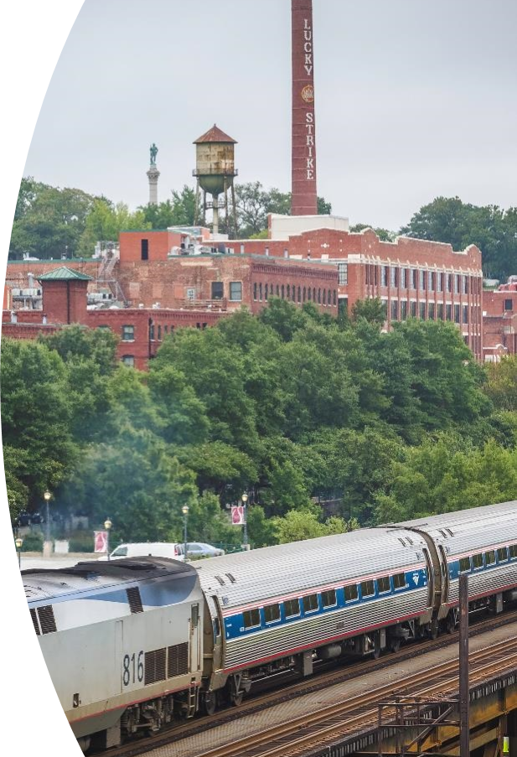



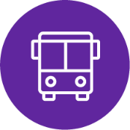

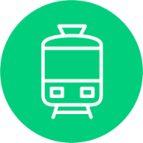
DRPT and the Virginia Statewide Rail Plan
Emily Stock, AICP
Chief of Rail Transportation
WARES Meeting
May 12, 2026

Slide 7
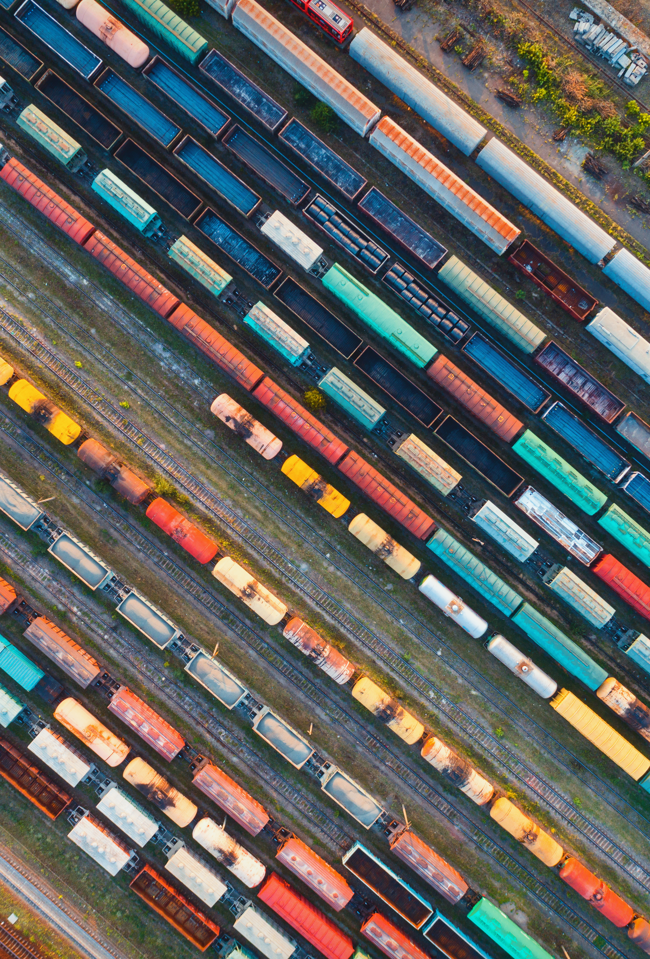
Agenda
DRPT Overview
State of Rail
Partner Agencies
Funding Sources
Grant Programs
Six Year Improvement Program Recommendations
Rail Planning, Federal Grant Assistance, and Rail Crossing Initiative
Virginia Statewide Rail Plan
Other Resources

Slide 8
Virginia Department of Rail and Public Transportation (DRPT)
Who are we?
What do we do?
The catalyst to connect and improve the quality of life for all Virginians through innovative transportation solutions
Our vision is a connected Commonwealth with an integrated multimodal network that serves every person, every business, and every need
The agency works with rail and public transportation stakeholders to provide service to people throughout Virginia
Promotes transportation options to the general public, businesses, and community decision-makers
Allocates state and federal funding through capital and operating grants, as well as grants to support specific enhancements or improvements
Conducts statewide rail and transit studies, including improving service or identifying new opportunities
Plans and programs new services and capital improvement projects, from public transportation to freight and passenger rail
Provides leadership, advocacy, technical assistance, and funding oversight

Slide 9
Rail and Public Transportation in Virginia
40 public transit systems
82 human service providers
17 transportation demand management (TDM) agencies
15 metropolitan planning organizations
1 commuter rail service (VRE)
1 state-supported intercity bus (Virginia Breeze)
9 shortline (Class-III) railroads
2 Class-I railroads (CSX and Norfolk Southern)
1 Intercity Passenger Rail (Amtrak)

Slide 10
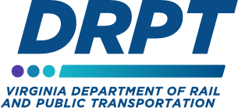
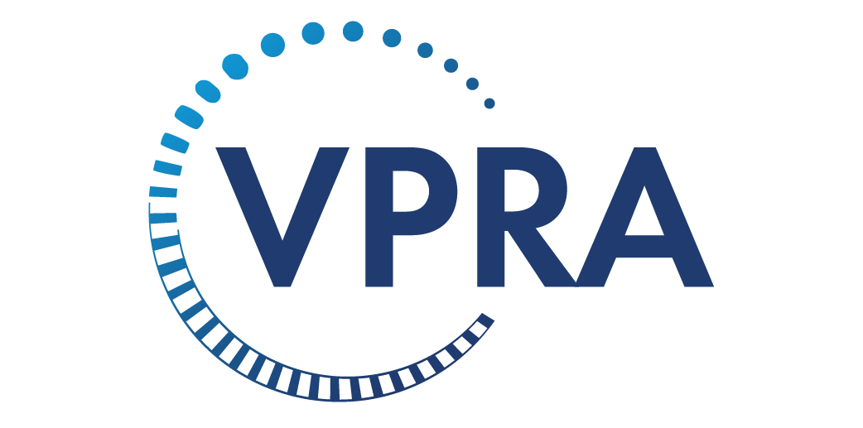
State of Rail in Virginia
Virginia and Our Rail Network
2 Class-I railroads
9 Short Line railroads
8 Amtrak intercity passenger routes*
2 Virginia Railway Express (VRE) commuter routes
3,000 route miles of rail

Slide 11
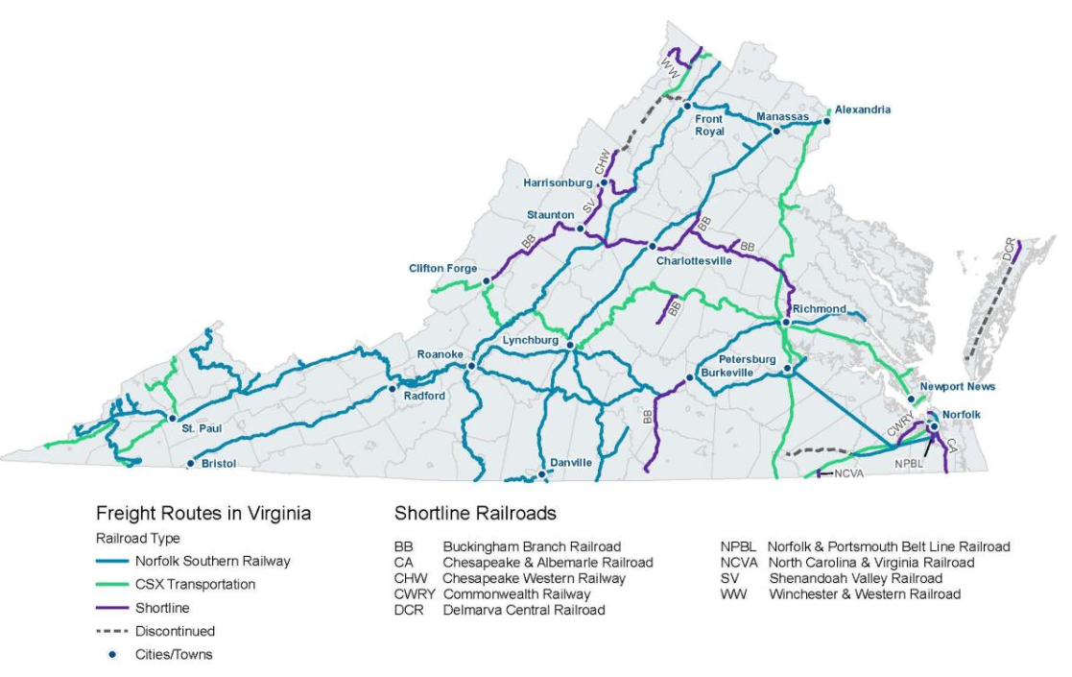
Virginia Freight Rail Network

Slide 12
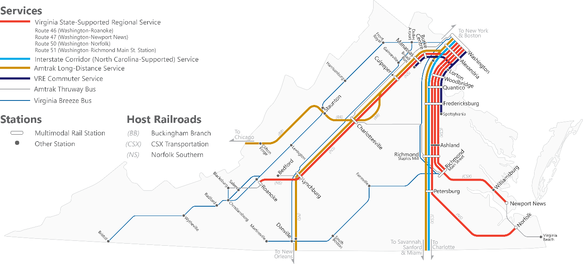
Virginia Passenger Rail Service

Slide 13




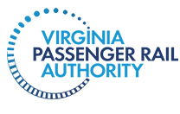

Rail division connects with other agencies

Slide 14
DRPT/VPRA Governance Structure
Commonwealth Transportation Board
Chair: Secretary of Transportation
DRPT
VDOT
Virginia Passenger Rail Authority Board
Chair: DRPT Director
VPRA Executive Director

Slide 15
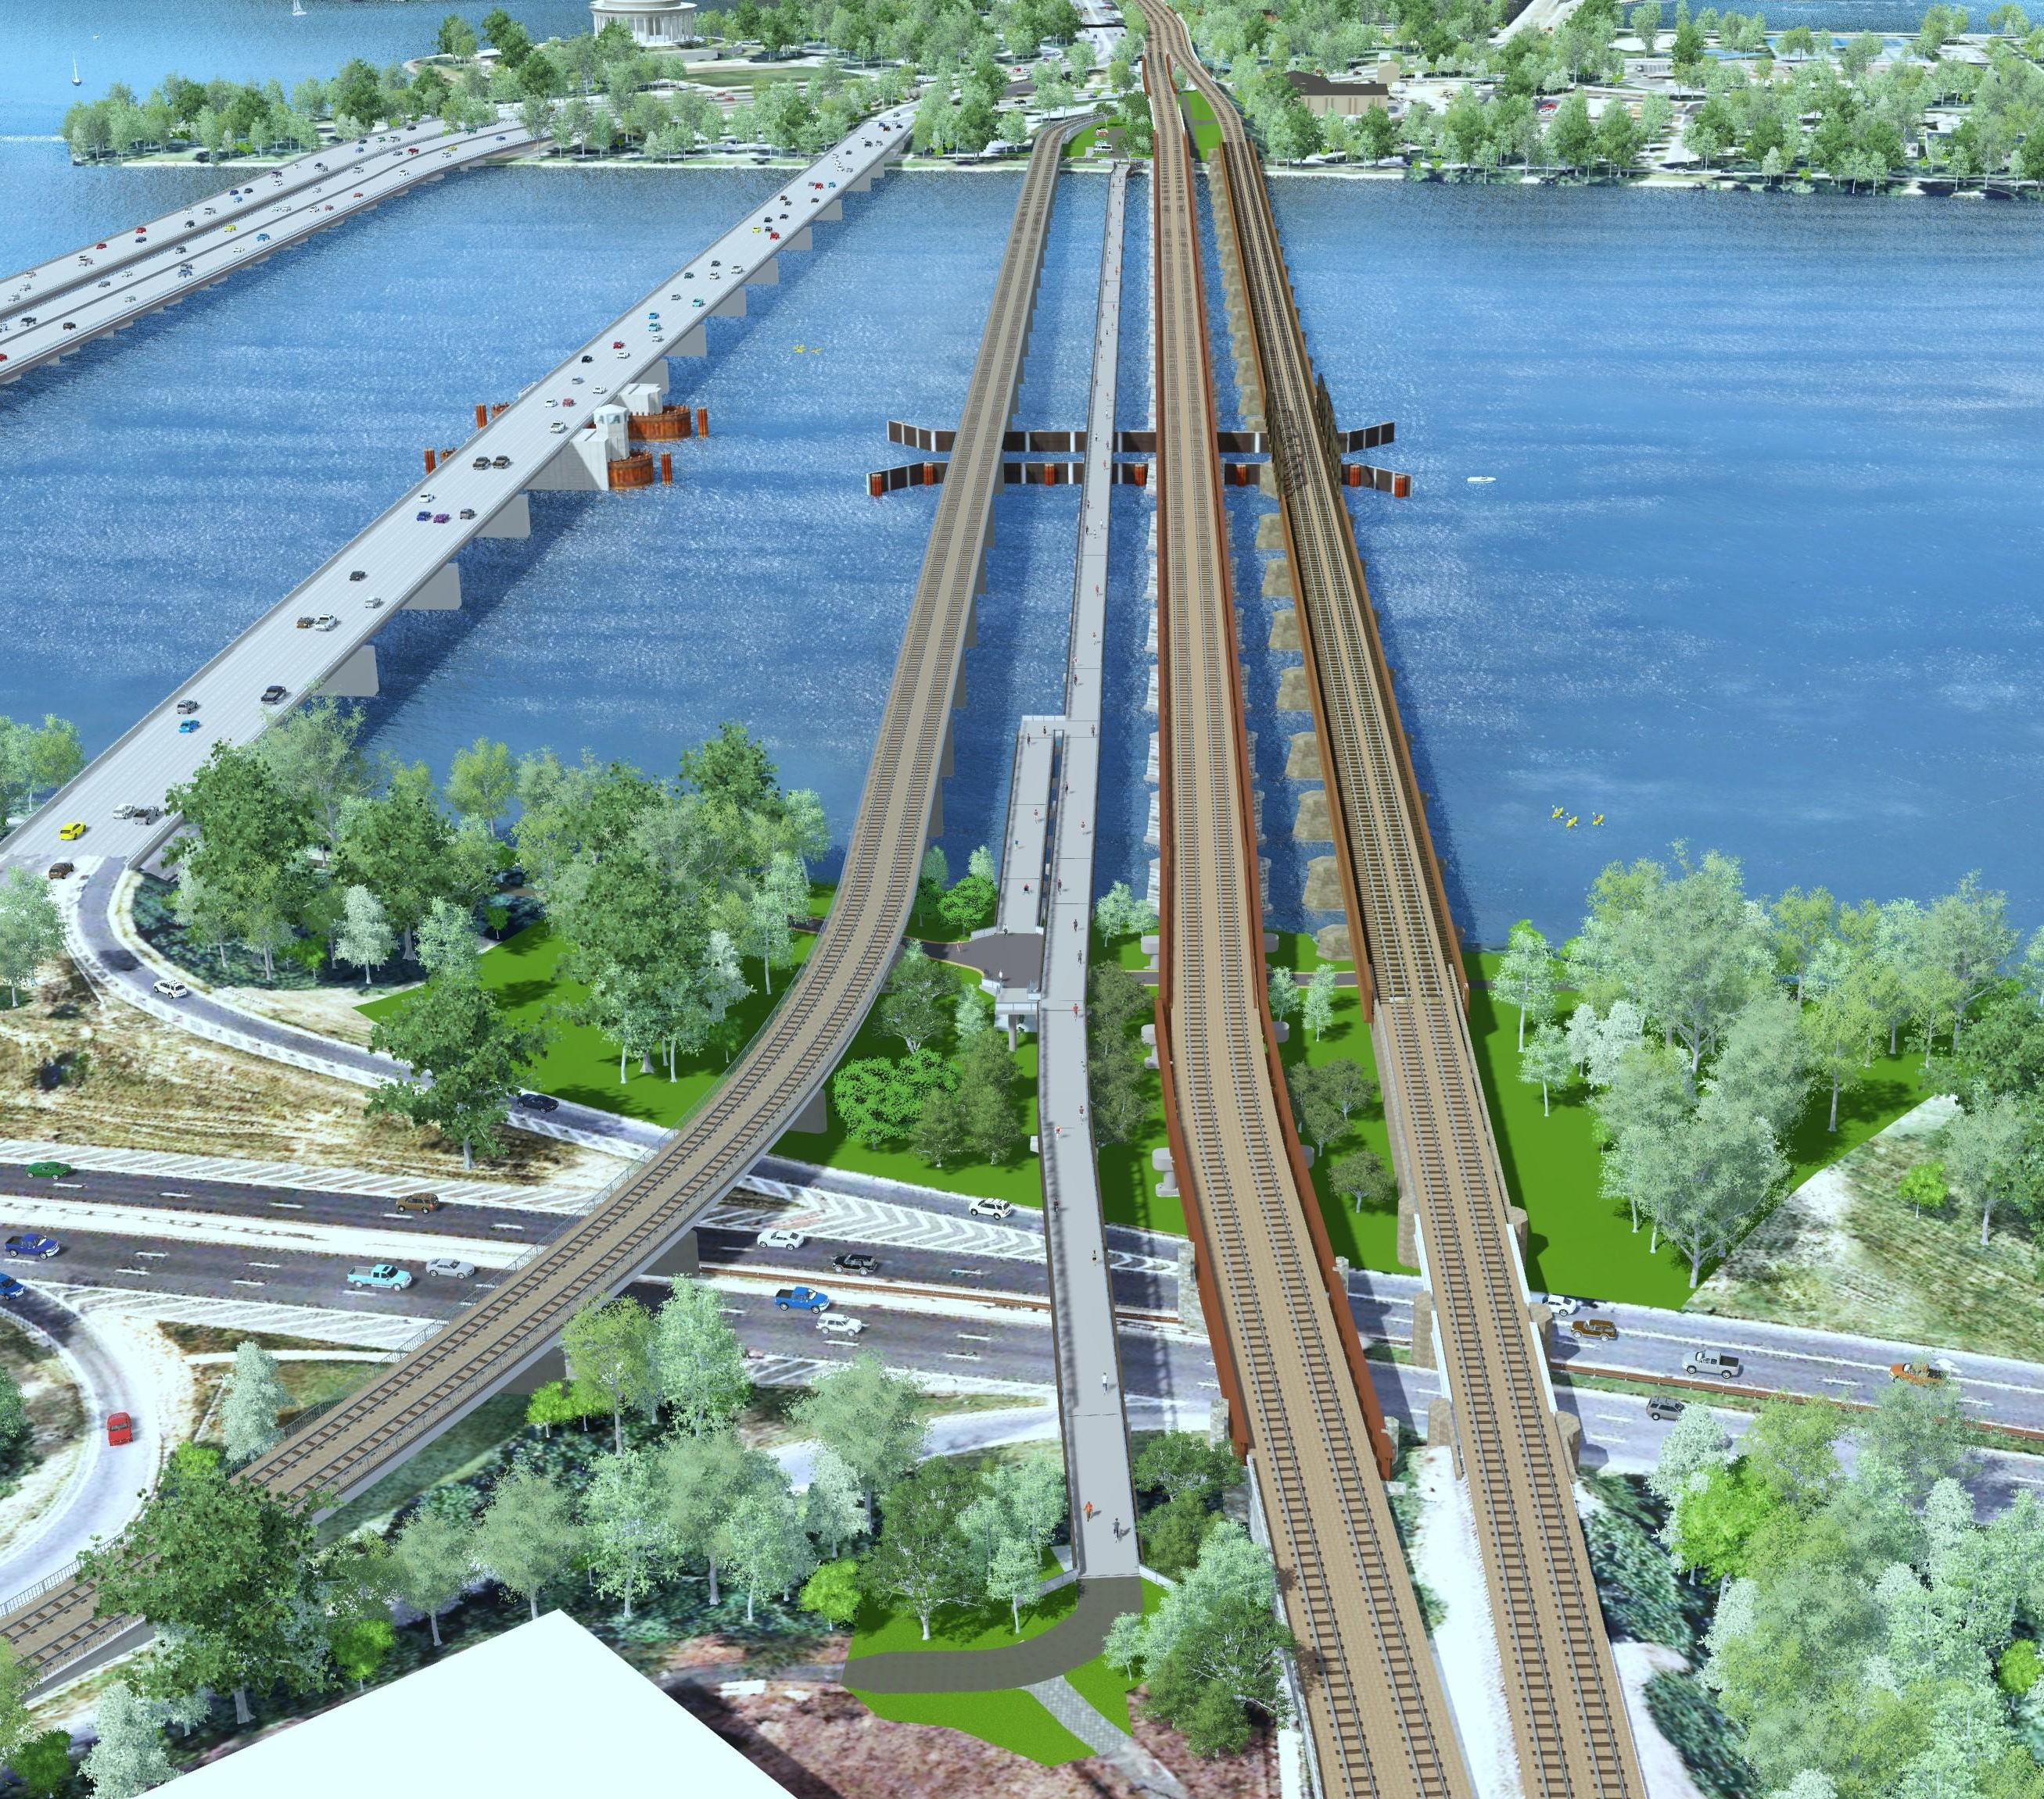
Virginia Passenger Rail Authority
Mission: Promote, sustain, and expand the availability
of passenger and commuter rail service in the
Commonwealth of Virginia.
Independent political subdivision created by
2020 General Assembly – fully governmental
Given powers necessary for carrying out statutory purposes:
  Design, build, finance, and maintain rail facilities
  Direct recipient of USDOT Grants
  Eminent domain powers
Owns rail assets and right of way
Partner with Amtrak and VRE to operate passenger and commuter rail service
Governed by a 15-Member Board

Slide 16
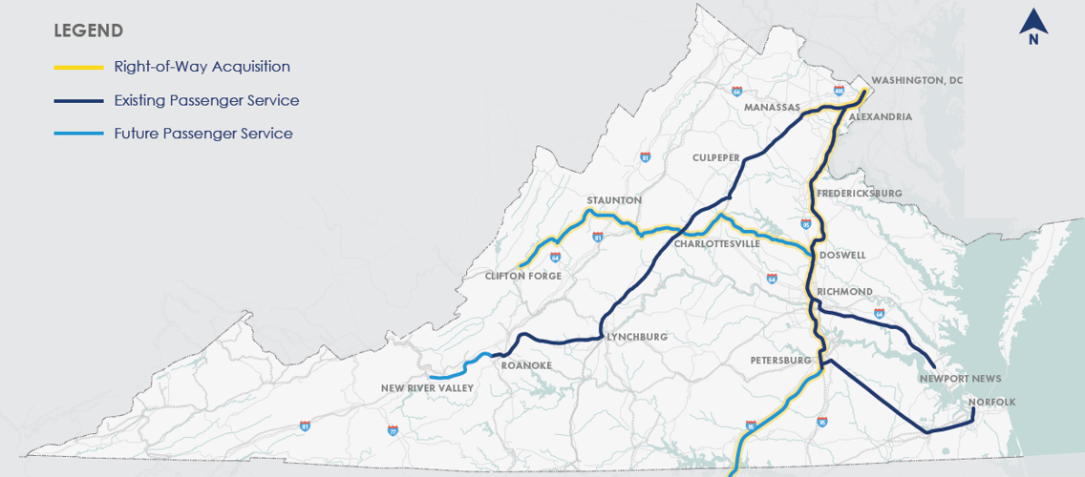
Transforming Rail in Virginia
Virginia’s first phase of passenger rail enhancement
Acquisition of hundreds of miles of right of way
Doubling Amtrak services between Richmond and DC, and increasing service to points beyond
Extending Amtrak services to the New River Valley
Major capital projects to increase reliability, reduce congestion
Notes:
TRV
$4.5B in infrastructure and capacity improvements
Goal of passenger and freight separation
Significant improvements to the frequency, reliability, and quality of passenger rail service in Virginia
Acquire nearly 400 miles of Railroad Right-of-Way
QUICK REVIEW OF TRV – THE RAIL PLAN CONSIDERS THESE PROJECTS EXISTING CONDITIONS!!

Slide 17
DRPT and the Virginia Passenger Rail Authority
 | Freight Rail Programs | Passenger Rail Projects | Public Transit & Commuter Programs
Funding Administration | DRPT | VPRA | DRPT
Corridor Planning | DRPT | VPRA | DRPT
Statewide Planning | DRPT
Programming & SYIP | DRPT | VPRA | DRPT
Policy Setting | DRPT | VPRA | DRPT
Design & Construction |  | VPRA
ROW/3rd Party |  | VPRA
Operations Oversight |  | VPRA
The Virginia Passenger Rail Authority was created in 2020 by the Omnibus Transportation Bill
VPRA is governed by a board of directors, and designs, constructs, and provides funding to operate intercity passenger rail in Virginia
DRPT plans passenger rail expansion and DRPT’s Director chairs the VPRA Board, VPRA designs and builds according to those plans
VPRA receives pass-through Commonwealth Rail Funds through DRPT. The CTB approves VPRA capital budget and any disposal of property >$5M

Slide 18
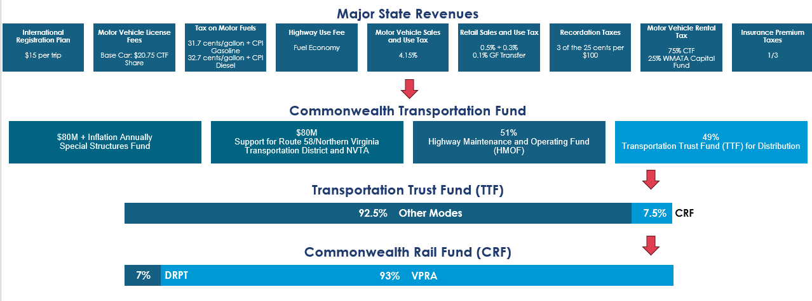
Virginia Transportation Funding Dedicated to Rail

Slide 19
DRPT Six-Year Improvement Program FY2027-2032
CTB votes on the DRPT SYIP every June
FY 2027 – FY 2032
FY 2027
$7.4 billion in allocations over six fiscal years
$5.4 billion to public transit, $1.8 billion to rail
Distributes formula-driven funding to rail, transit, and commuter programs
$950.4 million for public transportation (includes VRE and WMATA)
$25.4 million for DRPT rail
$101 million for VPRA rail

Slide 20

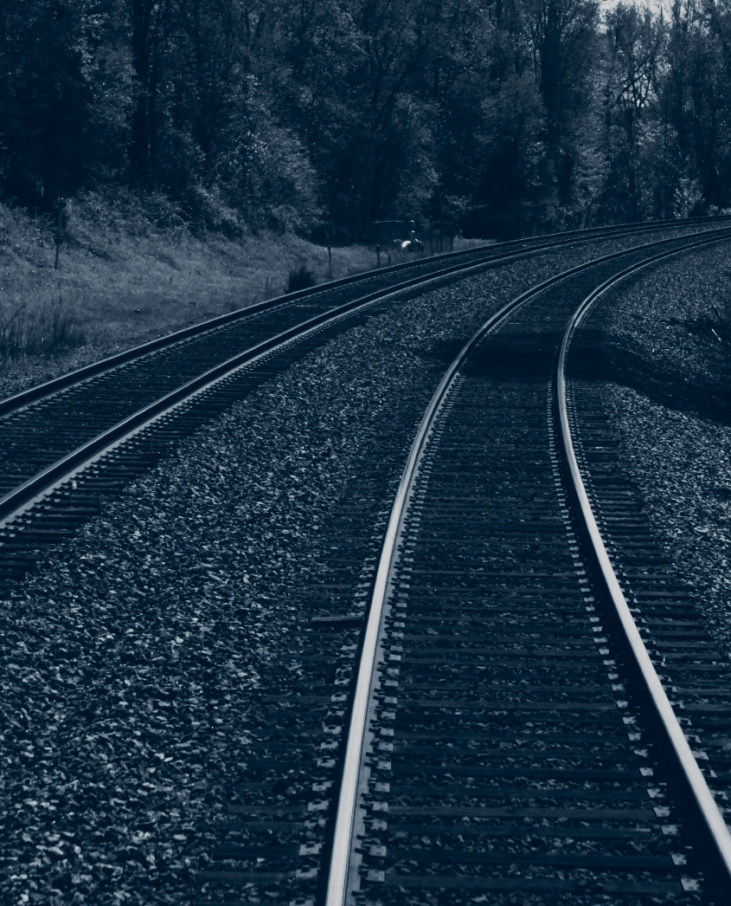
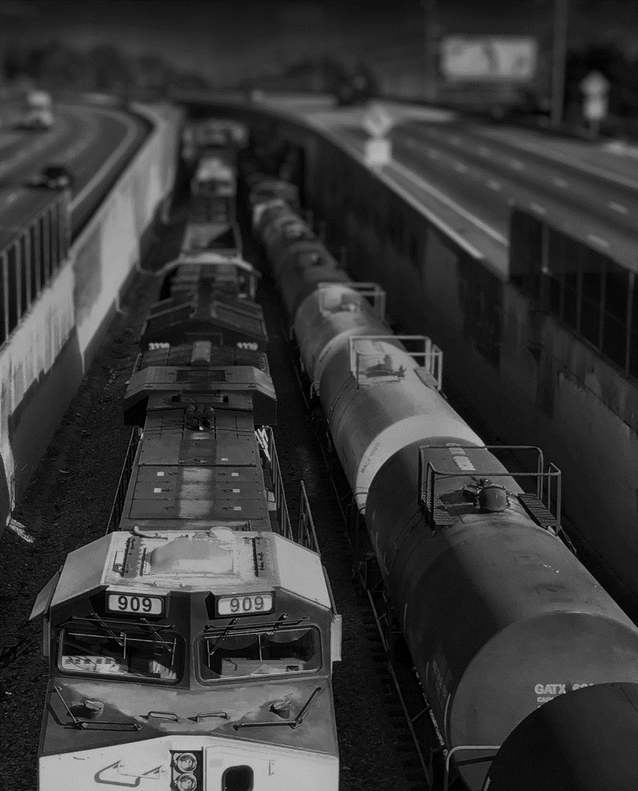
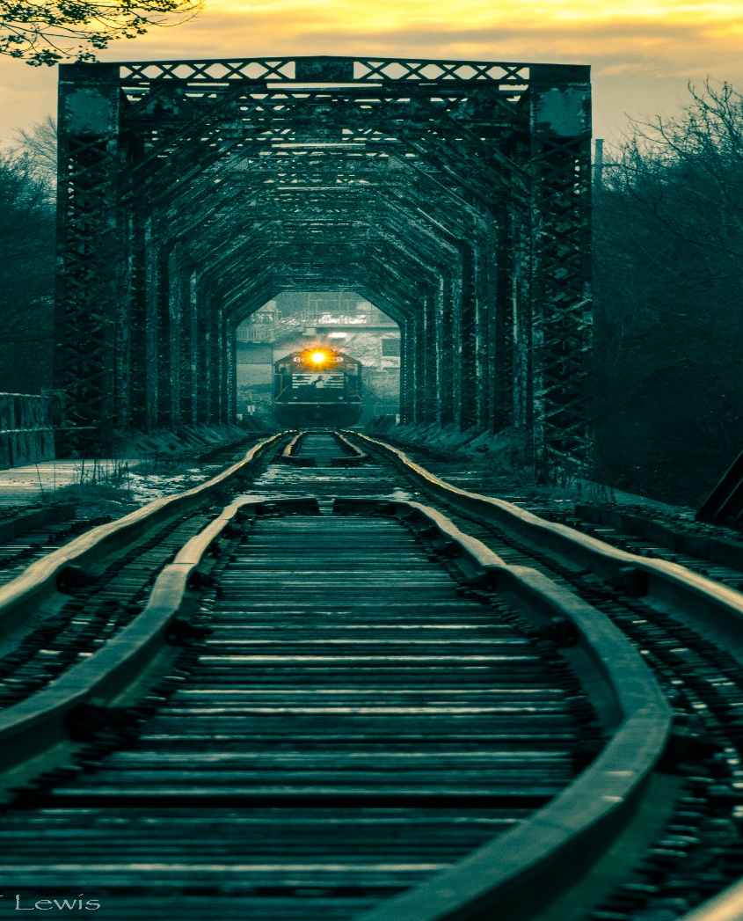
DRPT Rail Programs: Expand, Preserve & Connect
FREIGHT
Rail Preservation
Rail Industrial Access
PURPOSE
POLICY
SCORING

Slide 21
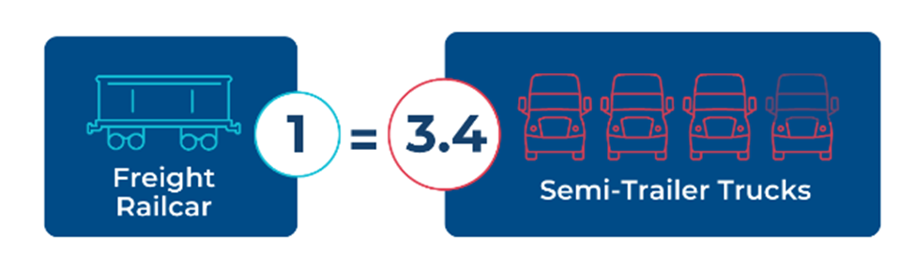
Value of Freight Rail Investment - Truck Diversion

Slide 22
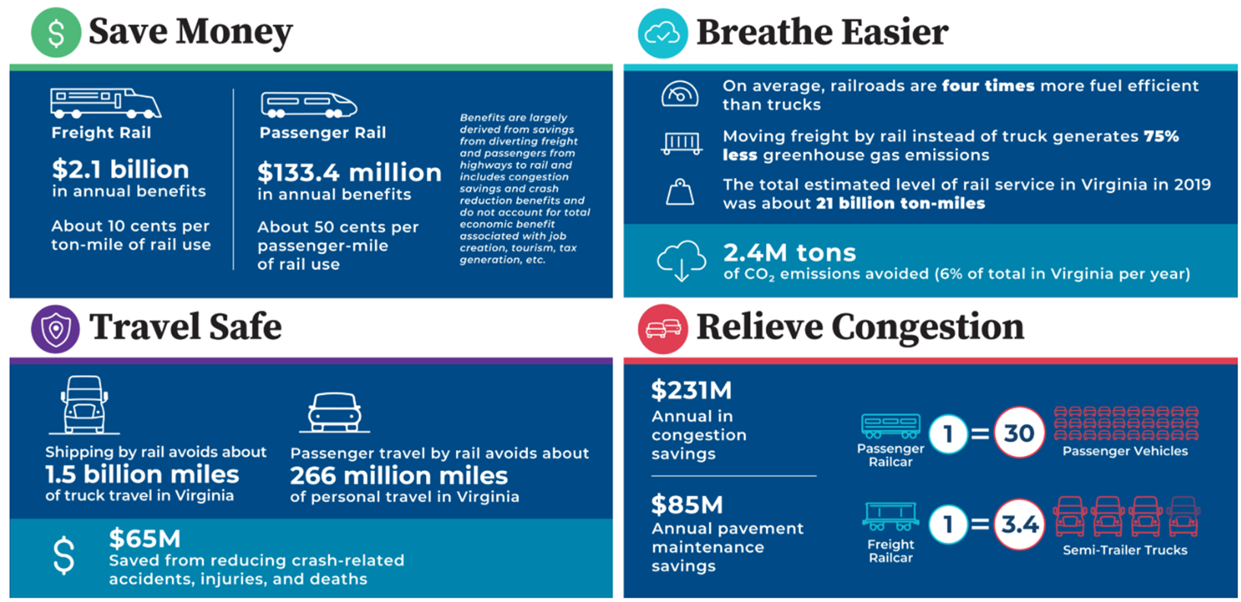
What is the Value of Mode Shift to Rail?

Slide 23
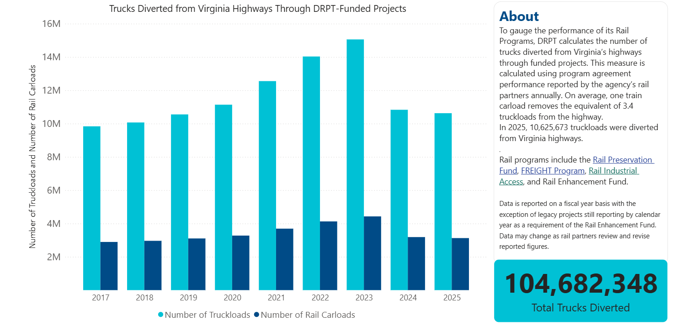
Freight Rail Performance Data Dashboard

Slide 24
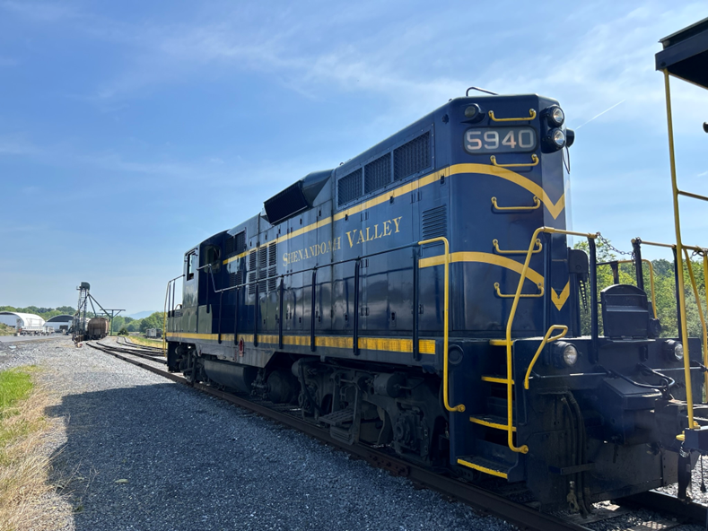
FREIGHT Program
Supports rail infrastructure investments to expand the Virginia freight rail network, bringing lasting benefits to Virginia's economy and transportation network.
Focus on investment in the freight rail network to meet statewide multimodal network goals
Use national best practices, lessons learned, and elements from current and prior rail programs
Each grant application must:
  Meet at least one statewide goal listed in the adopted State Rail Plan
  Focus on capacity improvements to the freight rail network (not operational or passenger-related costs)
  Include at least 30% design for construction projects

Slide 25
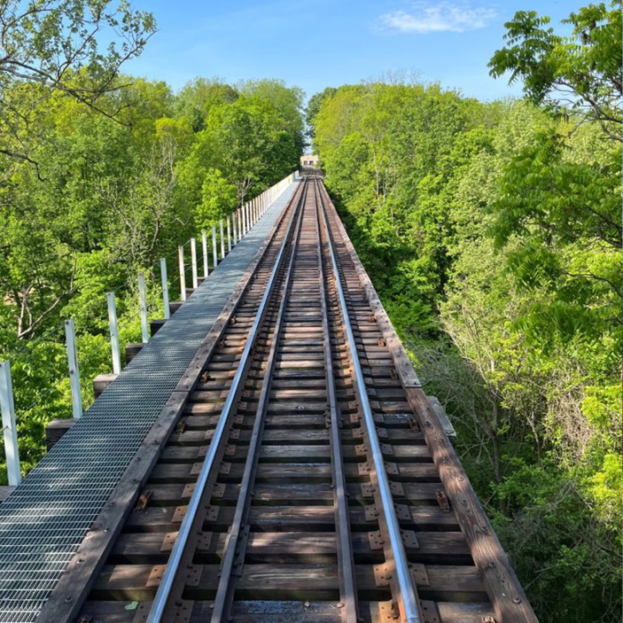
Rail Preservation Fund
The program’s purpose is to retain and improve the shortline railway network, maintain a state of good repair, and connect facilities for freight service
Shortline railroads provide vital last-mile and switching services for businesses. Additionally, they divert trucks from the road, saving on maintenance costs
Source of funding: $4M of Highway Construction from the Biennial Budget and up to 50% of DRPT’s share of the Commonwealth Rail Fund may be transferred to Rail Preservation annually.

Slide 26
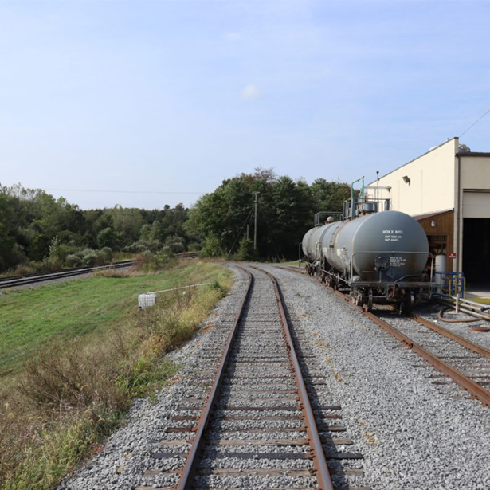
Rail Industrial Access Program
Rail Industrial Access connects businesses to the larger freight rail network by providing up to $750,000 to construct or improve industrial access rail spurs.
Incentivizes businesses to move goods by rail, invest in job growth, and expand its business.
Grant applications are scored on number of carloads per year, added employment, total private investment, among other factors.
From 2022-2025, 17 RIA projects have been awarded grants. These projects have added 3,215 jobs, diverted over 51,000 trucks from Virginia’s highways, and connected businesses to the rail network in every region of Virginia.

Slide 27
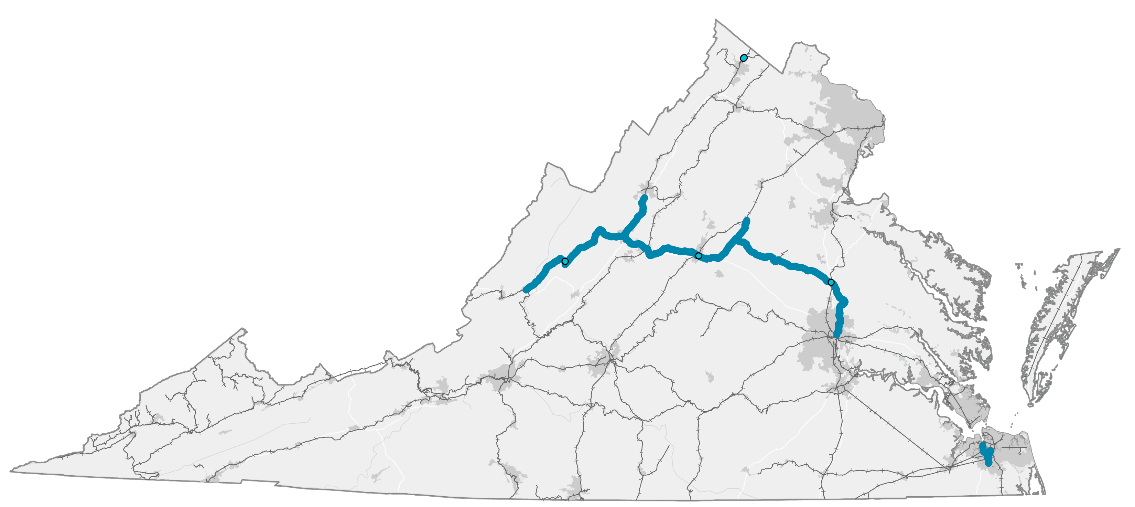
FY27 Recommended New Project Locations
Hub Scrap Metal
SVRR
BBR (4)
NPBL

Slide 28
Improving Network Fluidity and Preserving Critical Infrastructure
TOTAL NEW GRANT-FUNDED PROJECTS RECOMMENDED - $18M OVER MULTIPLE FISCAL YEARS
Hub Scrap Metal
(Staunton District)
  FREIGHT: $4.4M
  Scope: Expand on-site rail yard in Frederick County
  Benefit: 23K+ trucks diverted from highway annually
Shenandoah Valley Railroad (SVRR) (Staunton District)
  Rail Preservation: $4.7M
  Private Match: $2M
  Scope: Six-year programmatic track and roadbed upgrades in Augusta and Rockingham Counties
  Benefit: Class II Track Standard Preserved
Norfolk Portsmouth Beltline (NPBL) (Hampton Roads District)
  Rail Preservation: $1.05M
  Private Match: $0.45M
  Scope: Programmatic bridge, rail, and tie upgrades in Norfolk and Portsmouth
  Benefit: Preserve critical infrastructure
Buckingham Branch Railroad (BBRR)
(Multi-District)
  Three Crossover Projects
    FREIGHT: $0.9M total, $298K per project
    Private Match: $383K total, $0.13M per project
    Scope: Install new crossovers in Goshen, Charlottesville & Doswell
    Benefit: Improve overall network fluidity
  Richmond & Alleghany Bridge Improvements and Upgrades
    Rail Preservation: $7M
    Private Match: $3M
    Scope: Multi-bridge upgrade project to maintain 286k weight capacity between Richmond and Alleghany County
    Benefit: Preserve critical infrastructure

Slide 29
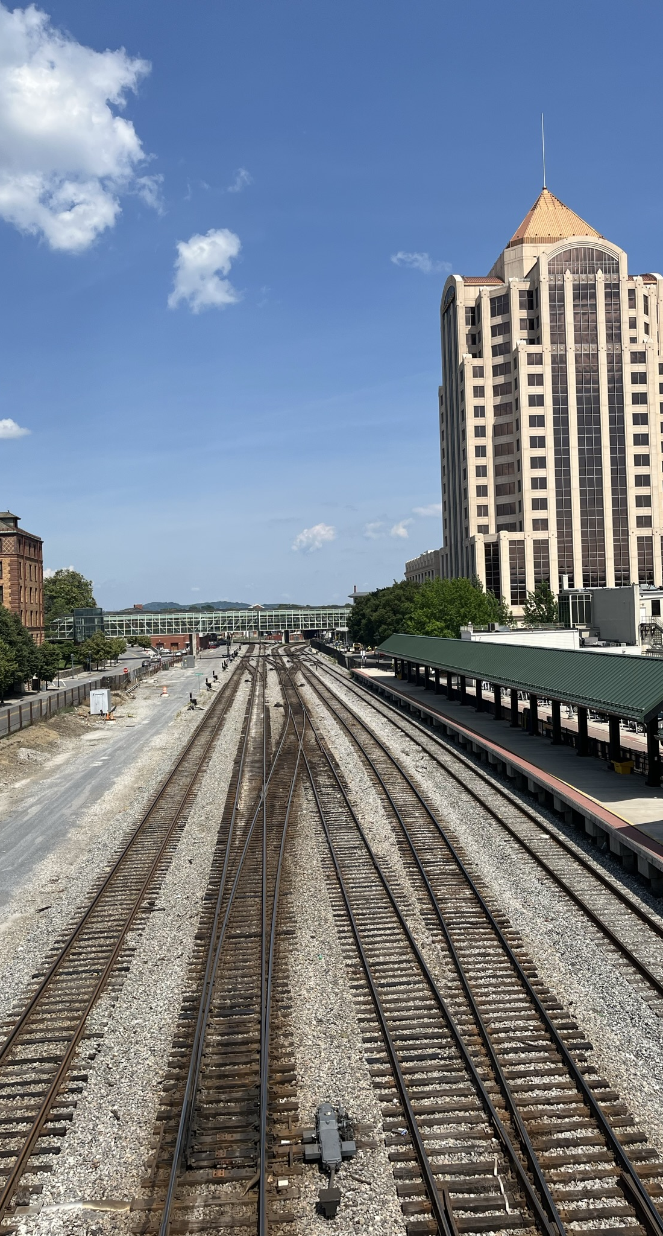
Corridor Identification and Development Program
Getting the train moving with Corridor ID
This new FRA program lays out a three-step process to develop a pipeline of projects for priority funding through other FRA grants.
Corridor ID creates a foundational framework for identifying and developing new or improved intercity passenger rail services.
In December 2023, four corridors in Virginia were selected to advance into the Corridor ID Program.

Slide 30
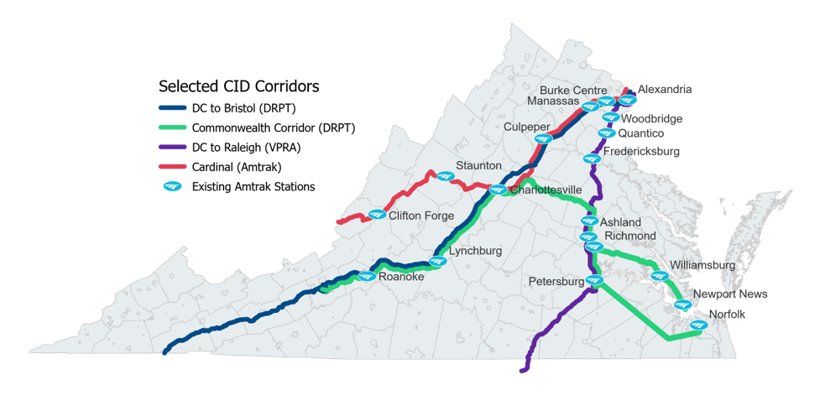
Improving Passenger Rail in Virginia & Beyond
Corridor ID in Virginia
Commonwealth Corridor
  Evolution of a 2021 Study
  New East-West connection
Washington D.C. to Bristol
  Extension of Roanoke (and soon New River Valley) service
DC to Charlotte
  Led by North Carolina DOT and VPRA
Cardinal Daily
  Led by Amtrak
  Increased Frequency

Slide 31
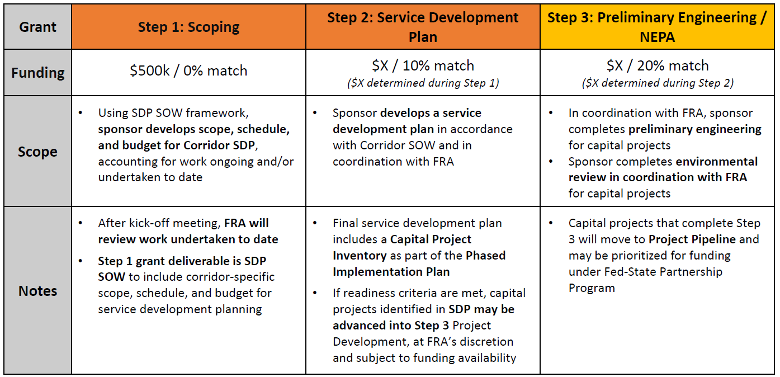
Corridor ID Steps

Slide 32
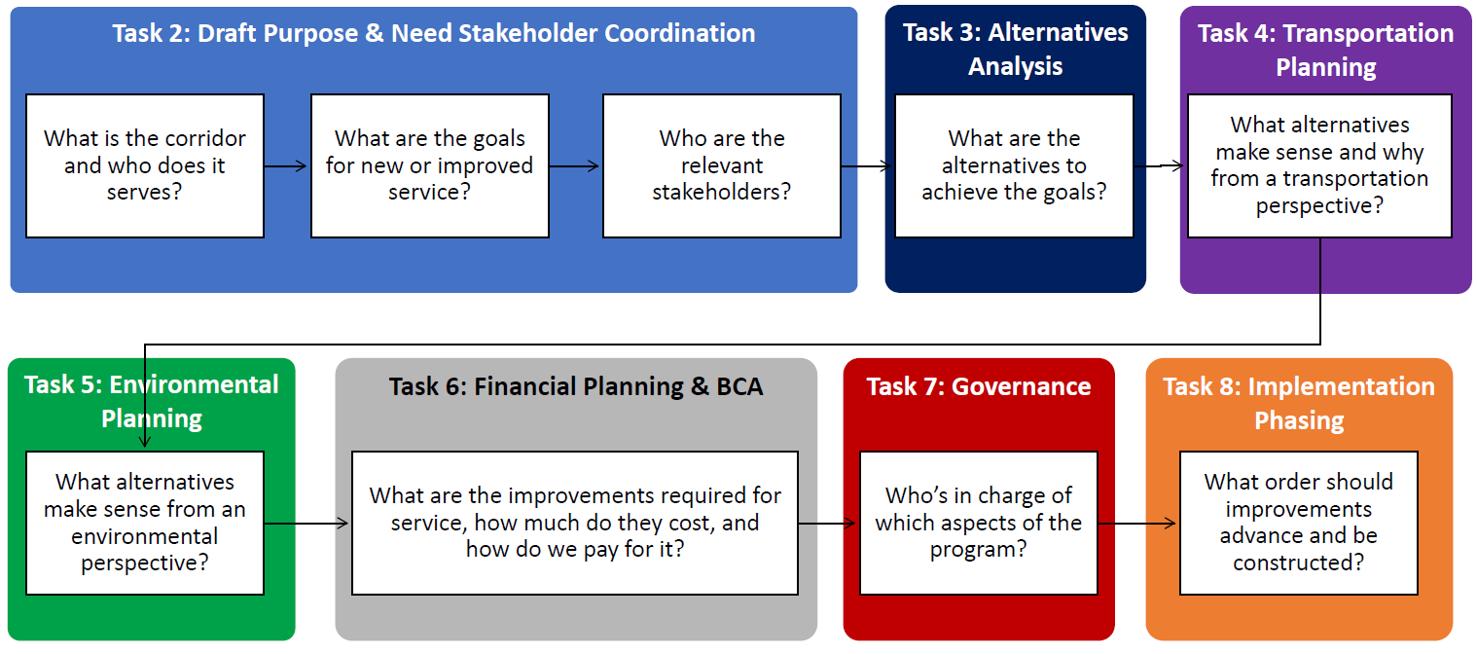
Step 2: Service Development Plan (SDP)
The next step of Virginia's Corridor ID planning

Slide 33
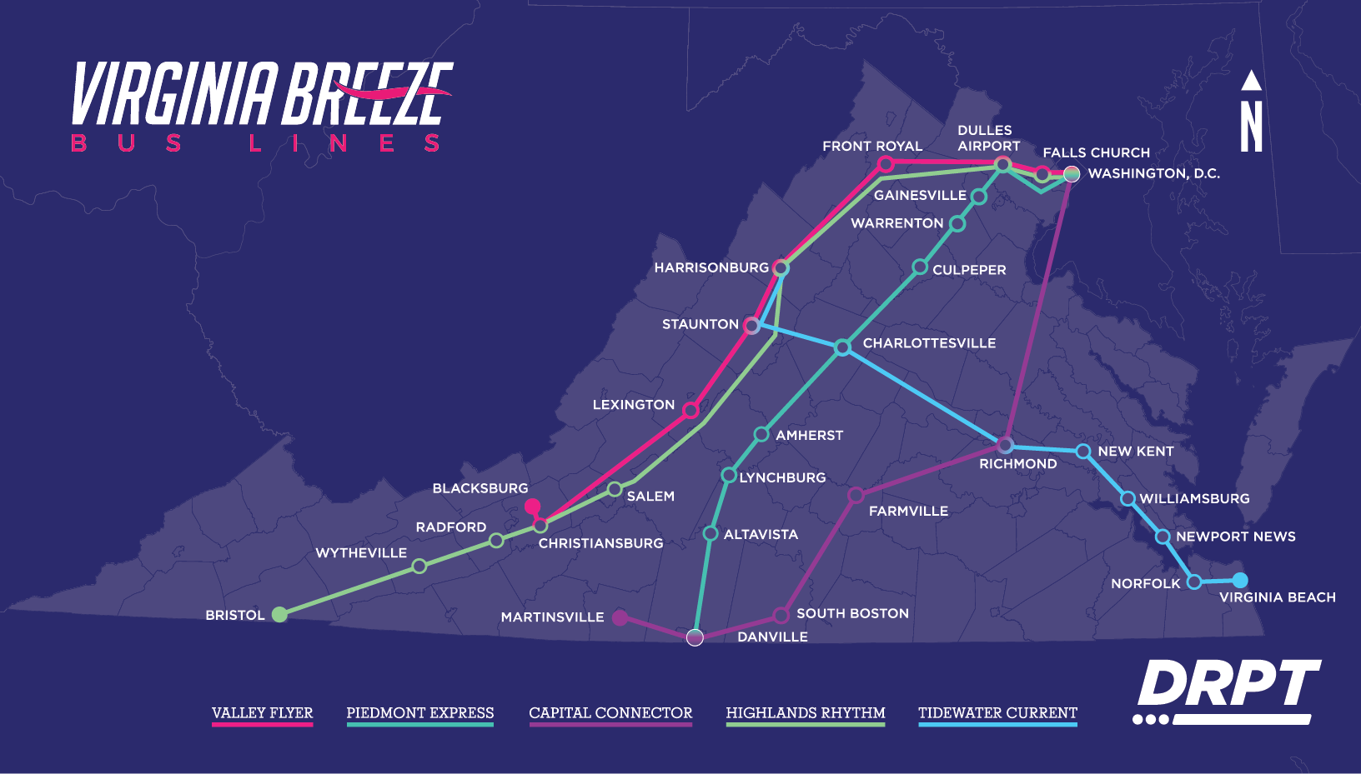
68,000 trips taken statewide in 2025
New Tidewater Current route opened April 20, 2026 (1st East-West service)

Slide 34
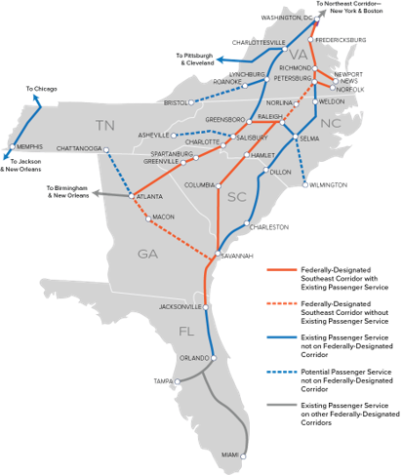

Southeast Rail Network Analysis Grant
Awarded by FRA to conduct a Southeast Rail Network Analysis that will evaluate the Southeast rail network constraints and identify opportunities to improve the fluidity of the network to benefit passenger and freight rail.​
Awarded for administrative and operational expenses related to VA-NC Compact and other technical coordination among states, Amtrak, FRA, and railroads to advance rail connections throughout the Southeast, including the Southeast Corridor Commission (SEC), which extends to TN, SC, GA and FL.

Slide 35

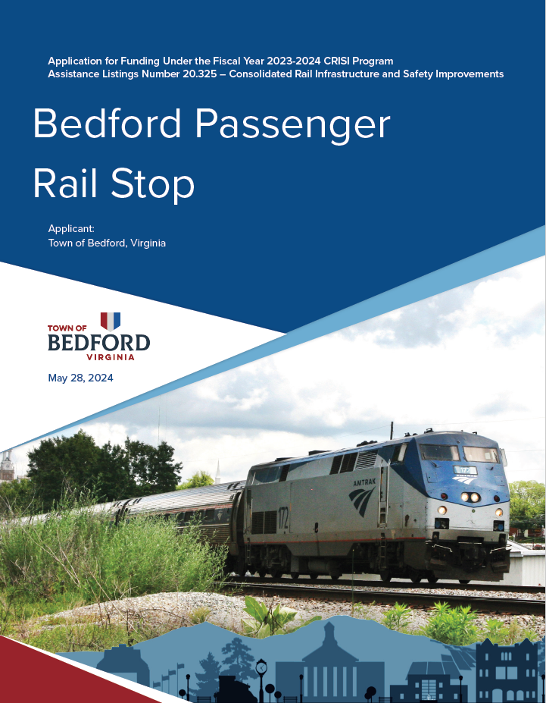
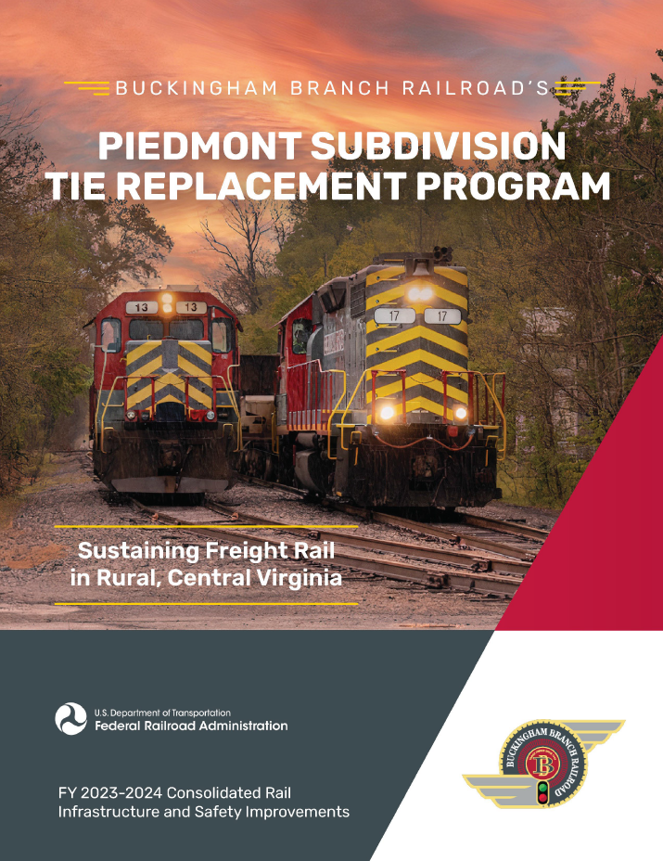
Consolidated Rail Infrastructure and Safety Improvements Program (CRISI)

Slide 36
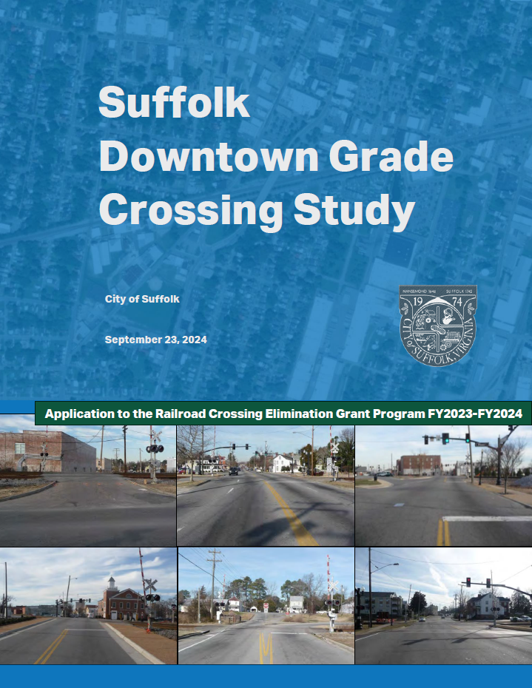
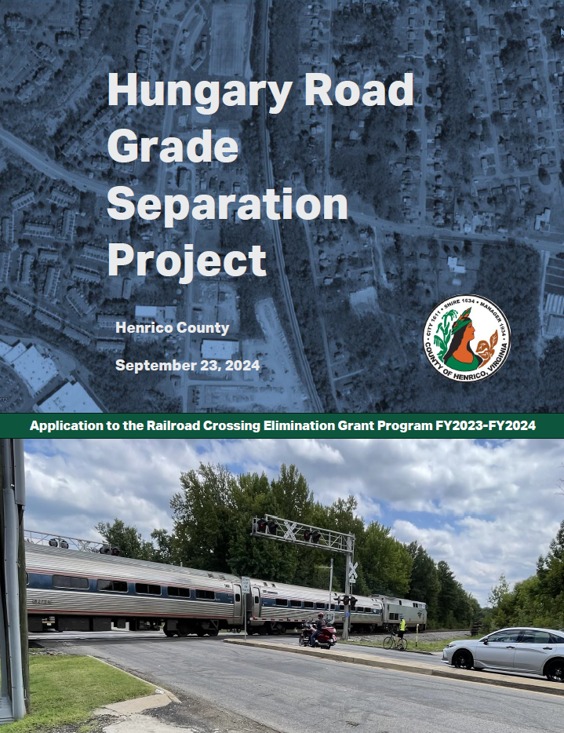
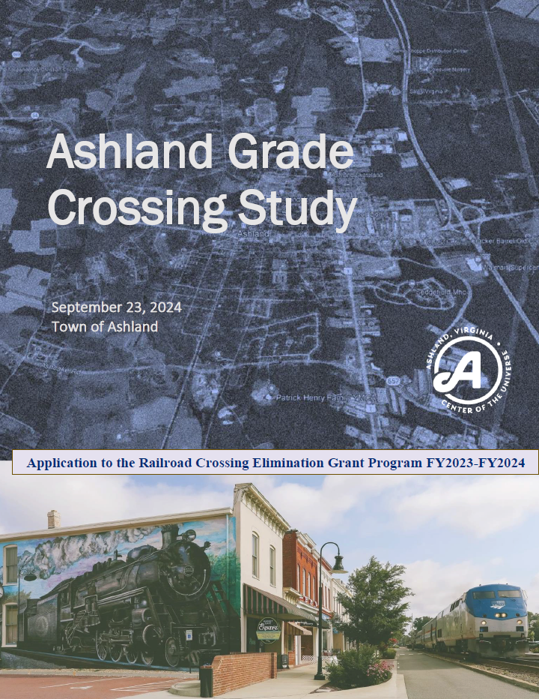
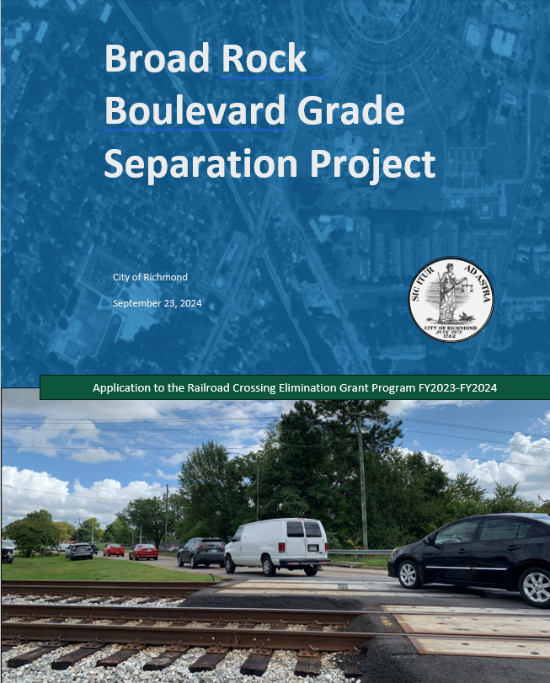
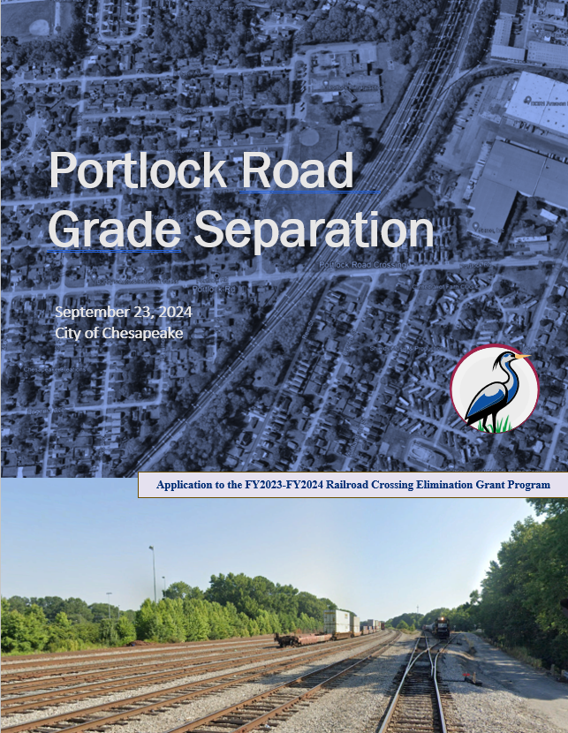
DRPT Rail Crossing Initiative

Slide 37
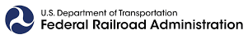
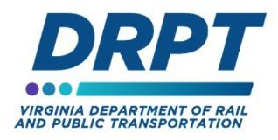
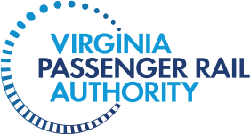
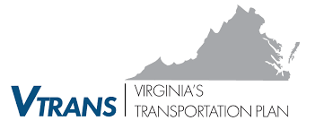
Virginia Statewide Rail Plan
Meeting goals, identifying needs, preparing for what's next
Data driven and aligns with goals/objectives of VTrans.
Includes 6-year and 20-year horizons.
Data points/metrics can be compared plan to plan and state to state.
Supports applications for federal rail funding for passenger and freight projects.
Requires close coordination with the Virginia Passenger Rail Authority (VPRA).
Records progress and charts path forward.

Slide 38
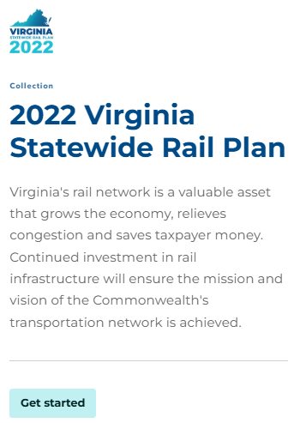
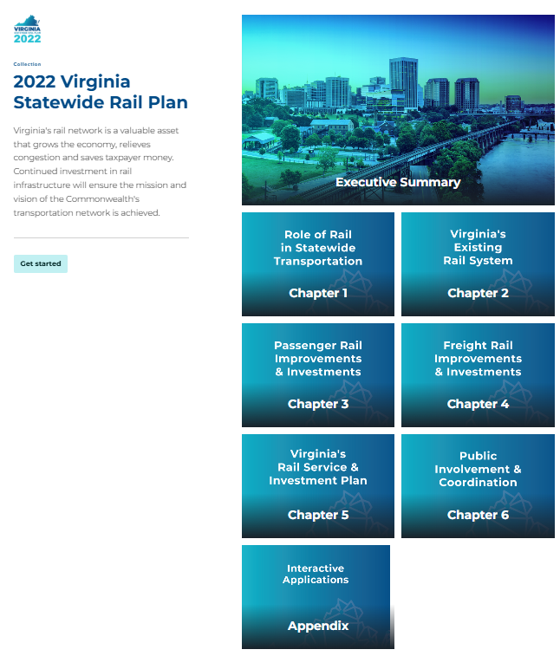
2022 Virginia Statewide Rail Plan Review
Innovating rail planning
First in the nation to be built entirely in ArcGIS Online StoryMaps.
  Multimedia applications.
  Interactive maps, dashboards, and visuals for required data.
Written during major changes to the Virginia rail landscape.
  Creation of VPRA in 2020.
  Transforming Rail in Virginia (TRV) agreements.
  Passage of the Infrastructure Investment and Jobs Act and creation of new FRA grant programs.

Slide 39
2026 Statewide Rail Plan Priorities and Process
Building off of progress thus far
Maintain consistency with FRA guidelines/format and build in 2022 digital success.
Highlight Virginia’s changing role in passenger rail, DRPT’s renewed focus on freight rail.
Evaluate progress, challenges, and funding impacts since the 2022 SRP.
Partnering with UVA’s Institute for Engagement and Negotiation for robust public and stakeholder engagement.
Look at changing landscape ahead
  IIJA Reauthorization and funding landscape
  Amtrak Fleet Renewal
  Artificial Intelligence and Other New Technology
  Infrastructure Resilience

Slide 40
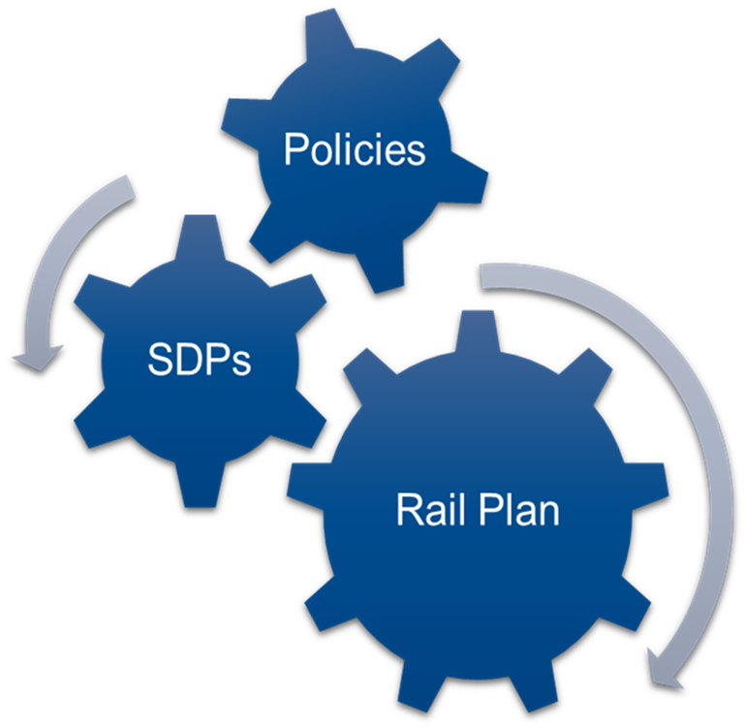
Statewide Rail Plan Integration
Coordinating planning and stakeholders
The Corridor ID Step 2 Service Development Plans (SDPs) will kick off during the Rail Plan, and continue after it is complete
Rail Plan stakeholder and public engagement will lead into Corridor ID SDP public engagement efforts
Addresses ongoing work related to
  Stations Policy
  Grant Program Changes
  Federal Grant Strategy
  SMART SCALE Updates

Slide 41
Rail Plan Data Sources and Analysis
INPUTS
Railroad Operators
VRE
VDOT
Transearch Data
MODELS AND TOOLS
DRPT GIS
IMPLAN Model
OUTPUTS
System Inventory & Infrastructure
Safety & Security Metrics
Virginia Statewide Transportation Model
Freight Demand & Commodity Flows
Passenger Ridership & Demand
Economic & Environmental Impacts
Inform Virginia’s Rail Investment Plan and Funding Needs
Amtrak
FRA
DRPT GIS

Slide 42
2026 Statewide Rail Plan Schedule
What comes next?
Jan - March
Kickoff
April - June
Public Meeting #1
July – Sept
CTB Presentations
Begin Data Collection
Surveys and Interviews
Stakeholder Workgroups
Data Analysis
Draft & Review Plan
Survey #2
Oct - Dec
Public Meeting #3
Finalize Plan
Public Meeting #2
Stakeholder Workgroups

Slide 43
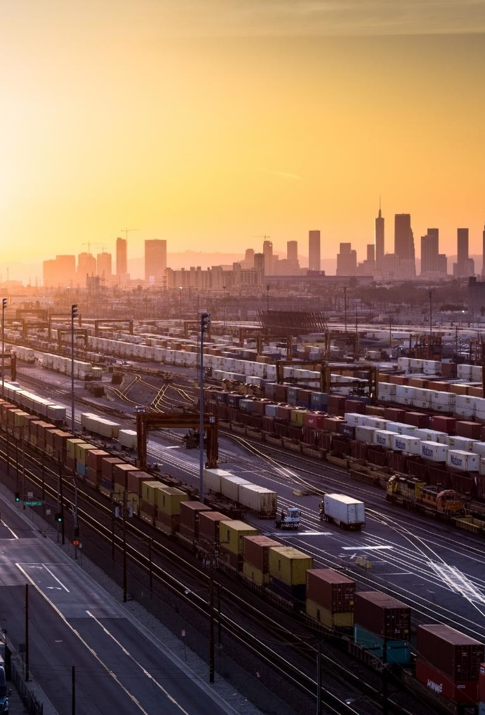

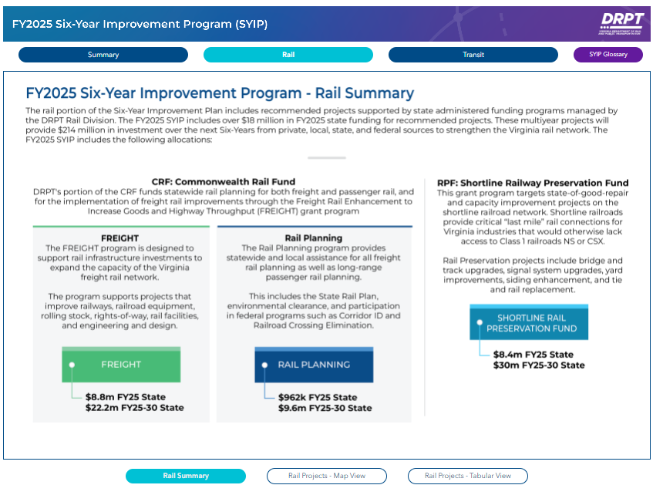
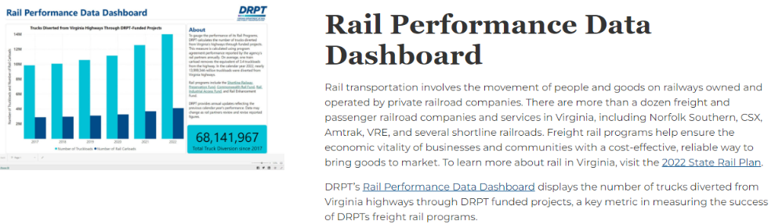
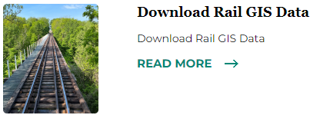
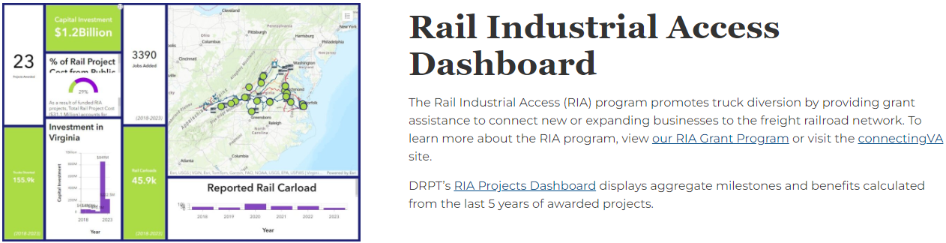
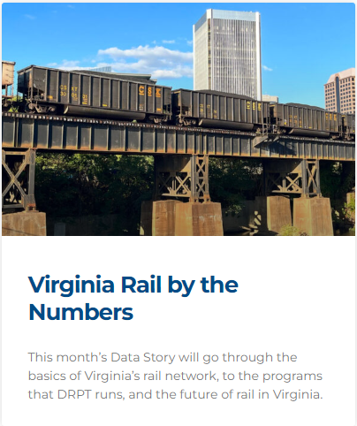



Open Data Portal

Slide 44

Virginia Statewide Rail Map

Slide 45



Follow Us
DRPT.Virginia.gov
Stay Connected on Social Media

Slide 46

THANK YOU!
Next Meeting:
November 2026
Baltimore, MD
Grab your PDH Forms!
If you have any questions about membership or are interested in presenting, please talk with one of the officers!

