Slide 1
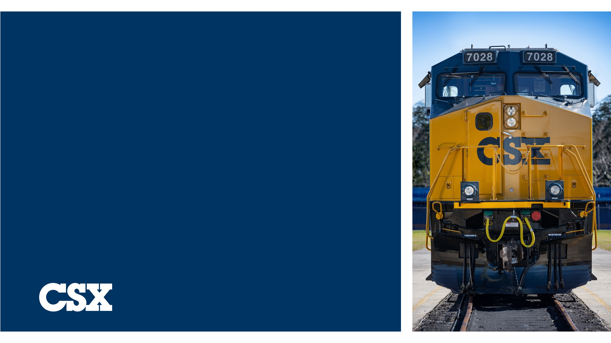
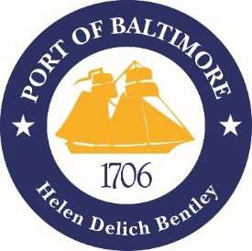
Howard Street Tunnel Clearance Program
Brandon Knapp, P.E.
Sr. Director – Mid-Atlantic Construction
2025

Slide 2
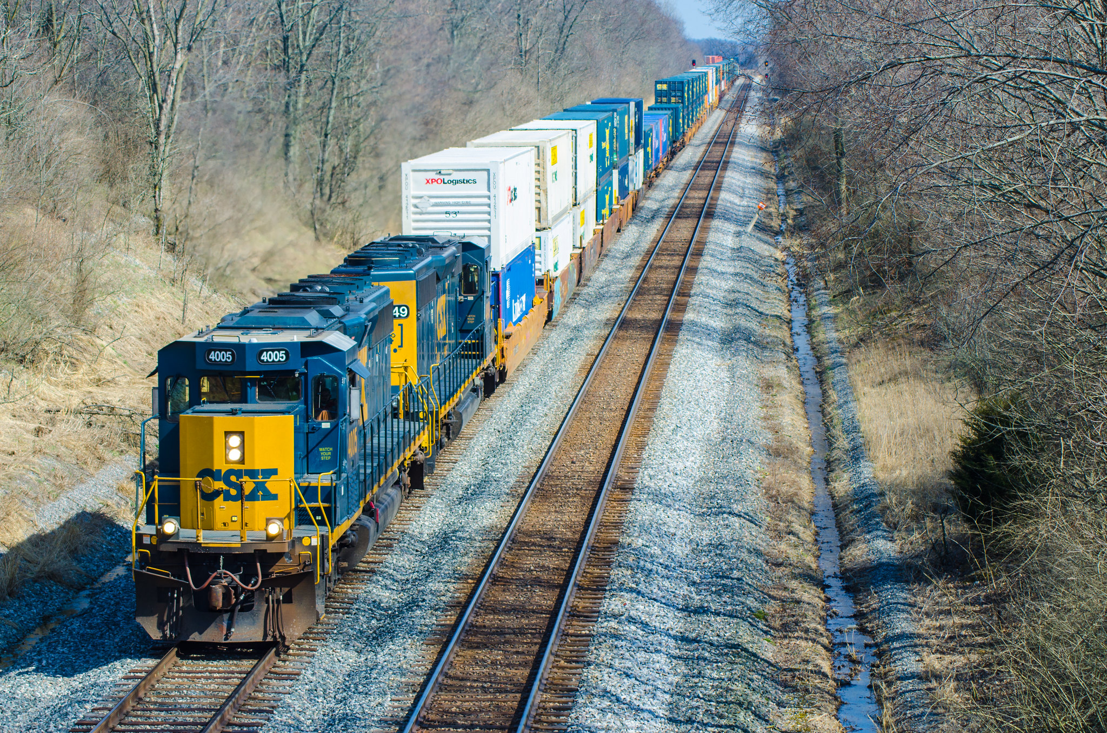
CSX Core Intermodal Network
Bedford Park
NWOH
NY/NJ
Philadelphia
Baltimore
East St Louis
Portsmouth
Memphis
Wilmington
Jacksonville
New Orleans

Slide 3
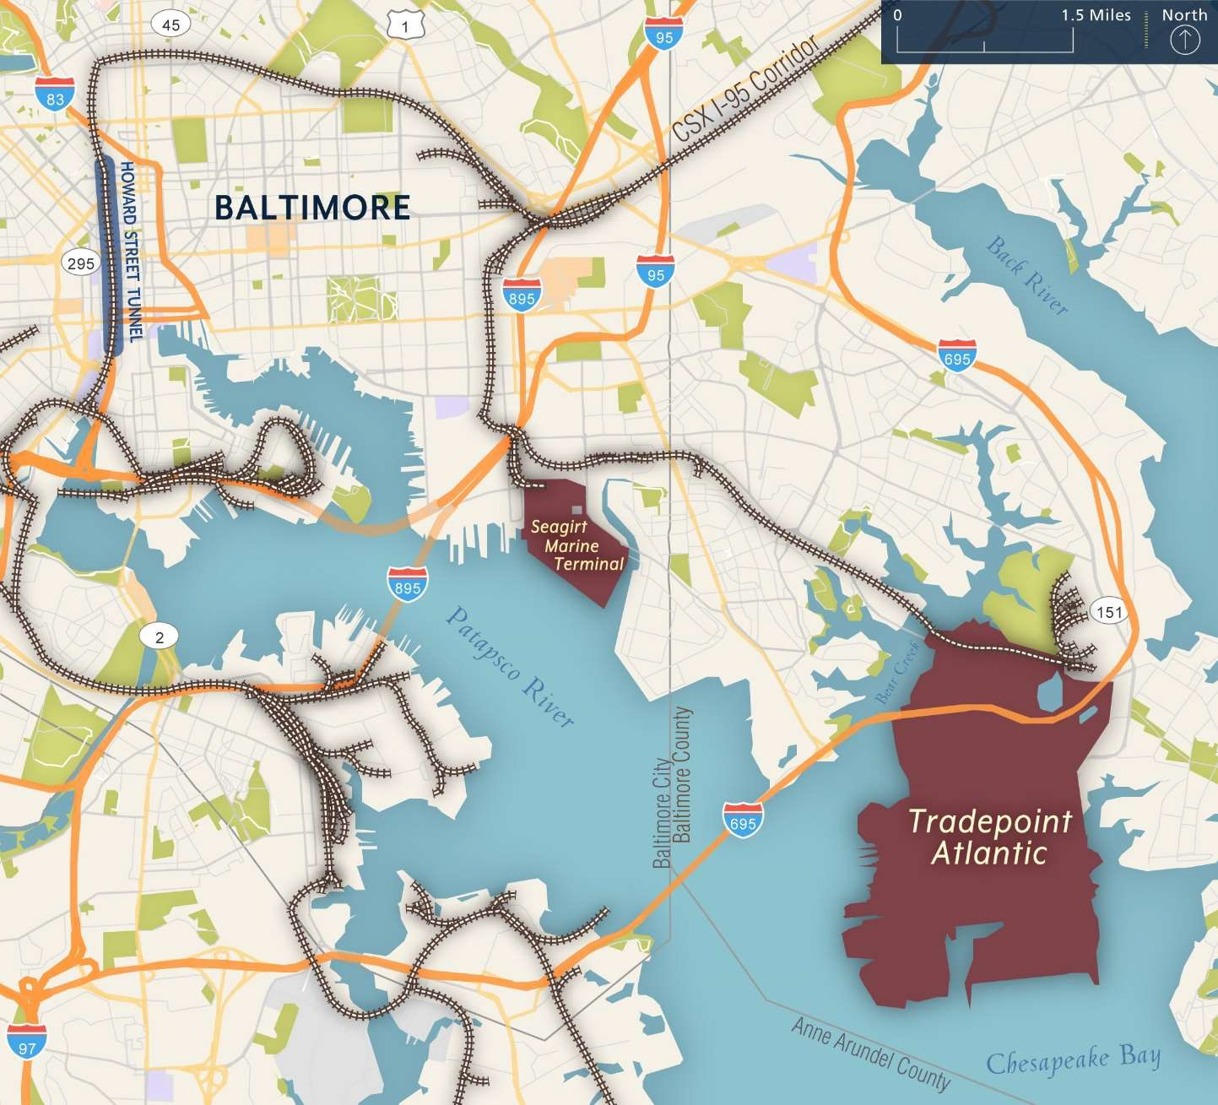
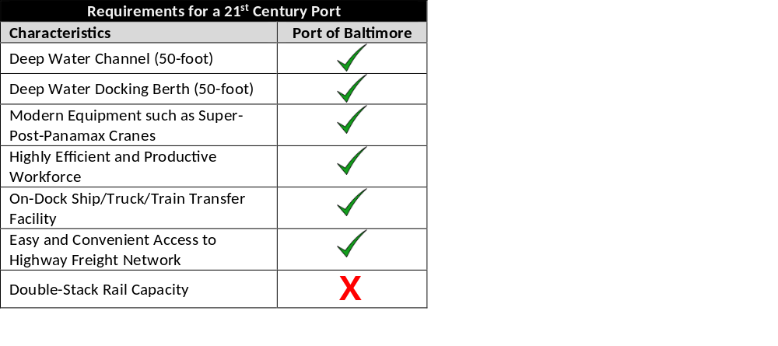
Port of Baltimore

Slide 4
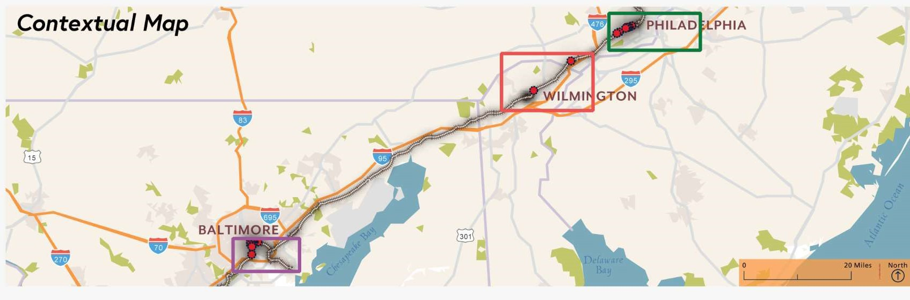
Howard Street Tunnel (HST) clearance Program
Program consists of vertical clearance improvements at 21 locations between Baltimore and Philadelphia.
Once complete, CSX double-stack trains will be able to travel to/from the Port of Baltimore
The project has been grouped into ten (10) packages for design and construction
Five (5) packages in Maryland, one (1) package in Delaware and four (4) packages in Pennsylvania

Slide 5
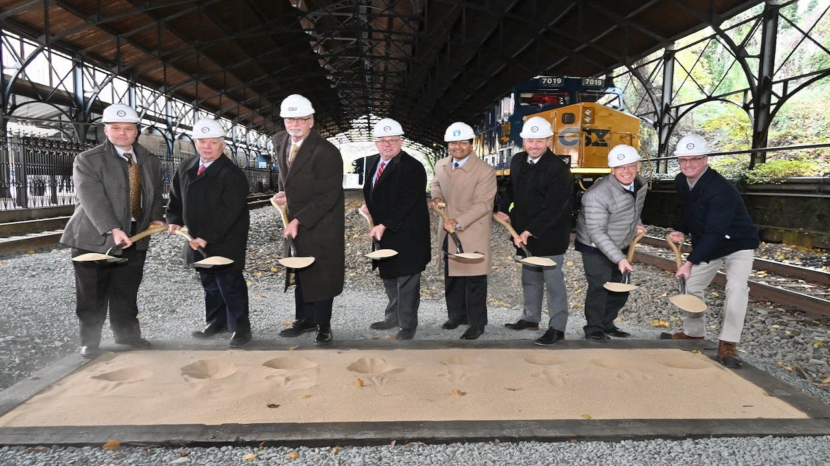
Howard street tunnel background and timeline
2016 - Partnered with the State of Maryland to develop Preliminary Engineering Plans
2019 - Awarded a Federal INFRA Grant
June 2021 - Received NEPA FONSI
November 2021 – Grant Award Agreement Executed
April 2022 - Started Construction
October 2024 – Cleared Philadelphia Sub
February 2025 – Closed HST to Train Traffic
End of 2025 – Will Clear HST & Reopen
2nd Q 2026 – Will Clear Baltimore Terminal Sub

Slide 6
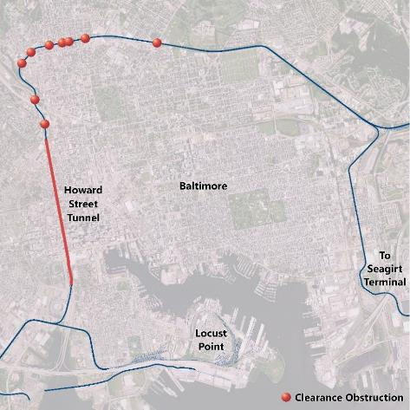
Baltimore Projects
Howard Street Tunnel
  Howard St., Mt. Royal Station, and MTA Bridge
Overhead highway bridge (OHB): North Avenue Bridge Modification
OHB: Guilford Avenue Bridge Reconstruction
OHB: Harford Road Bridge Reconstruction
Baltimore Track Lowerings
  Sisson St., Huntington Ave., Charles St., St. Paul/Calvert St., and Greenmount Ave.

Slide 7
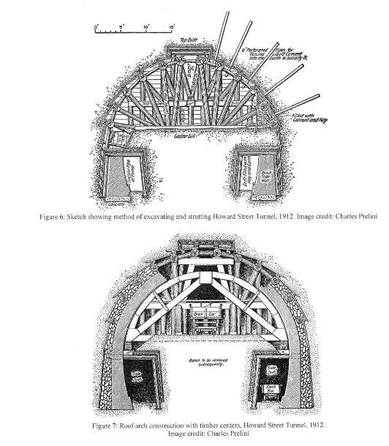
Howard Street Tunnel
Originally constructed between 1890 – 1895 – extended in the 1980’s
Three distinct tunnel sections
  Mined section
  Cut and cover section
  Concrete box section
Total length: 8,700’
Runs generally under Howard Street from Camden Station to Mt. Royal Station
Single Track tunnel – 19’6” Clearance
Cover varies from 40ft.+ to <5ft

Slide 8
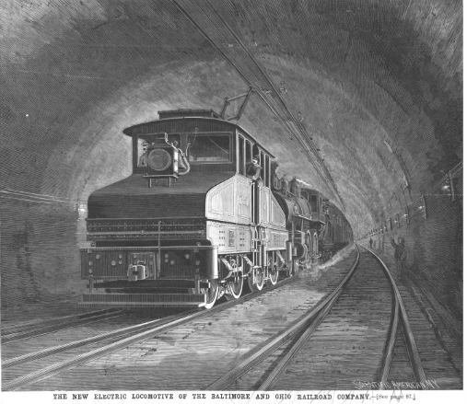
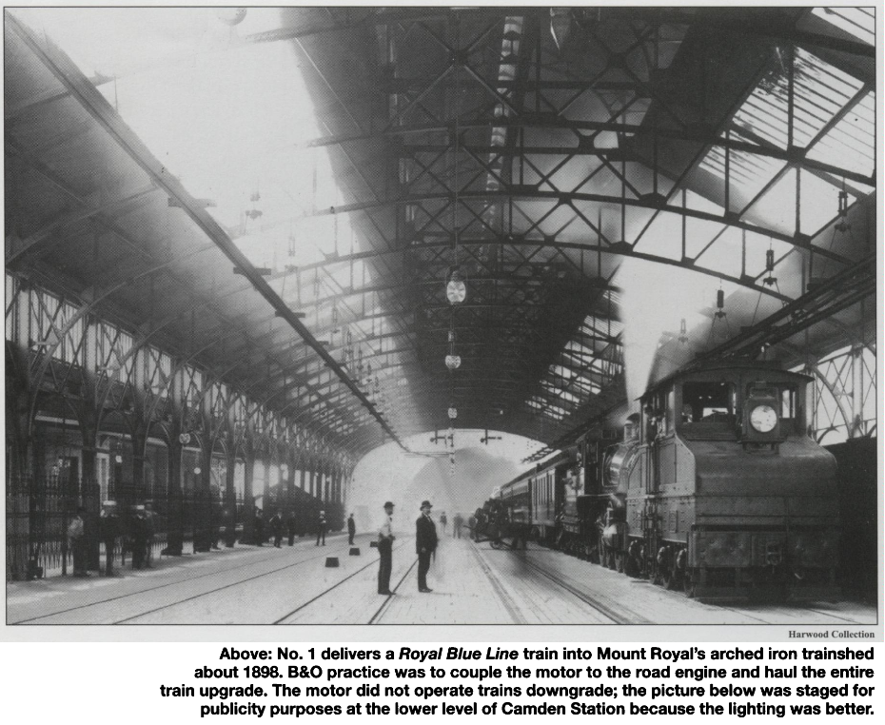
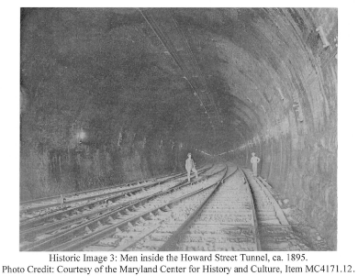
Historic Howard street tunnel

Slide 9
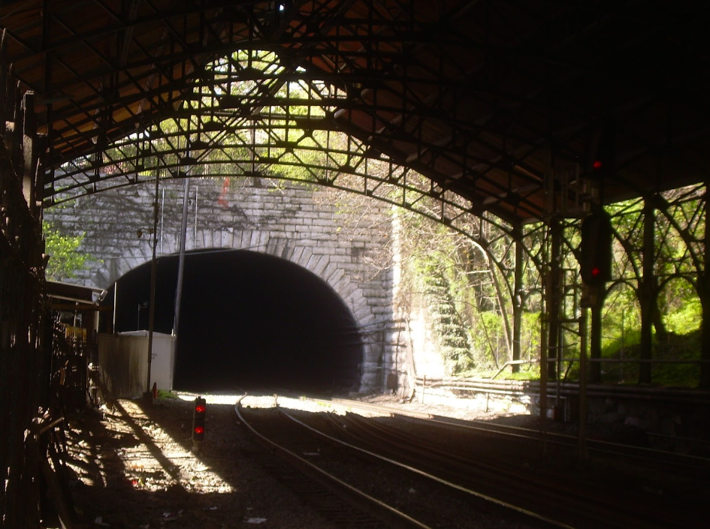
Howard street tunnel project progression
Progressive Design-Build
Skanska-Fay JV (SFJV)
Designer – Hatch with WRA
Phase 2 NTP – January 2024
Field Construction started March 2024
Changed to a Full Closure w/ Reroute option mid-2024
Tunnel turned over to SFJV on February 10, 2025
Working 7 days/week – 24 hrs/day

Slide 10
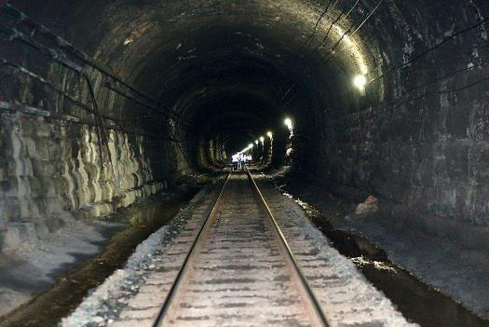
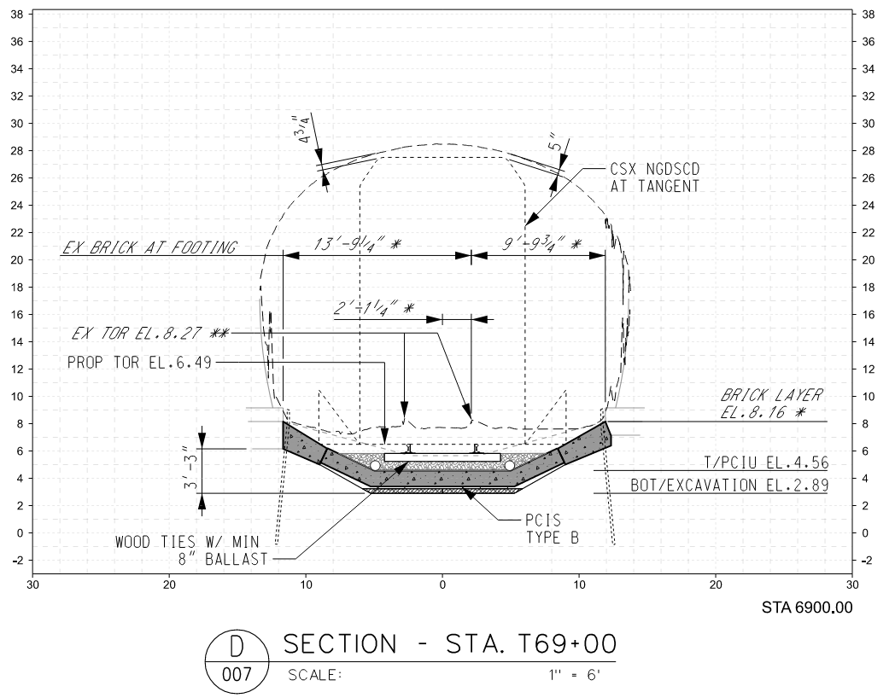
HST Clearance method – Replace Invert

Slide 11
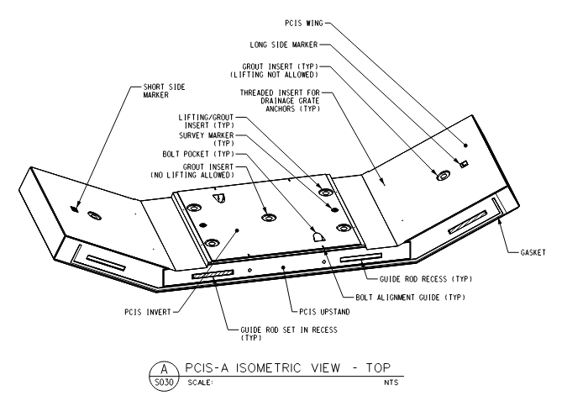
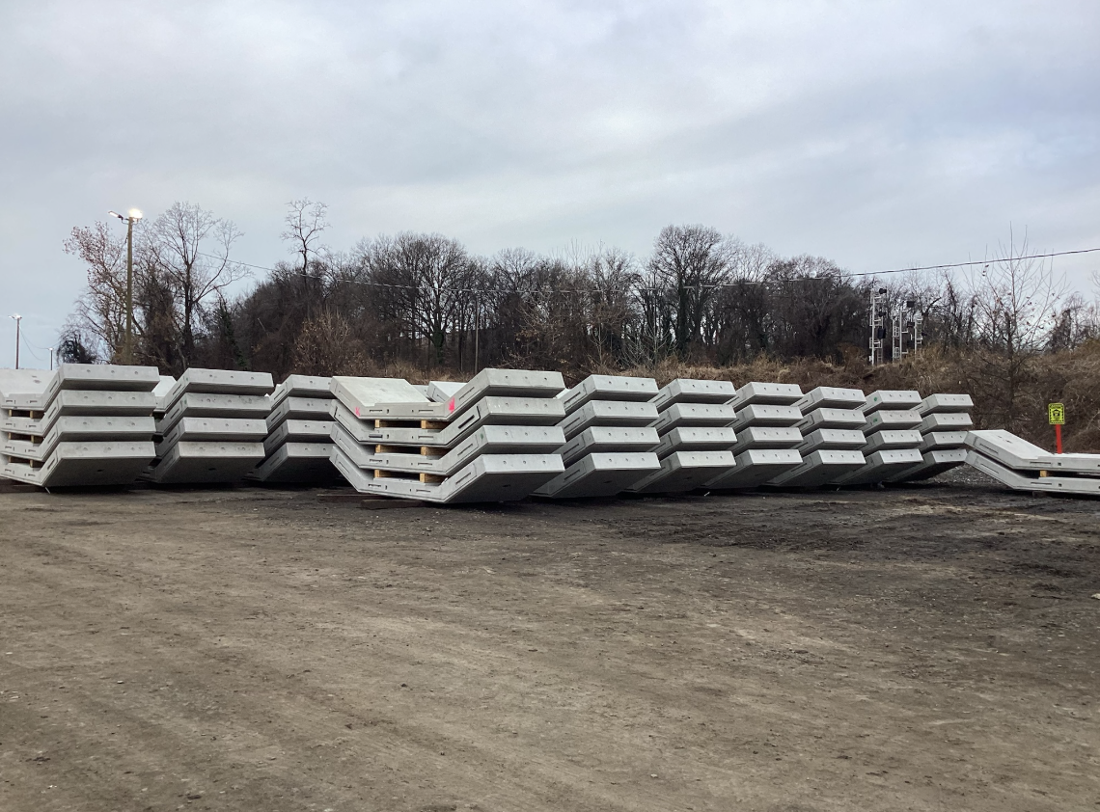
Precast invert slabs (PCIS)

Slide 12
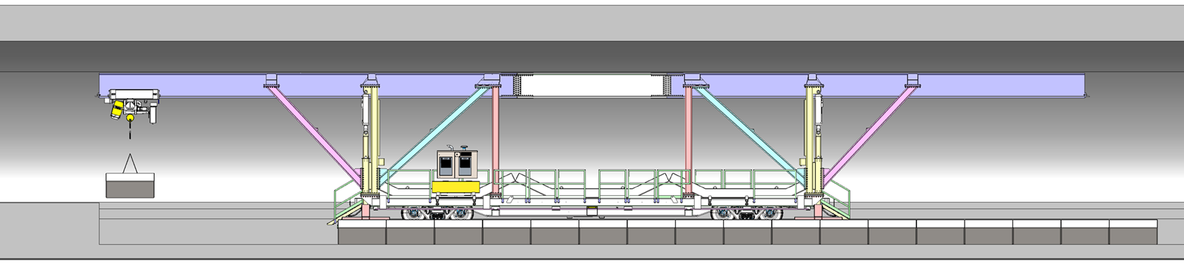
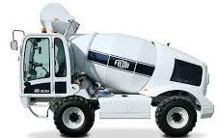
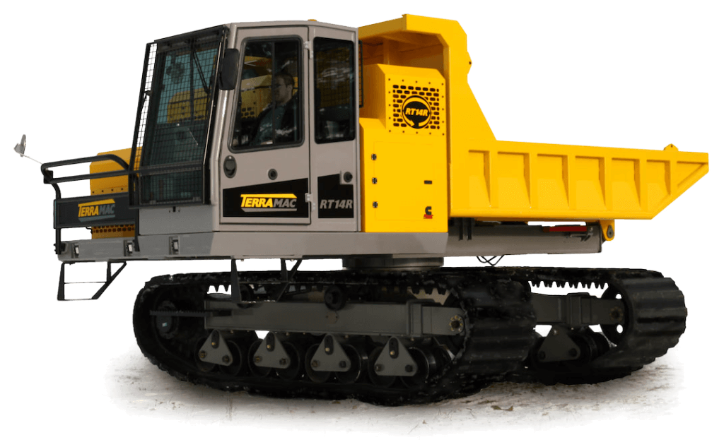

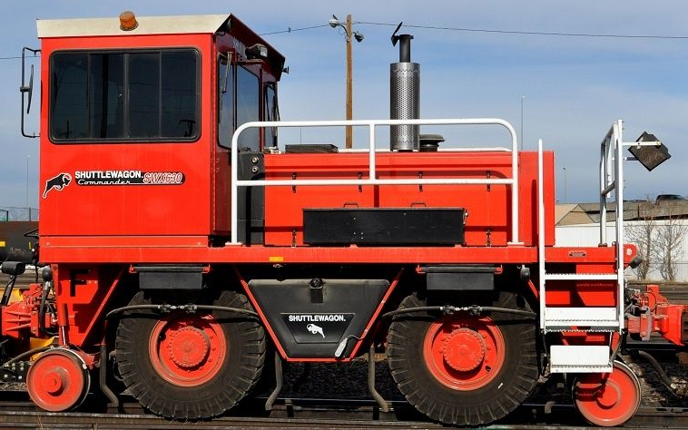
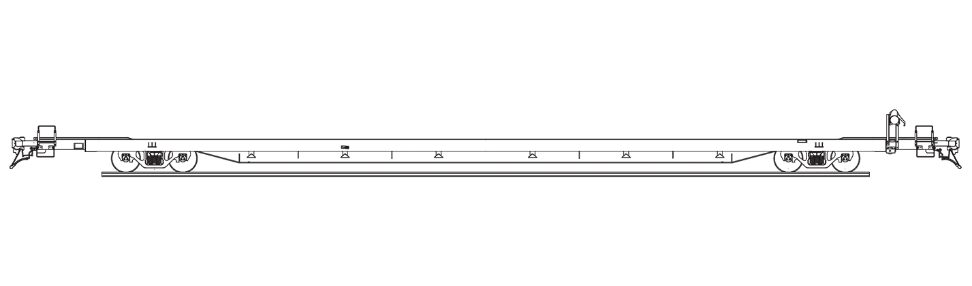
Logistics Plan
Segment gantry placed on temporary track directly on top on new invert
Shuttlewagon brings flat car with supplies to gantry and transloads materials
Excavated material loaded into crawler carriers on West side
Gantry sets PCIS Units
Concrete Closure Pour ties the PCIS Units into the Existing Tunnel Footing

Slide 13
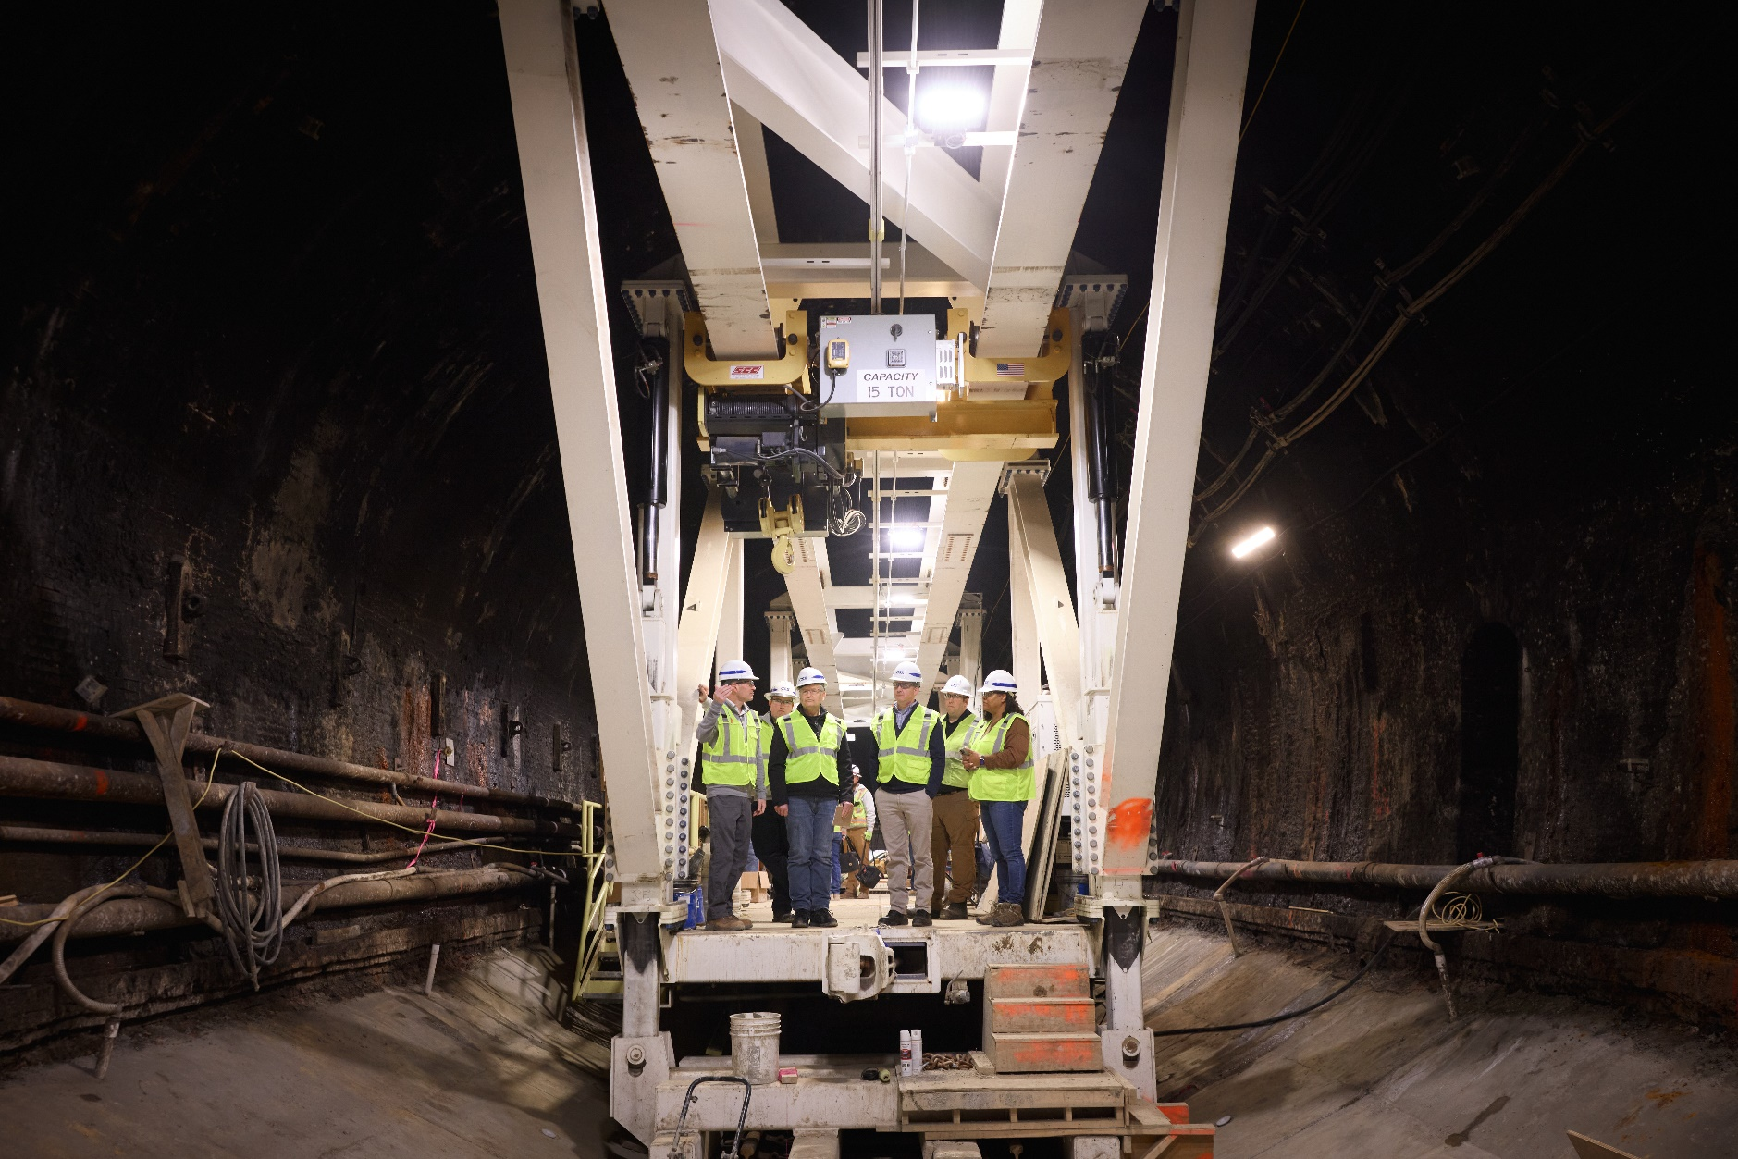
Howard ST. Tunnel - Gantry

Slide 14
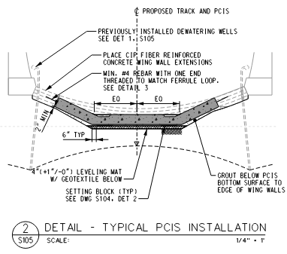
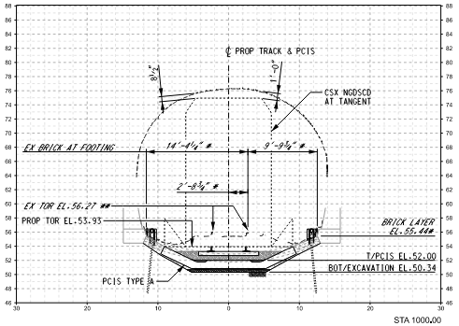
Typical Section at invert replacement with PCIS
Dewatering system is installed
Existing invert removed
Precast invert slab installed on leveling pads
Contact grout under segments
Form & pour invert “wing” extensions

Slide 15
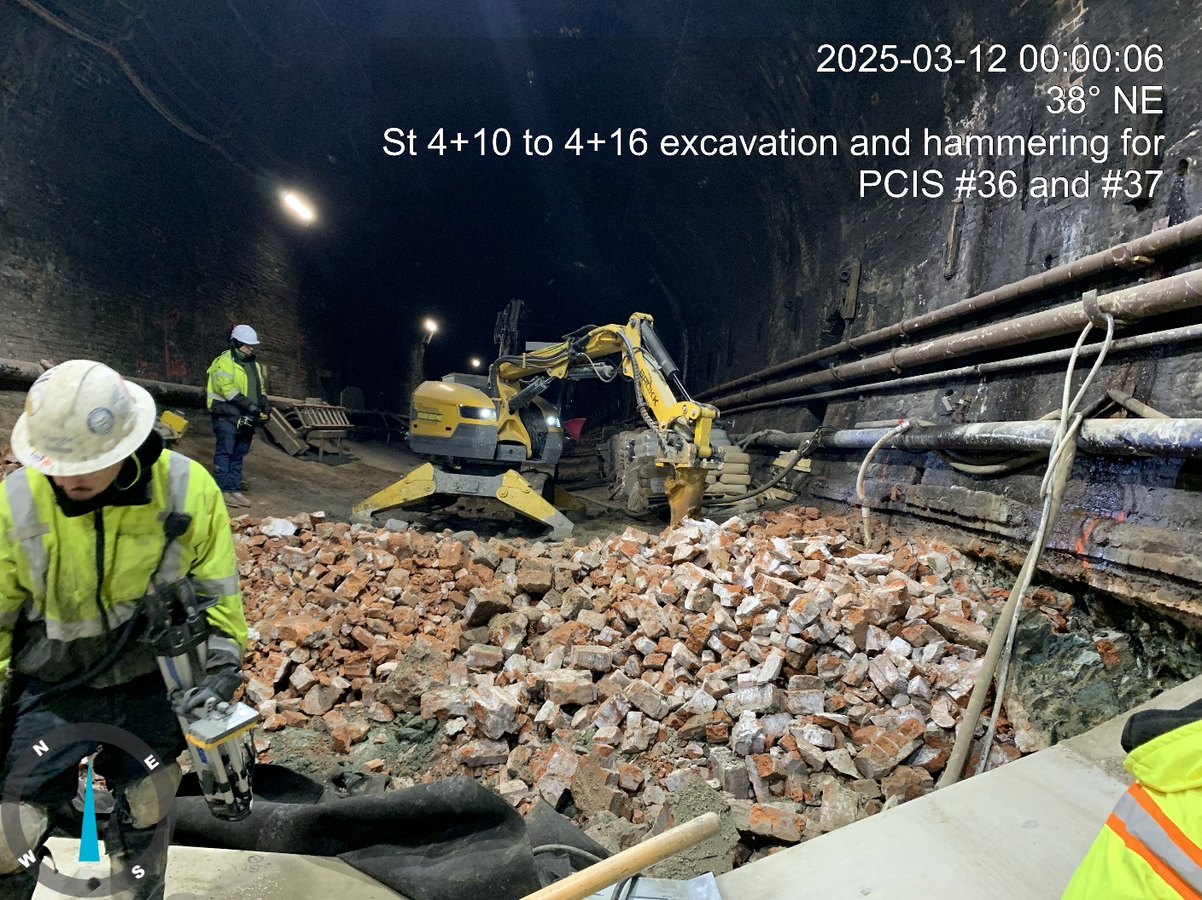
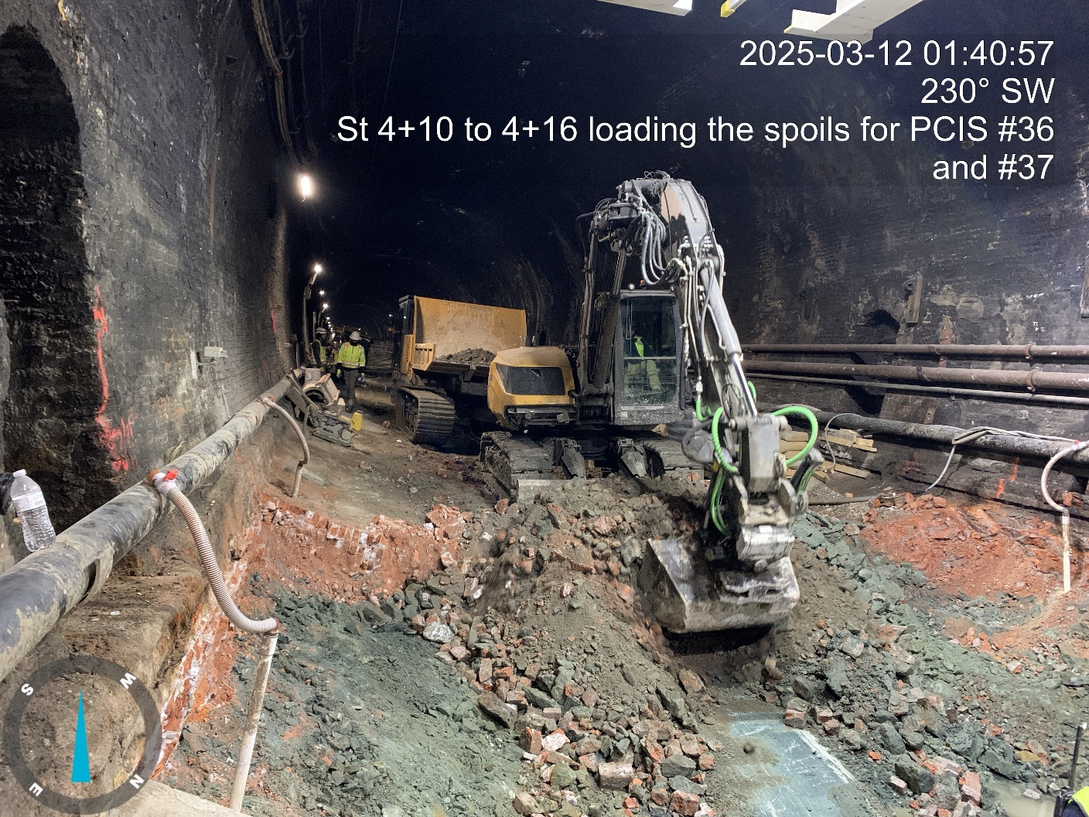
HST Pictures – PCIS Cycle

Slide 16
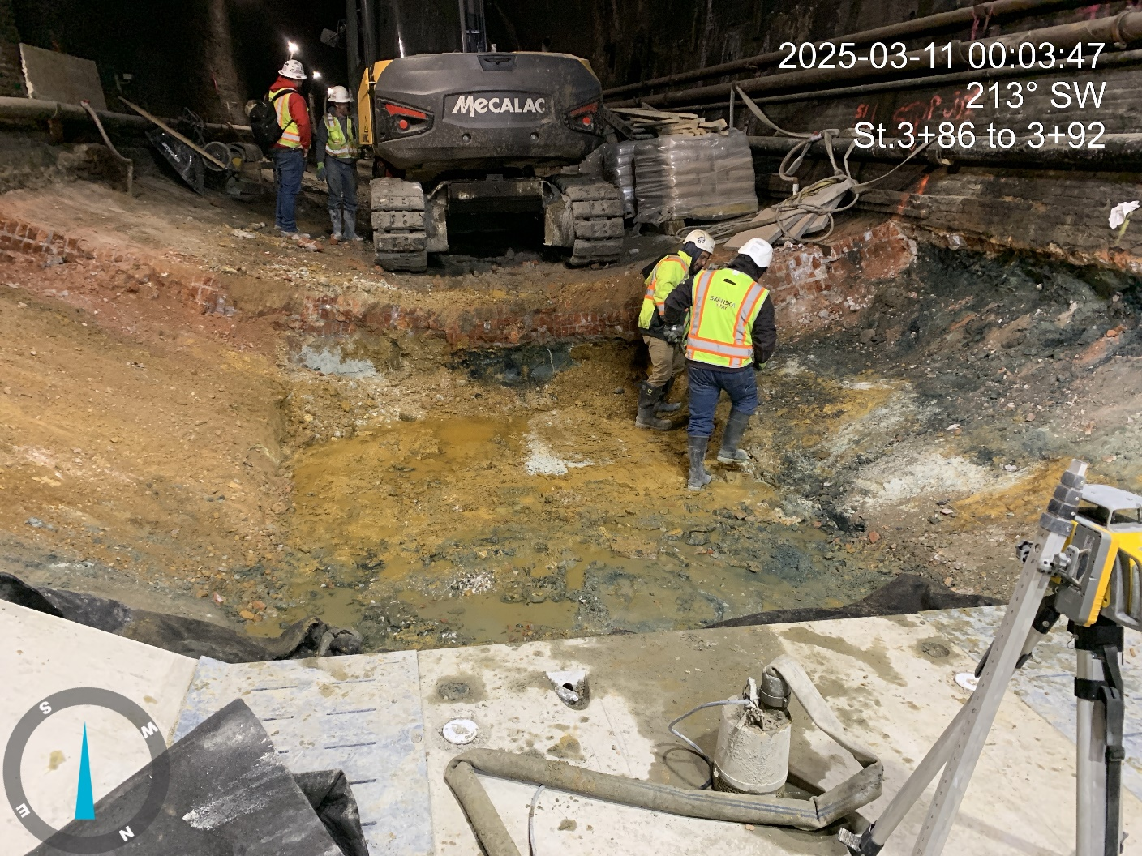
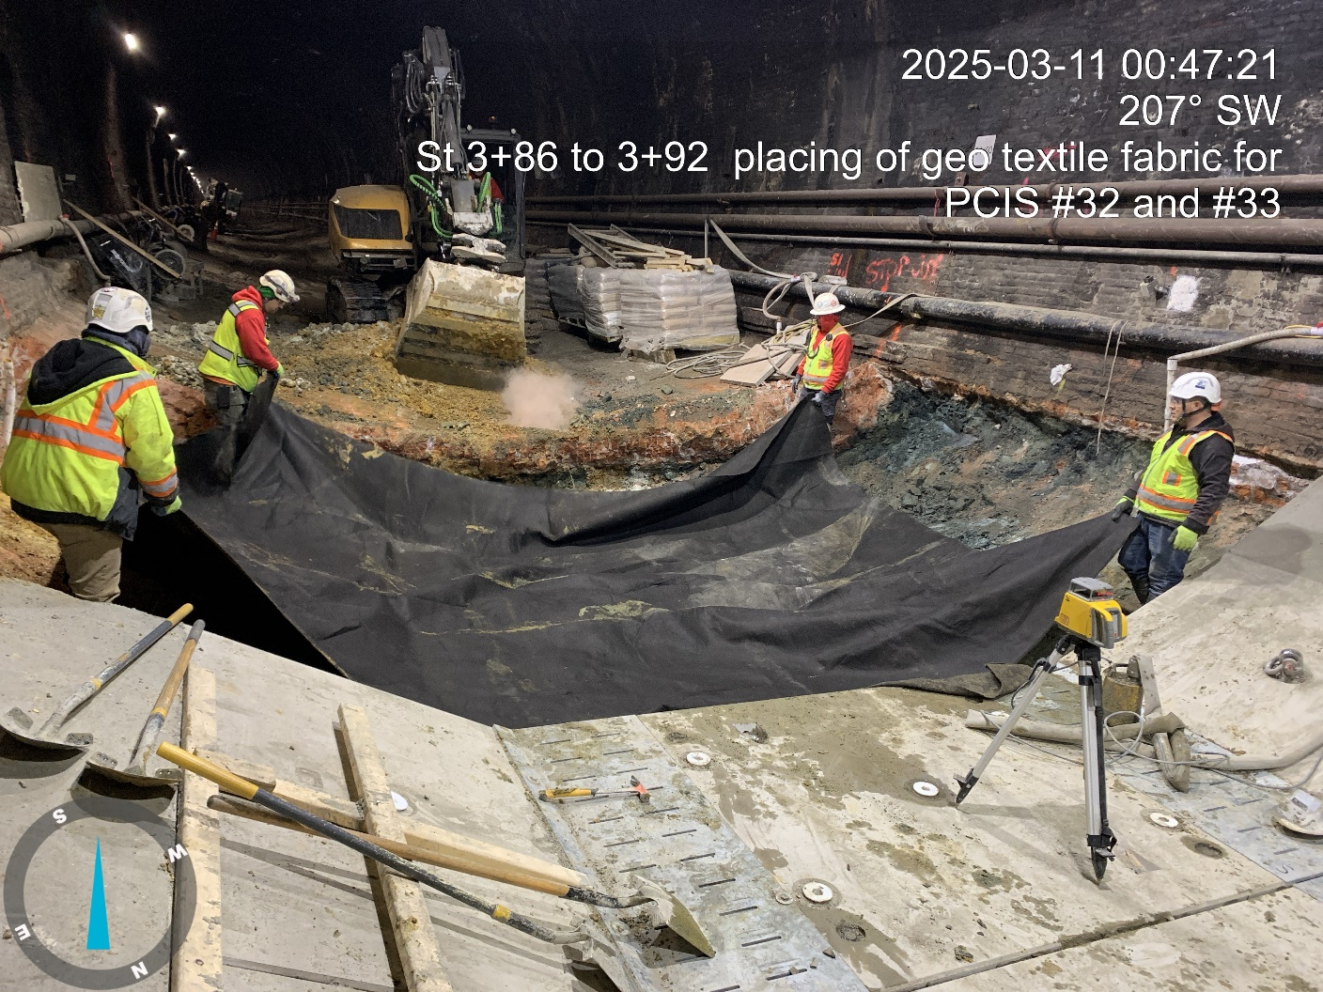
Hst pictures – PCIS Cycle

Slide 17
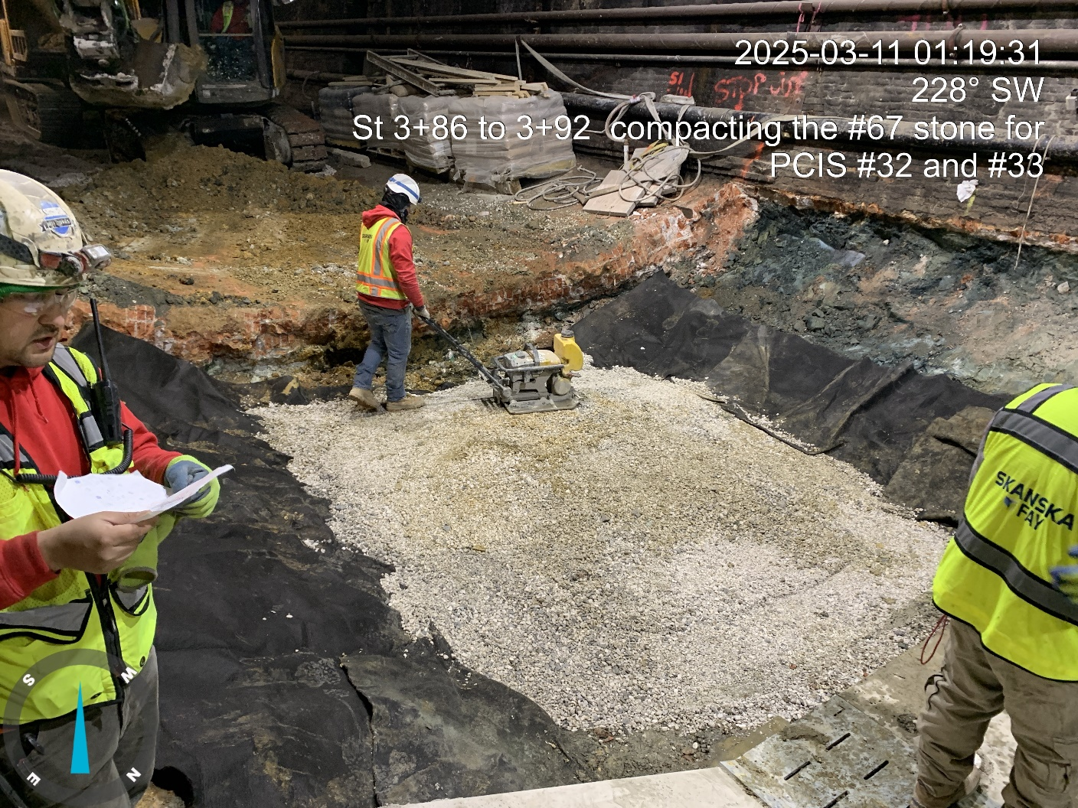
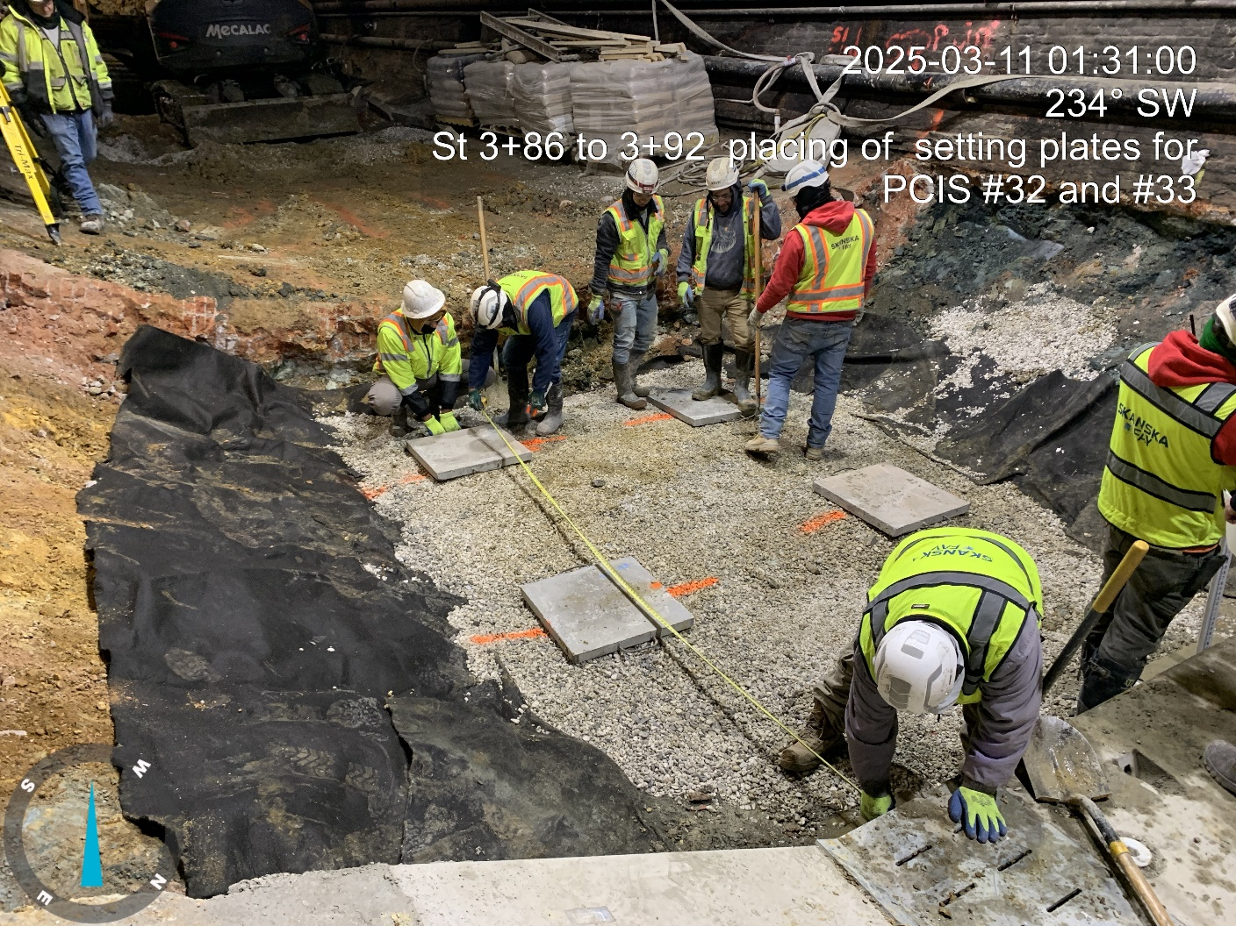
HST Pictures – PCIS Cycle

Slide 18
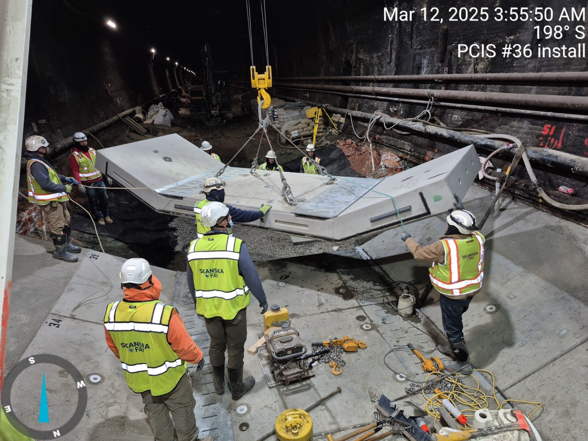
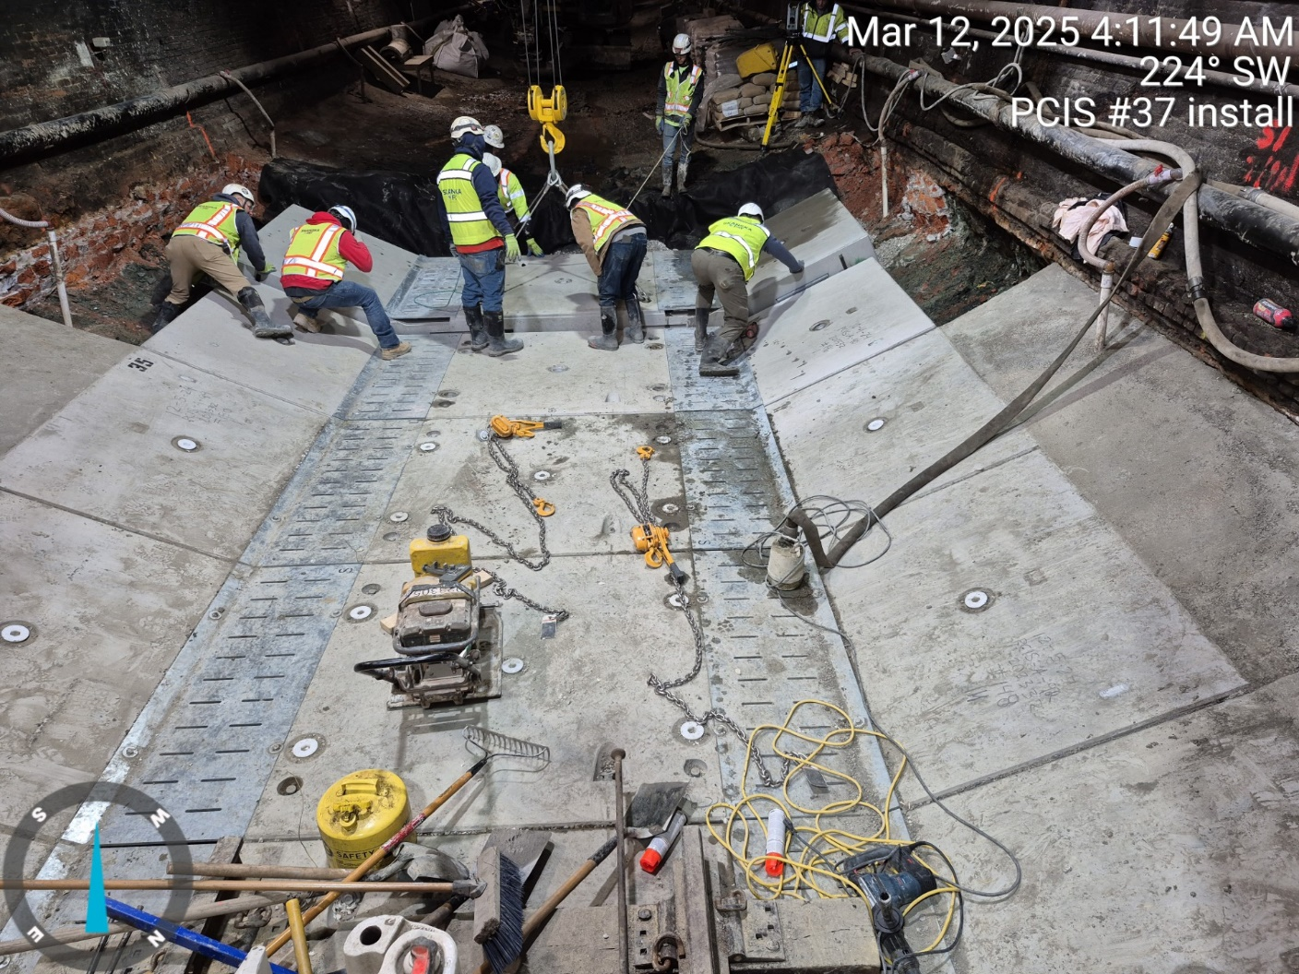
HST Pictures – PCIS Cycle

Slide 19
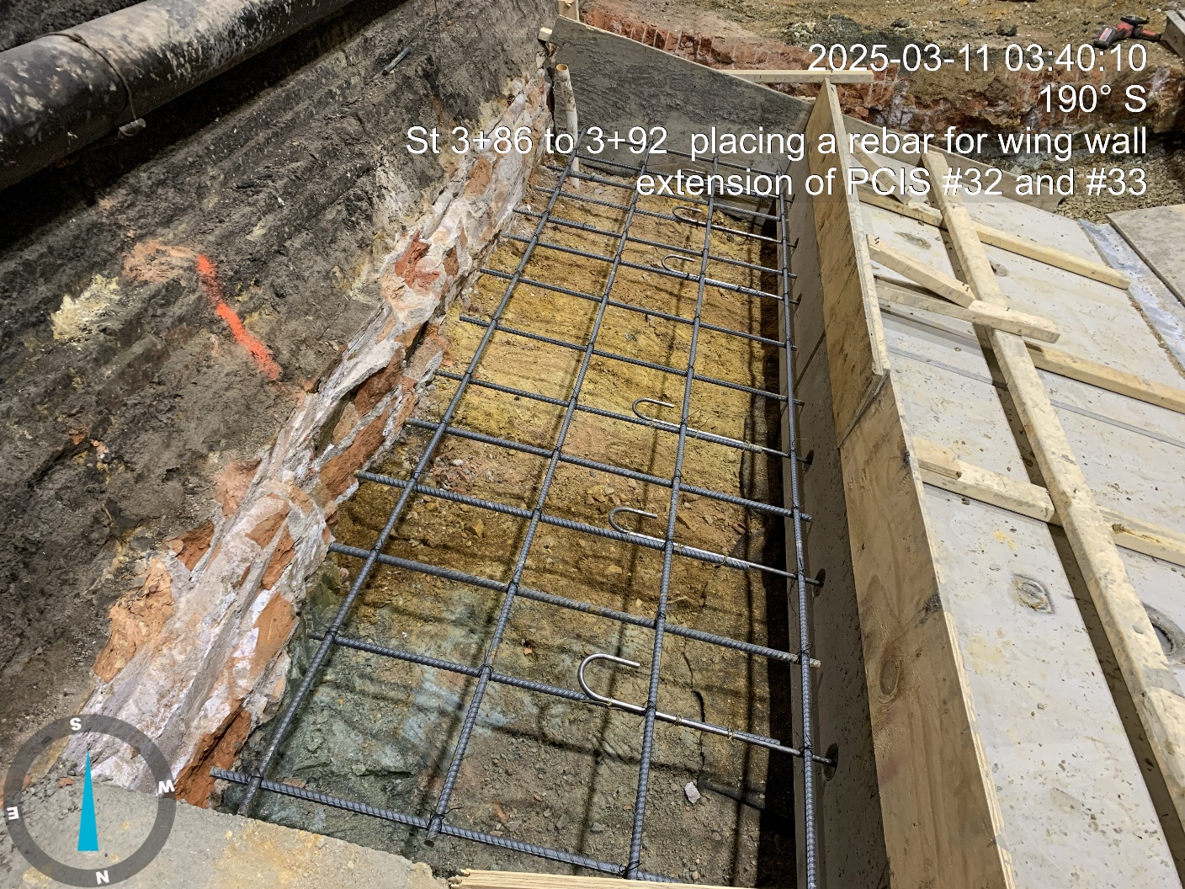
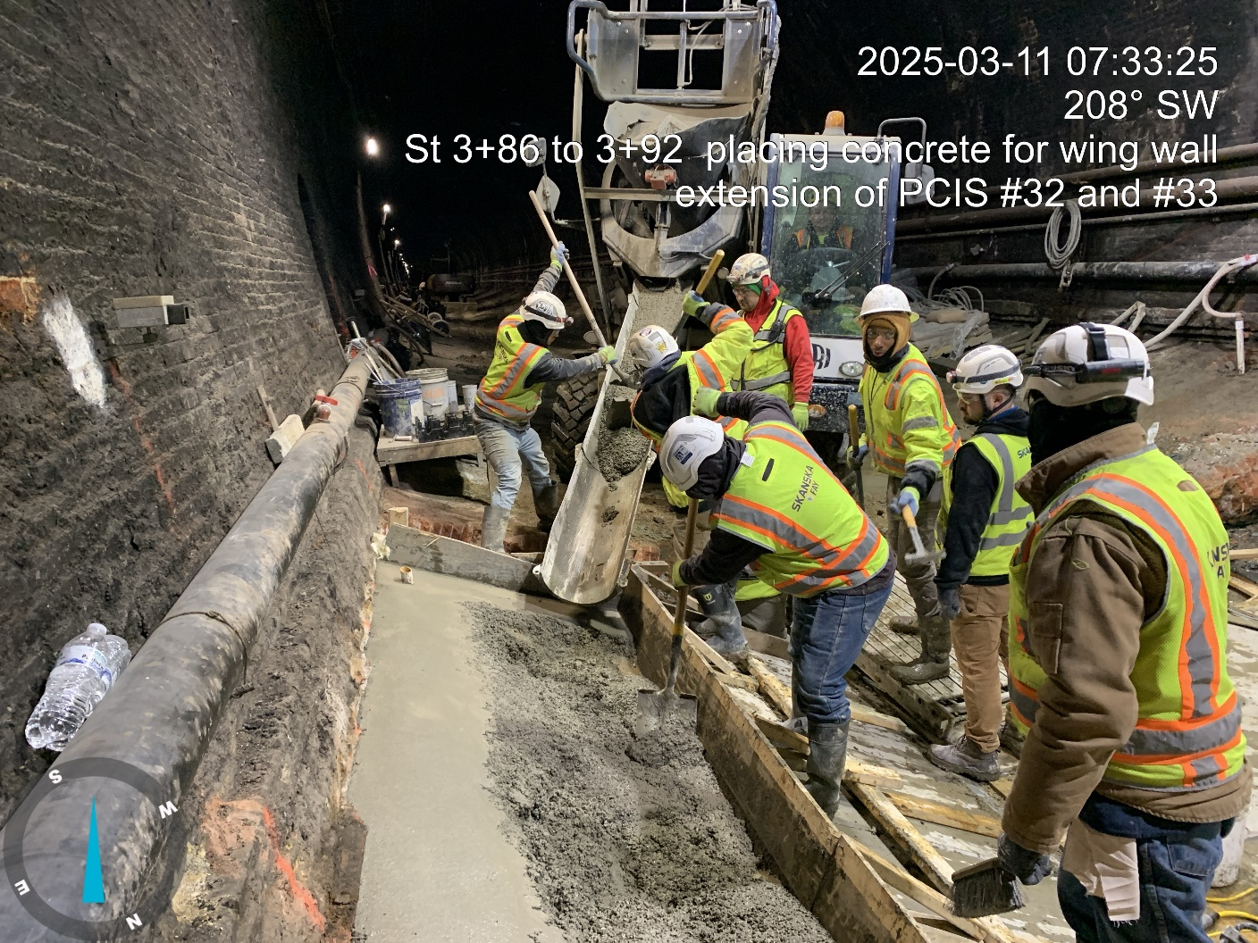
HST Pictures – PCIS Cycle

Slide 20
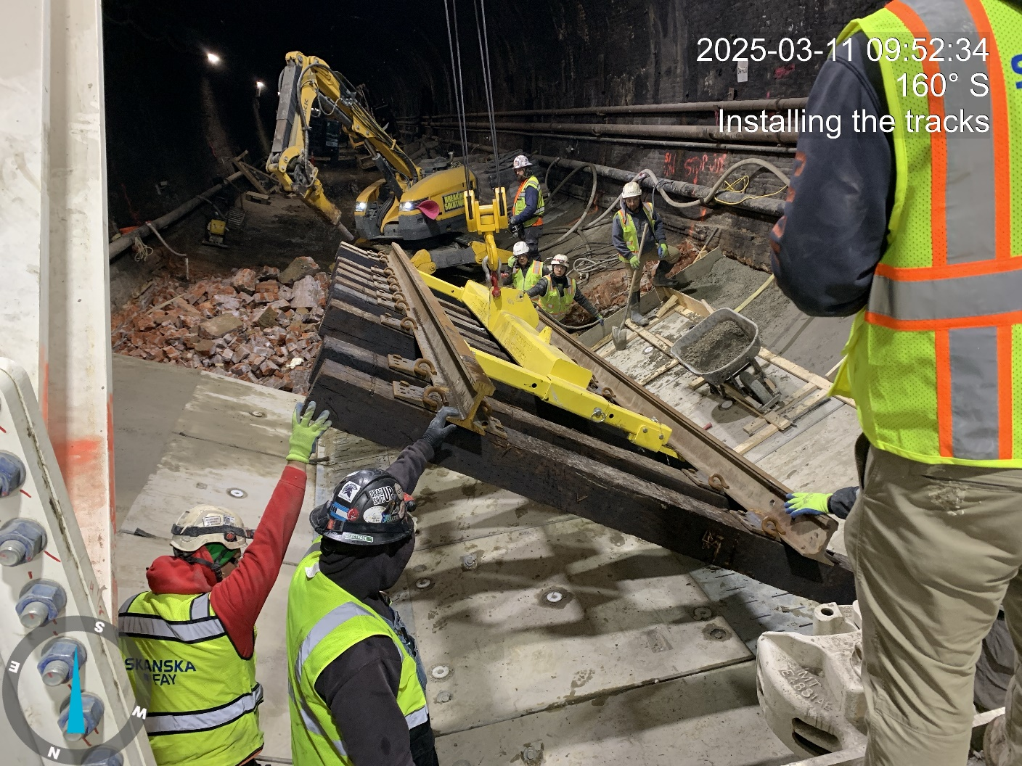
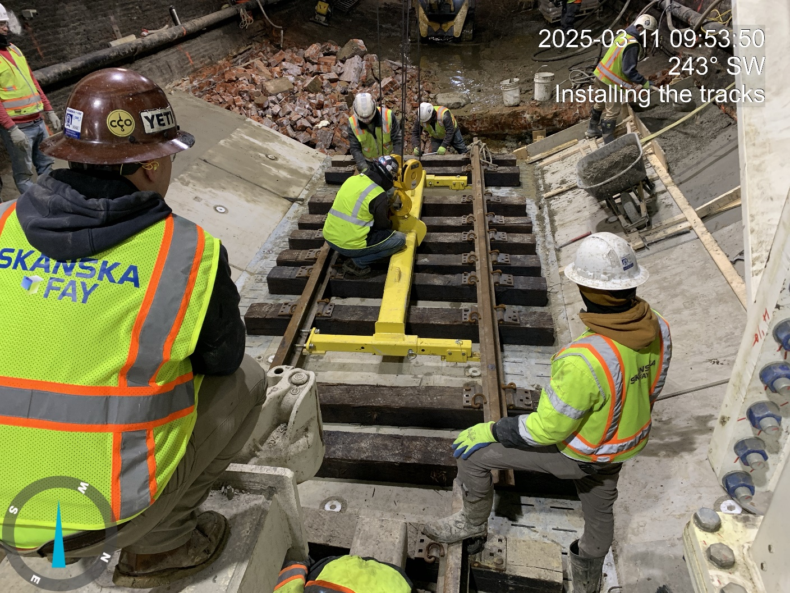
HST pictures – PCIS Cycle

Slide 21
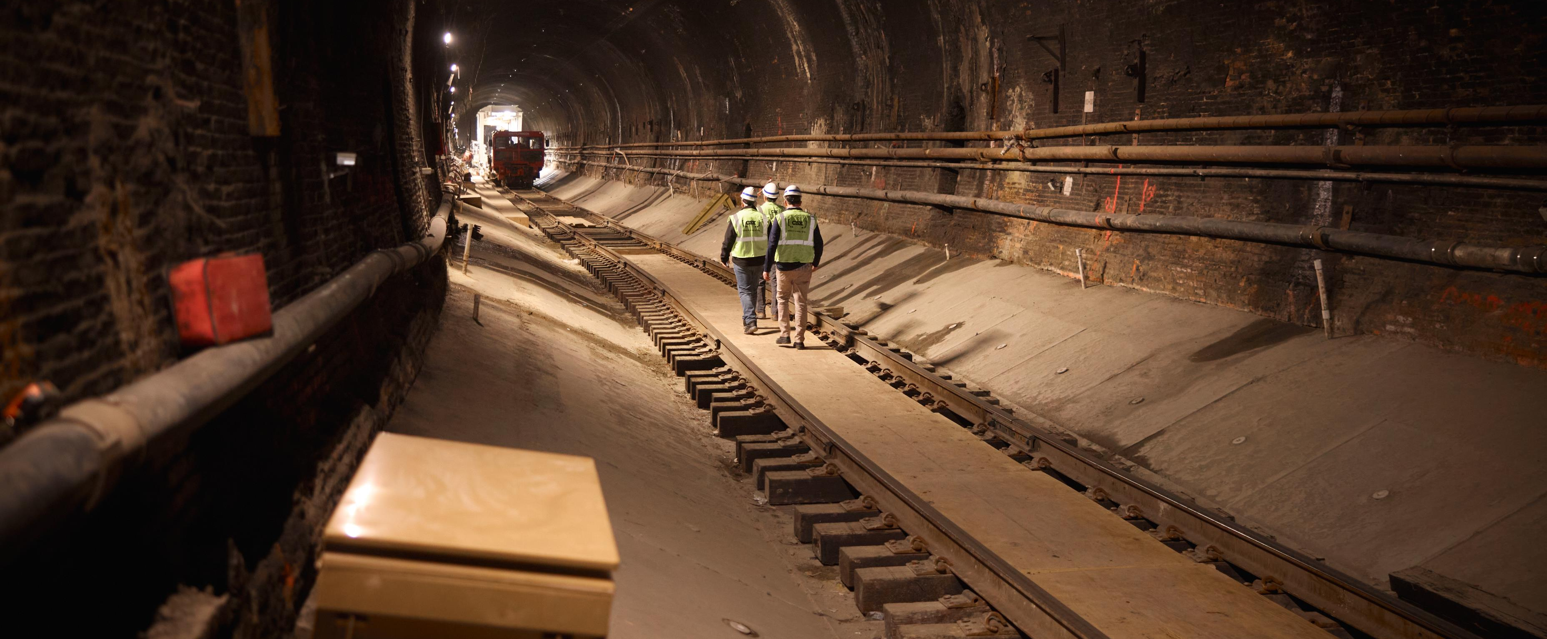
Howard Street Tunnel

Slide 22
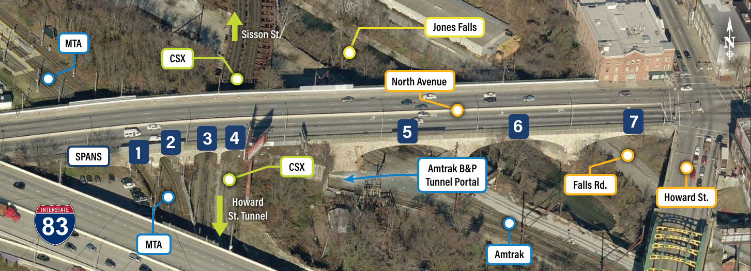
North Avenue bridge
Tri-level Structures
  North Avenue
  CSX
  Amtrak B&P Tunnel
Replace a portion of the North Avenue arch bridge with a signal span, shallow girder bridge

Slide 23
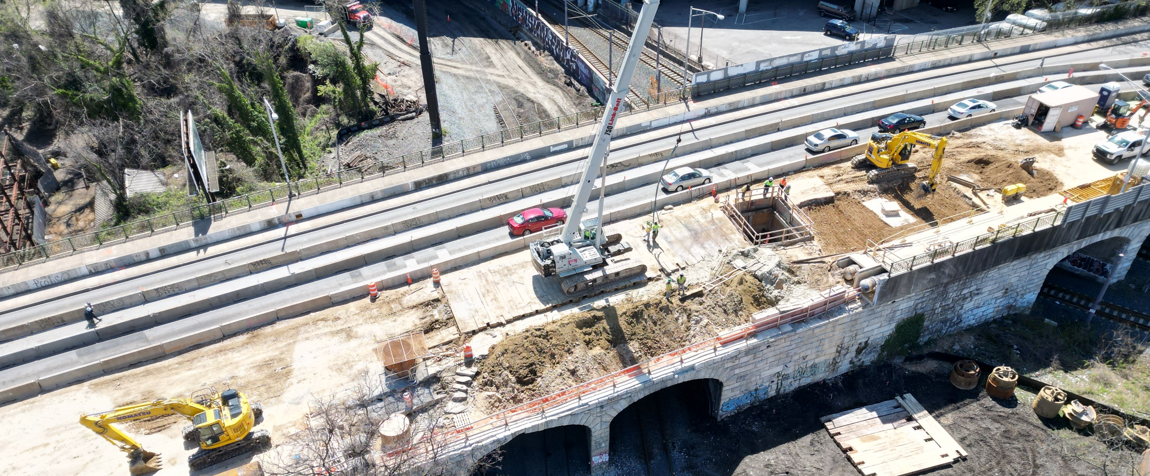
North Avenue

Slide 24
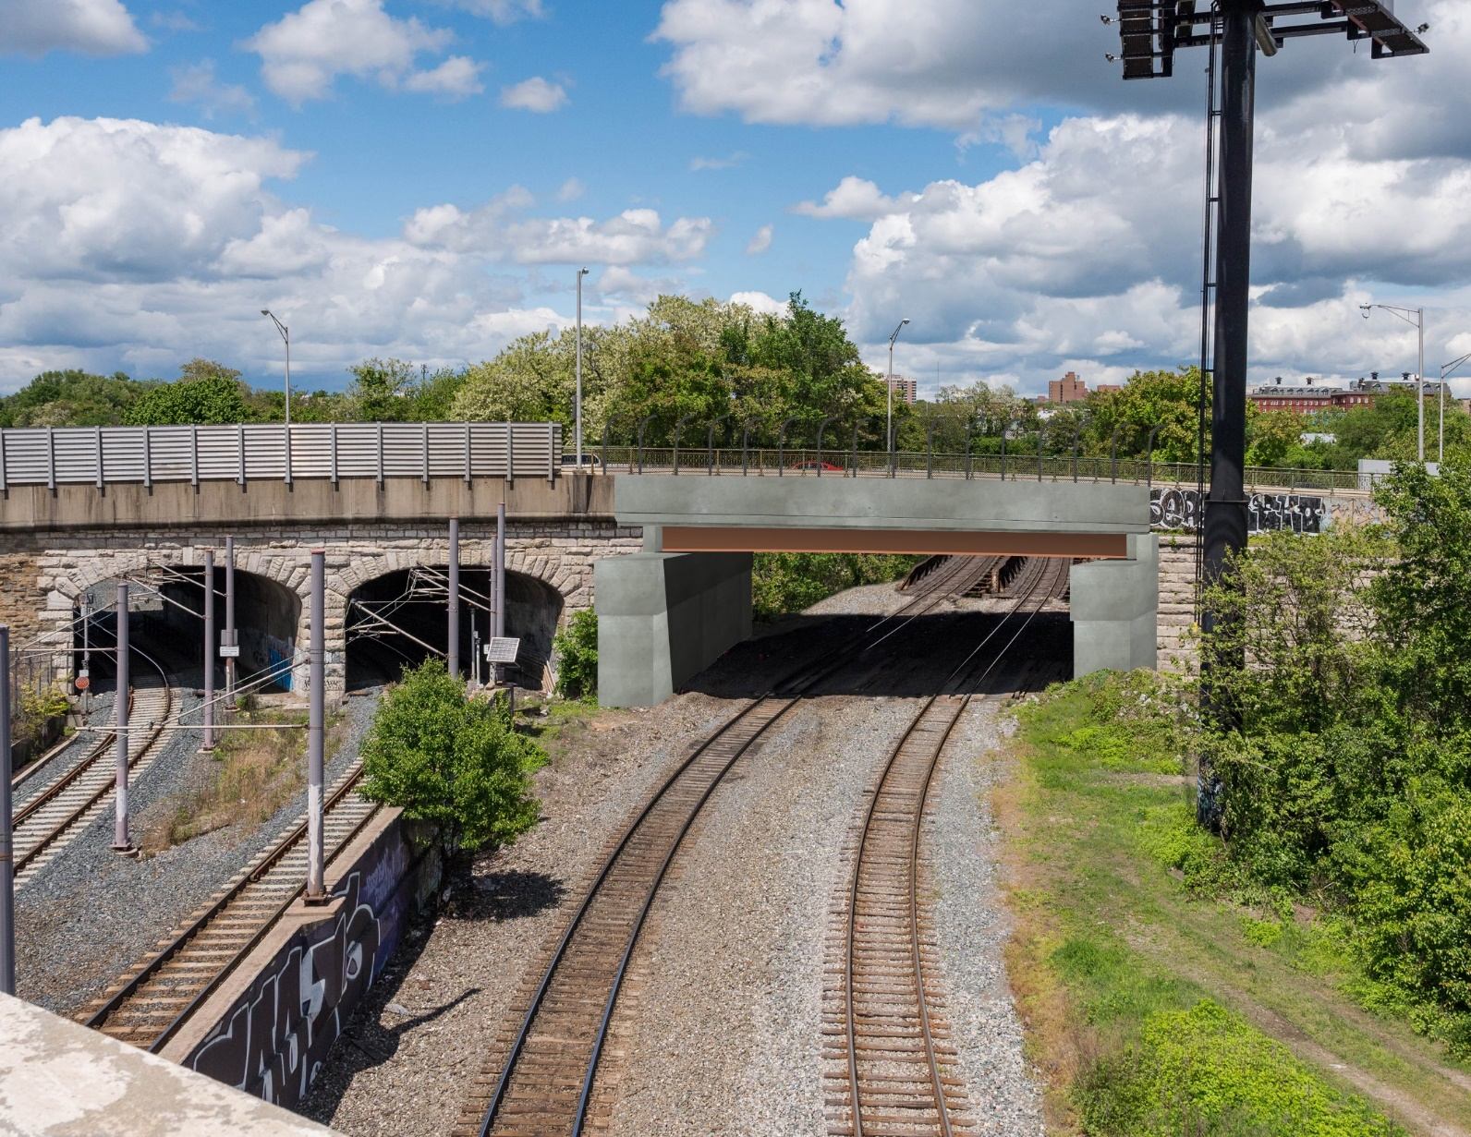
North Avenue Bridge rendering

Slide 25
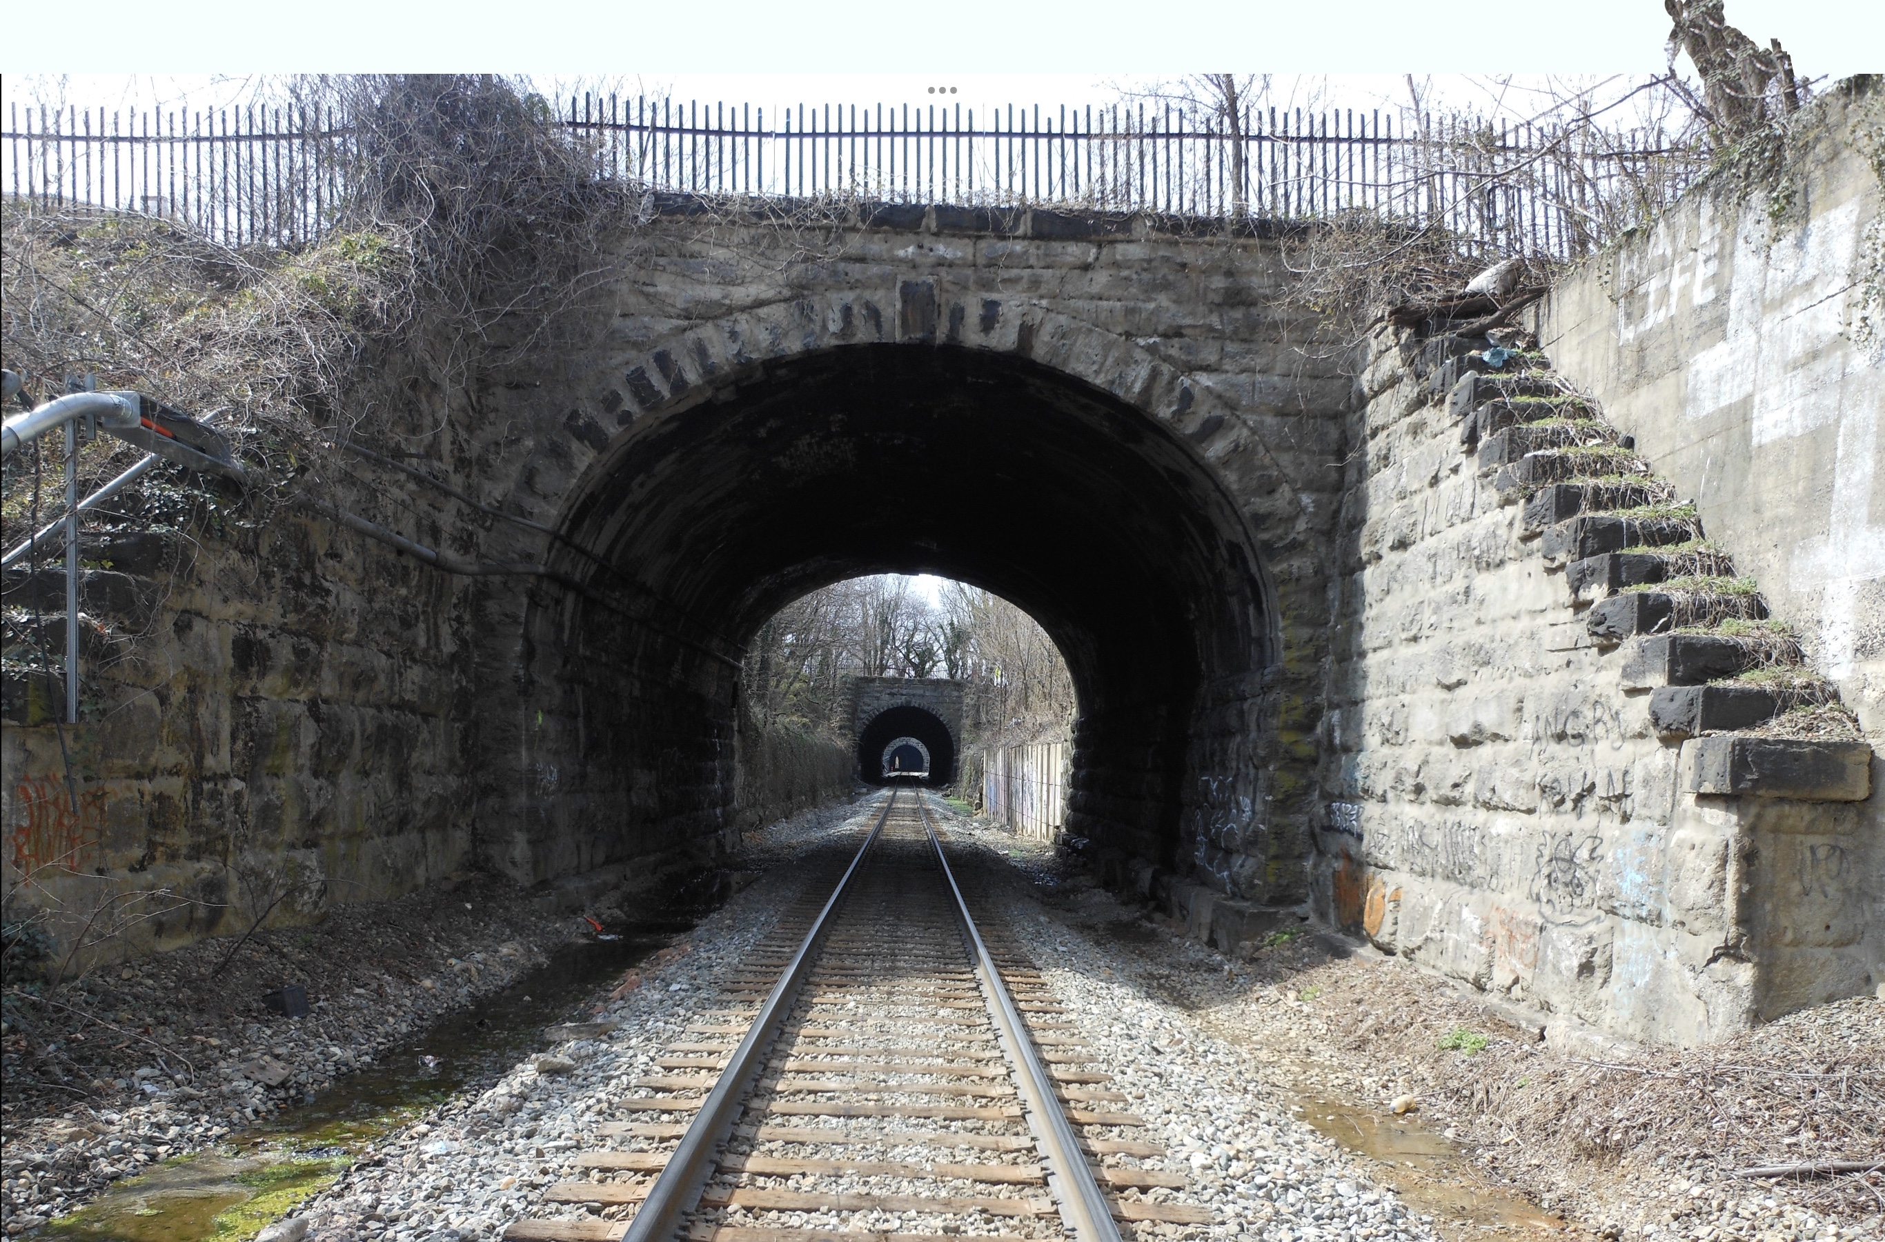
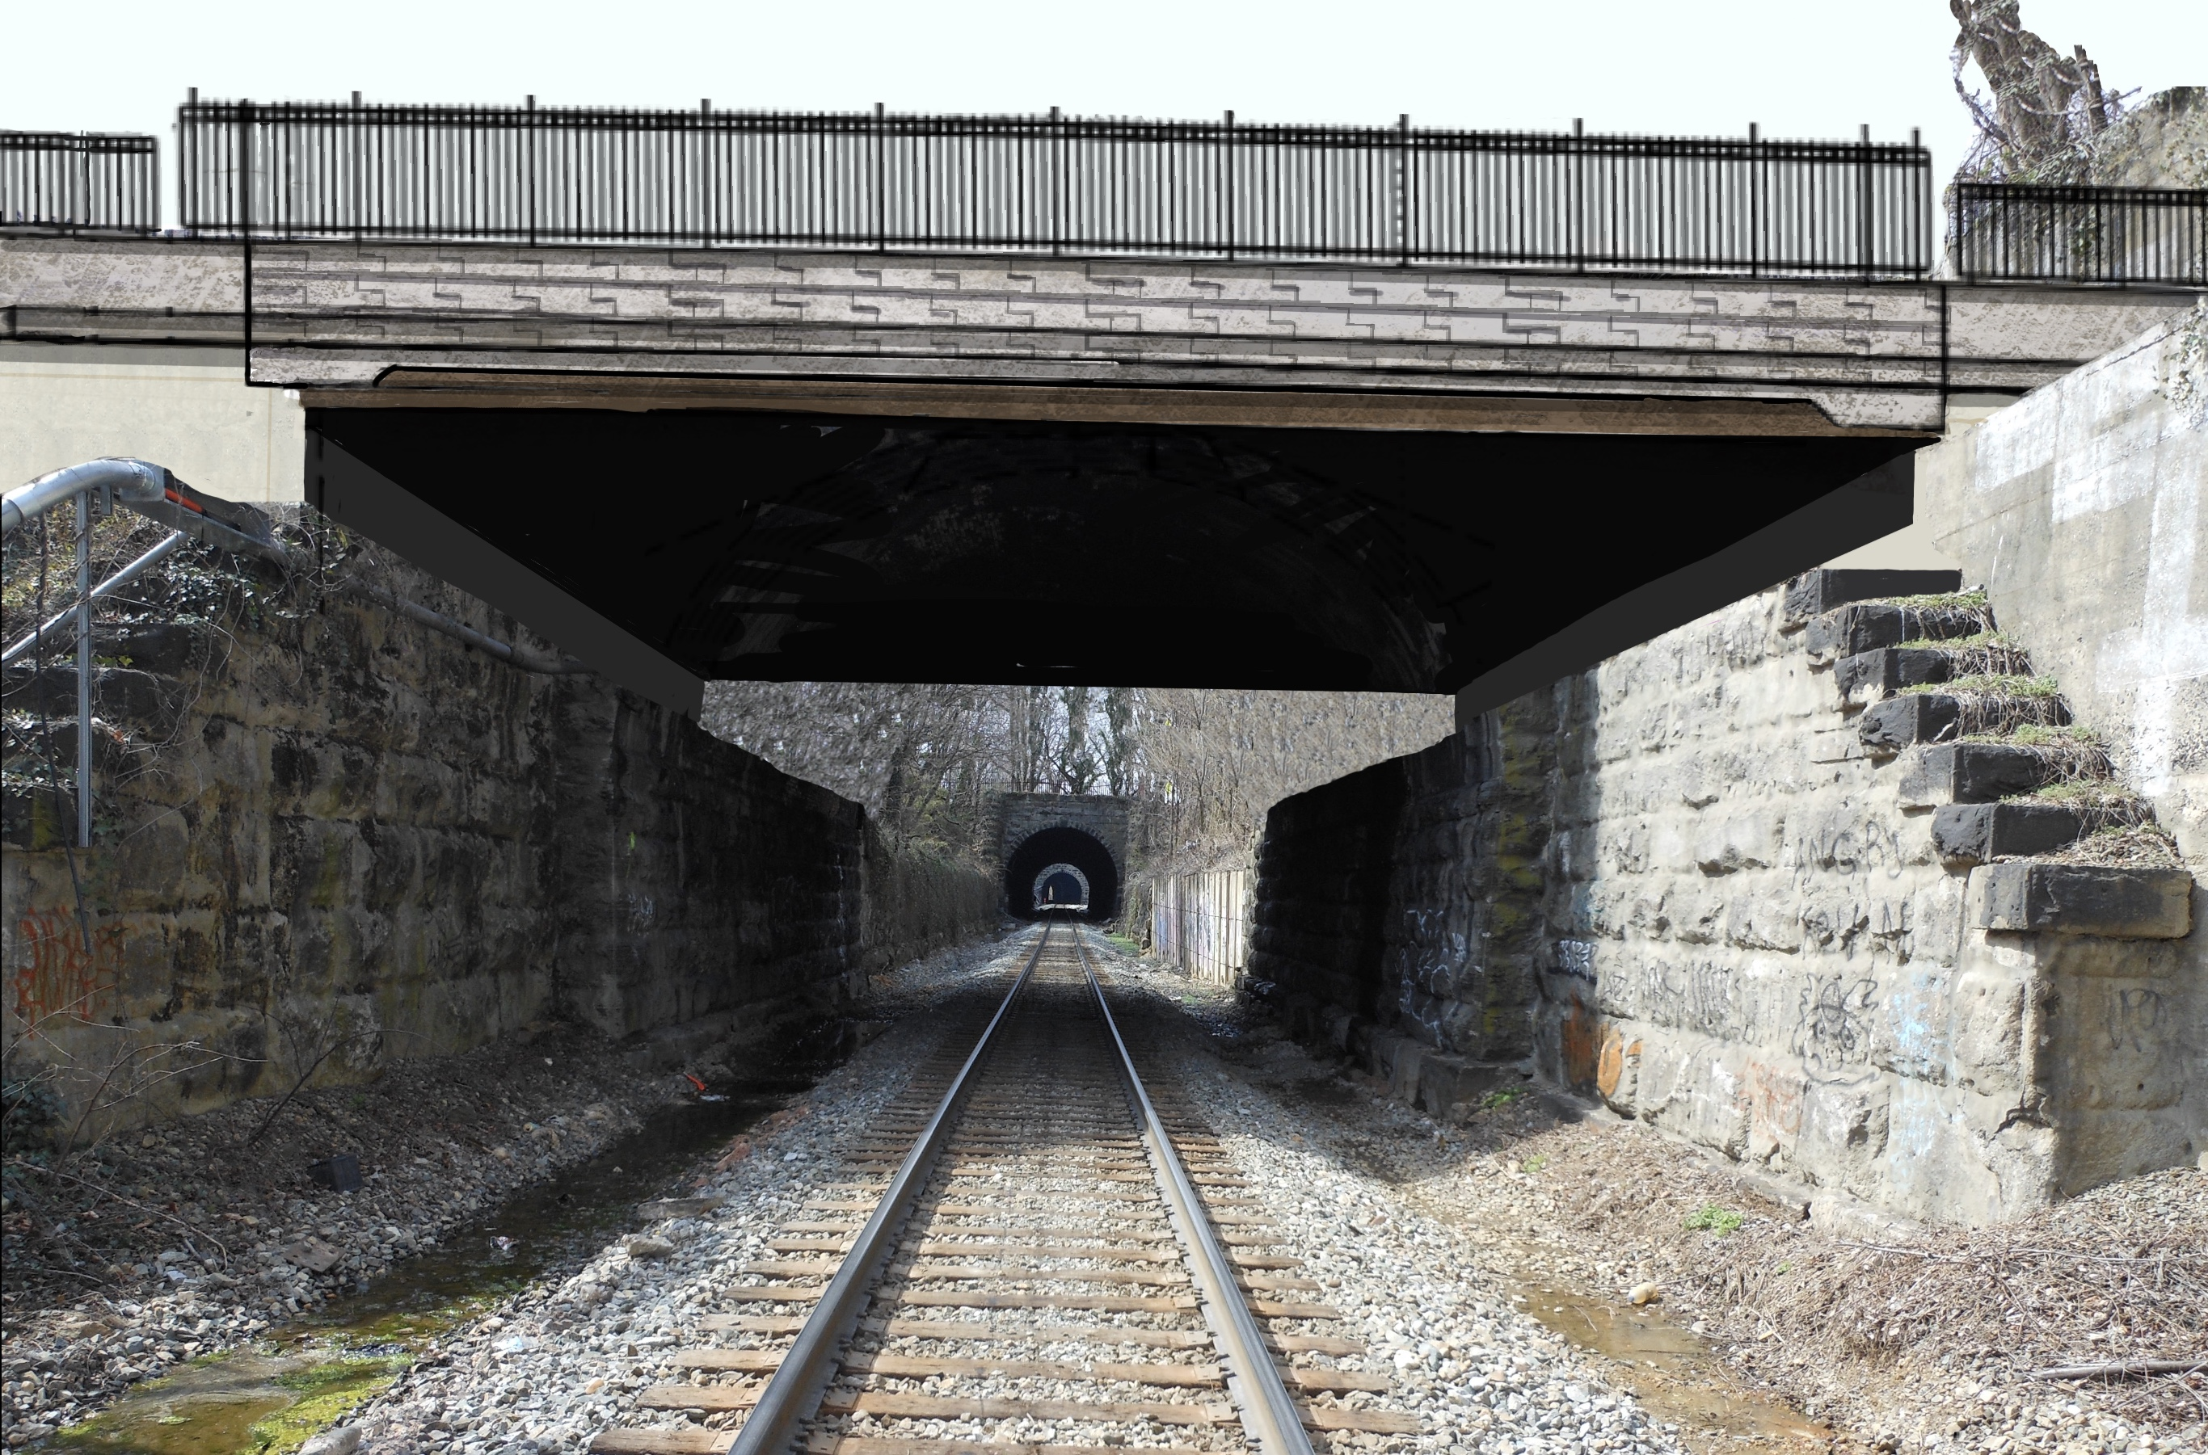
Guilford Avenue Bridge

Slide 26
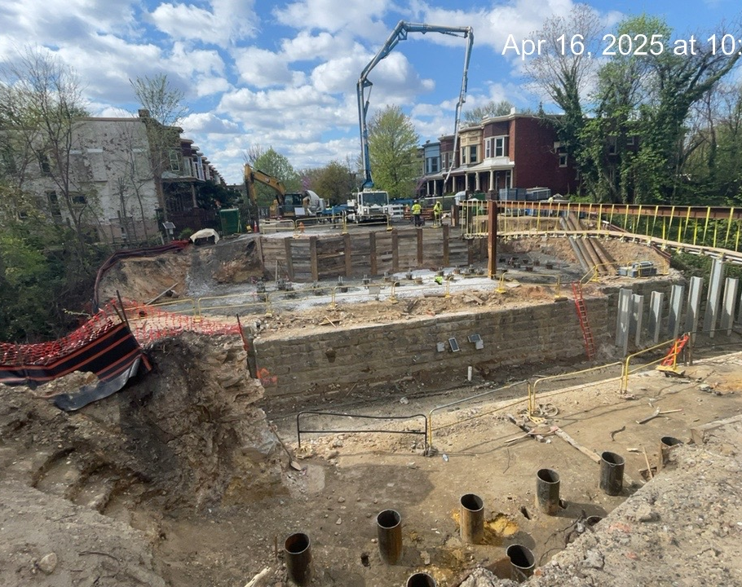
Guilford avenue Bridge

Slide 27
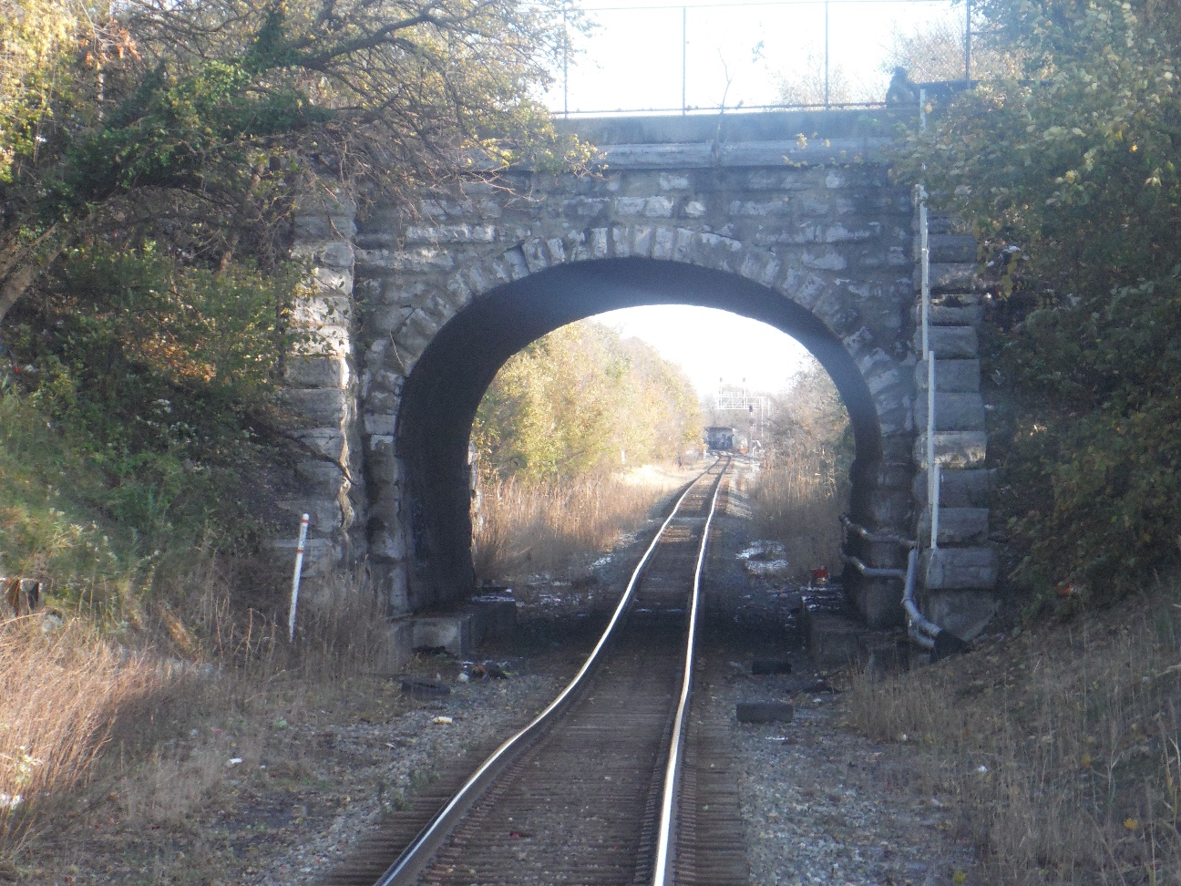
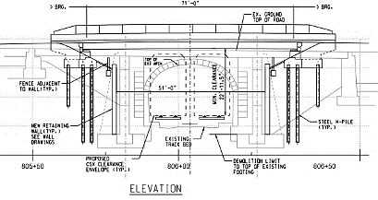
Harford road Bridge
Replace existing arch with single span, shallow girder bridge
Required due to existing water main conflict
Provide clearance for double stack and track profile adjustment
Phased maintenance of traffic

Slide 28
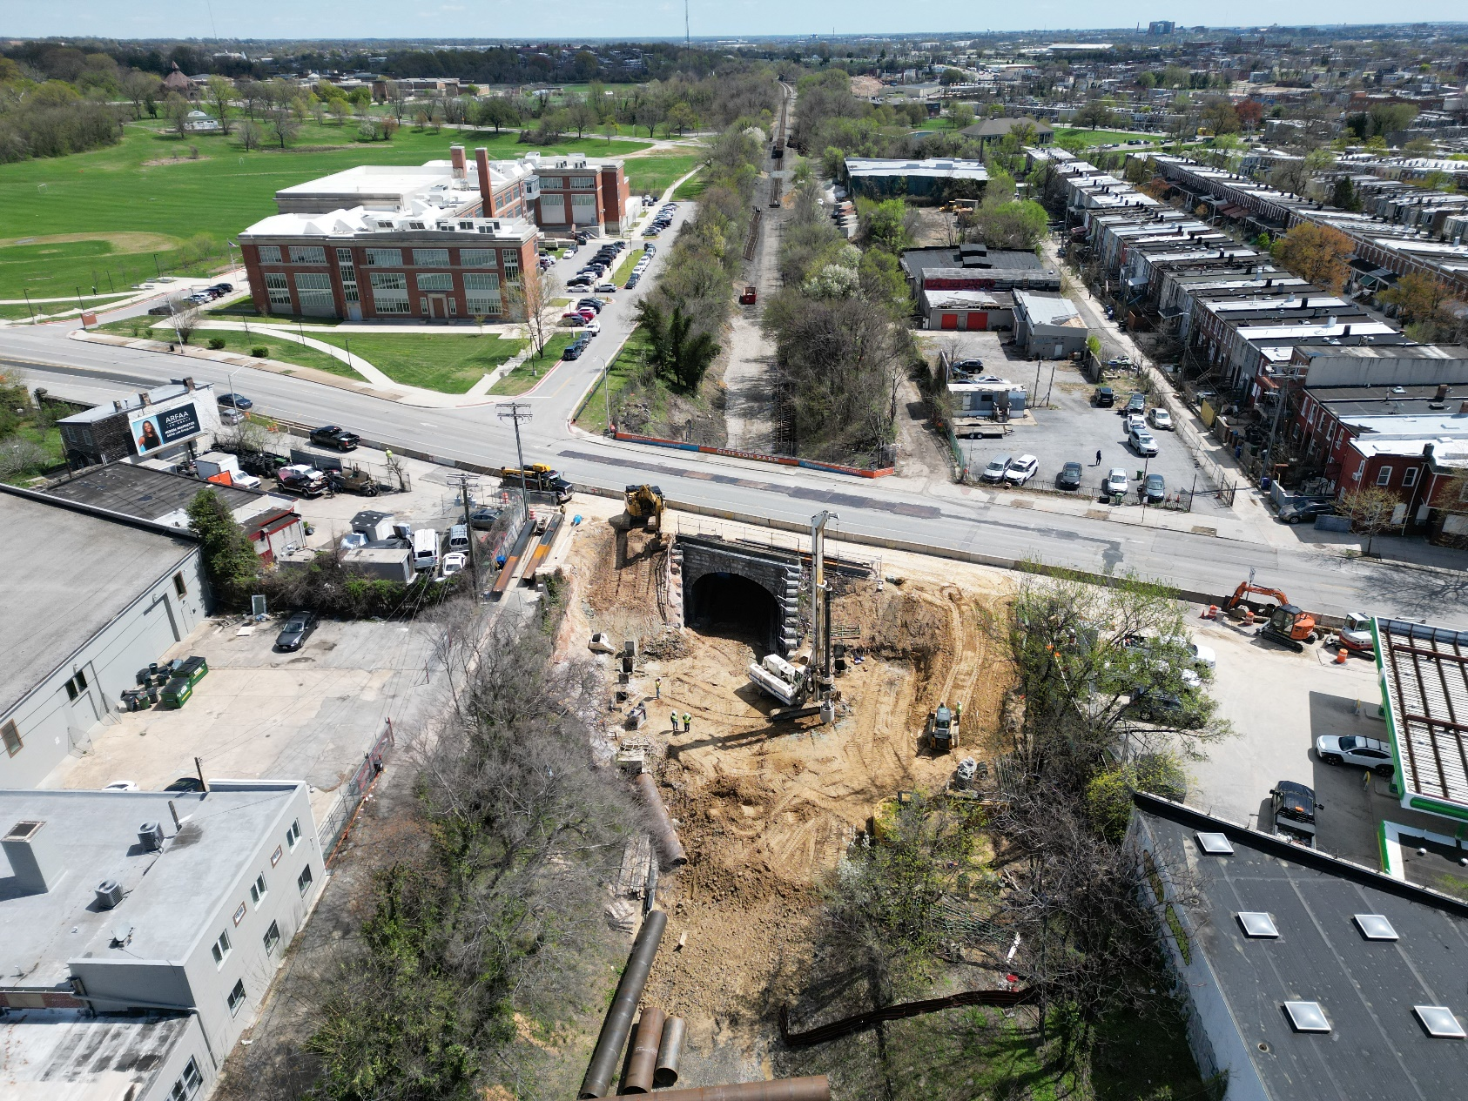
Harford Road Bridge

Slide 29
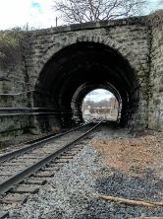
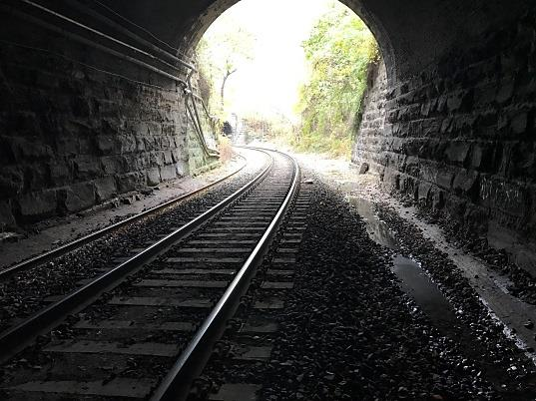
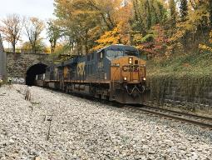





Baltimore Track Lowering
Huntington Avenue
Charles Street
St. Paul / Calvert Street
Barclay Street
Greenmount Avenue

Slide 30
Conclusion
The HST Program continues to progress safely and on schedule
Currently operating double stack service to the Port via the northern route (Philadelphia Sub)
Train traffic will reopen through the Howard Street Tunnel in late 2025
Double stack service through Baltimore City will commence once North Avenue & Harford Road are demolished – expected 2nd Q 2026
Program to be complete by end of 2026.

Slide 31
Stay connected
Visit Project Site: https://mpa.maryland.gov/Pages/hst.aspx
EMAIL: CSX_HST_Outreach@assedollc.com
PHONE:
443-535-6920
Thank you!
Notes:
Kirsten checking on voicemail or an actual # for someone to answer

Slide 32


Boone tunnel

Slide 33


Clifton Ave.

Slide 34


Chichester aVenue

Slide 35


4th st. And Lancaster ave.

Slide 36


58th – 68th STreet

Slide 37

Project Status
Design Complete on all projects
5 of 10 Projects complete
Remaining 5 Projects under construction
Clearance achieved from Baltimore to Philly in October 2024
HST to be complete in 2025
Overhead Highway Bridges to be complete shortly thereafter

