Slide 1
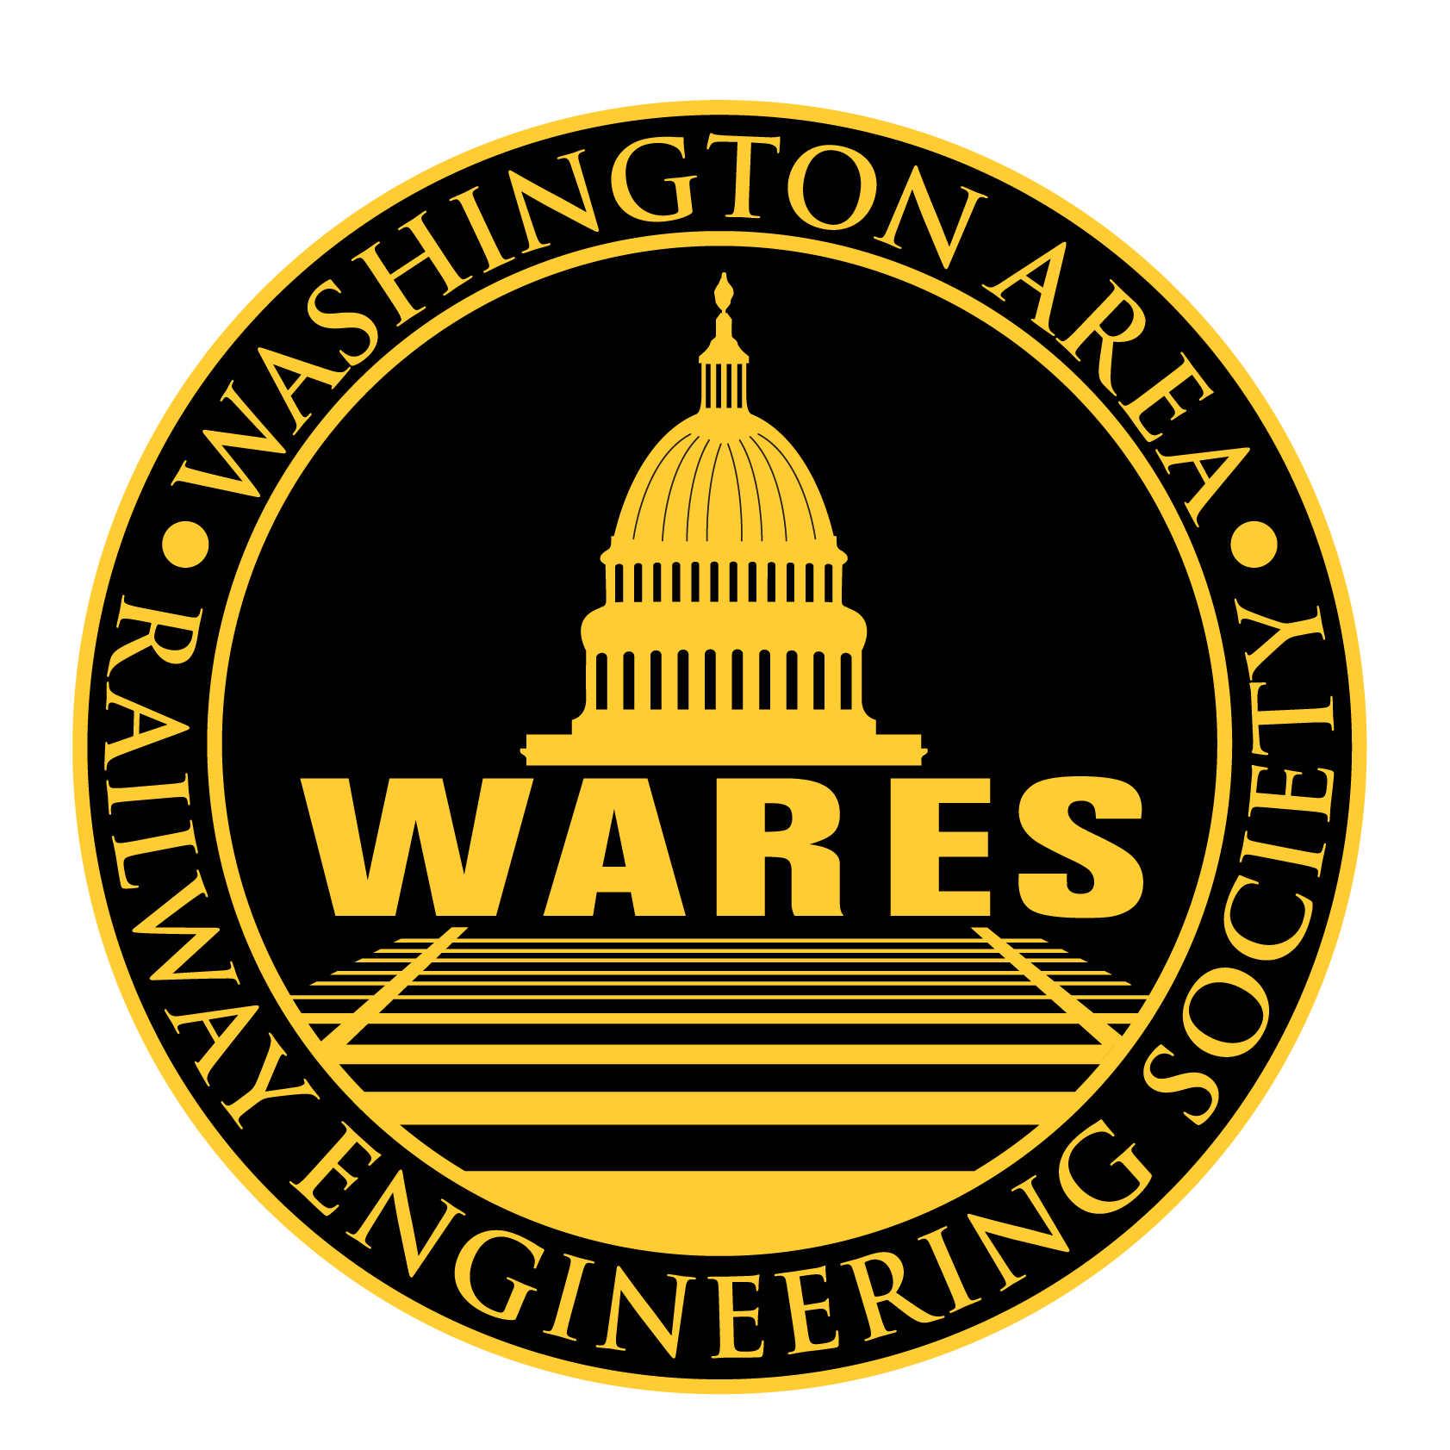
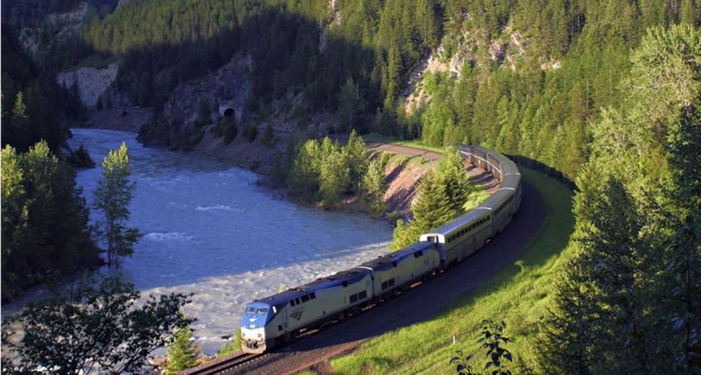
Agenda – Rail Passengers Association
Jim Mathews
    Pres. & CEO - RPA
Presenting on:
    A Passenger Rail Revolution!
      Transformational Change in American Transportation

Slide 2
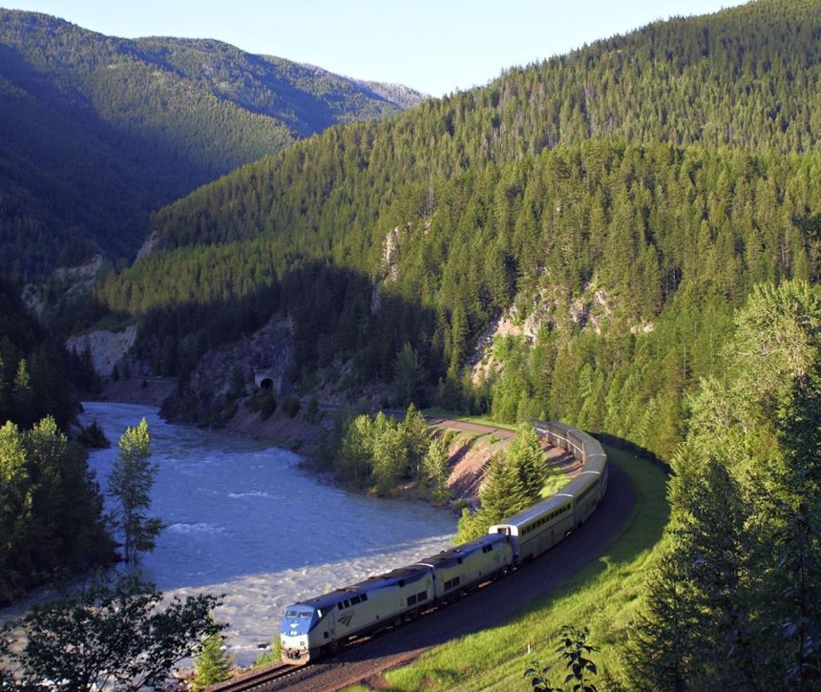

A Passenger Rail Revolution: Transformational Change in Transportation in America

Slide 3
A Presentation by
Meredith Richards, Chair,
Rail Passengers Association.

Slide 4
“How our Work is Expanding the Passenger Rail Network, and its Impact on the Rail Industry.”

Slide 5
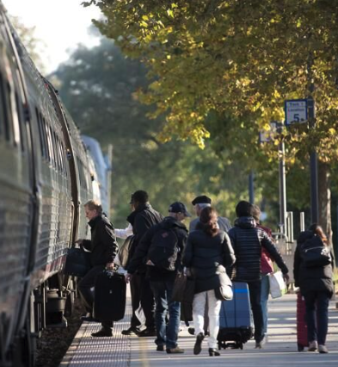
WHO WE ARE
The Rail Passengers Association:
Since 1967, Non-Profit and Non-Partisan
We’re the leading voice for the more than 40 million rail passengers in the U.S., working for a modern and robust national rail network delivering safe, efficient, and affordable rail travel for everyone.
We do this because it makes communities more accessible, more productive, and more prosperous, improving the lives of everyone who lives, works, studies, and plays in towns all across America.
Notes:
How is we talk about “everyone” when we talk about passenger rail? Isn’t Amtrak, for example, pretty much limited to people who take “land cruise” vacations across the country to see the pretty mountions and eat in the dining cars?
So this is why I include this when I speak about our mission: We do this because it makes communities more accessible, more productive, and more prosperous, improving the lives of everyone who lives, works, studies, and plays in towns all across America
We’ve learned to focus on the things people don’t think about when they think about passenger rail. The people in small town America and dense urban areas alike who depend upon passenger rail for their mobility, their health, their education and their opportunities.

Slide 6
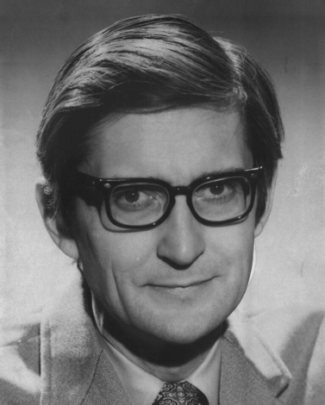
WHO WE ARE
'National Association of Railroad Passengers'
Founded by Chicago Attorney Anthony Haswell In 1967
Our Role
Represent the American passenger
Full-time DC staff
Non-profit educational organization
Our Goals
More capacity, More routes, More frequencies, Higher safety
Our Mission
… is to expand and improve passenger rail service to more places for more people.
Our Vision
…is a passenger rail system that works everywhere for everyone.
Notes:
Our 58th year
Introduce Ross Capon

Slide 7
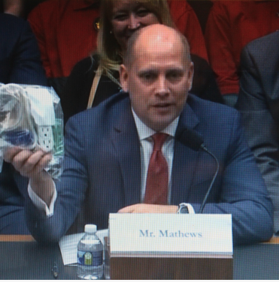
WHO WE ARE
The Rail Passengers Association:
Rigorous, Professional Public Policy Research
We work with local, state, Federal, and tribal leaders and planners, local legislators, congressional members and staff, and businesses.
Our staff produces rigorous economic-benefits studies, white papers, educational materials, model legislation, and bill language. We also testify before Congress and agencies, vote in advisory bodies, and comment on rulemakings.
Notes:
Those investments were targeted to professionalize our staff, to elevate our public communications and media presence with outside PR and marketing counsel, to sharpen and focus our public-policy messages with data-tested strategies, and to re-create our image in the eyes of decisionmakers to shift away from emotional enthusiasm and instead to
We’ve spent the past ten years building credibility and trust to prepare for scenarios just like the one we’ll enter in January 2025. That trust Rail Passengers has worked so hard to earn as a true nonpartisan voice for the American passenger will be even more crucial in the upcoming congressional session. We’ll be heard, taken seriously, and consulted at a time when – let’s not sugar-coat it – all of our great “wins” for passenger rail in the past six years are at risk.
ward credible, fact-based advocacy. We spent money to get better at our mission
The economic-benefits work that we co-developed in 2017 with the Univ. of Southern Mississippi informed and catalyzed congressional support in 2021 to require FRA to perform the long-distance study which, today, has already de facto recommended that the Sunset Limited and the Cardinal both be returned to daily service right away – a significant win all by itself.
Those studies helped persuade Congress to think boldly about passenger-rail when they were drafting the IIJA, and our arms-length public opinion polling strengthened congressional resolve a year later when IIJA/Bipartisan Infrastructure Law investments might have been under threat
, starting in 2016, we began investing significant dollars to bring in, for example, Xenophon Strategies, IMPLAN, Change Research, the University of Southern Mississippi, and many others – people, organizations, vendors, and partners with real professional expertise to help us advance our mission with speed, precision, and effectiveness.
We are now trusted policy partners in Congress, FRA, STB, and beyond. When Jim Matthews arrived in 2014, we were quoted so rarely in the press that we issued press releases when it happened...as if that in itself were news. Today, not a week goes by when our staff isn't in contact with dozens of news outlets around the country, including the New York Times and Washington Post, or even around the world, to include BBC and The Economist. Daily Kos slide.
I’ve worked very hard and for many years building our professionalism, our credibility, and our expertise so that we can be a genuine policy partner and resource for lawmakers on both sides of the aisle. That’s why so many offices and Committee staff reached out for the Association’s help when Congress was crafting the Bipartisan Infrastructure Law, and it’s why Republican offices in the last Congress sought our help, for example, on winning more transparency for Amtrak Board meetings.

Slide 8
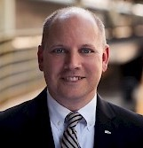
Jim Mathews
President and CEO
26-year career at Aviation Week & Space Technology magazine (Executive Editor).
Just appointed to Passenger Rail Advisory Committee to US Surface Transportation Board (STB), chief federal economic regulator for railroads.
Service on 8 eight U.S. Federal government advisory panels.
Presentations, briefs, testimony to Congressional committees, Federal Railroad Administration (FRA) and STB proceedings.

Slide 9

Sean Jeans-Gail
Vice President of Policy + Government Affairs
Directs Rail Passengers’ national grassroots advocacy campaigns.
Oversees federal legislative policy for Rail Passengers.
In charge of RPA’s field organizing team.
Drafts RPA’s Legislative Program, supports RPA’s legislative field work at the Federal, state and municipal level.

Slide 10
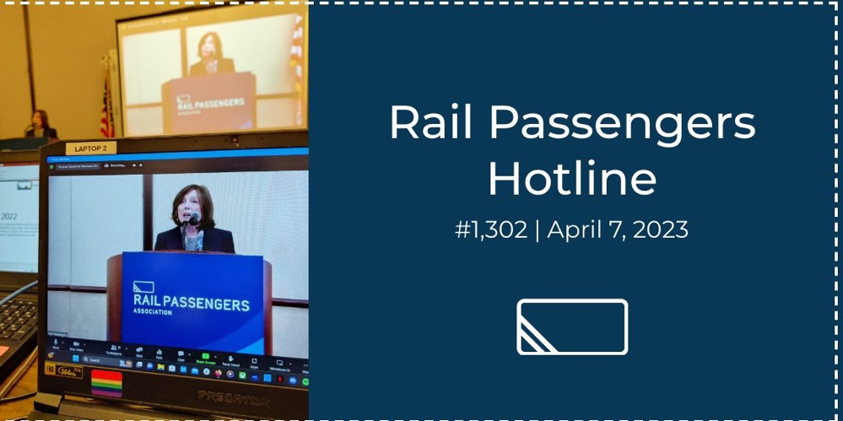

Slide 11
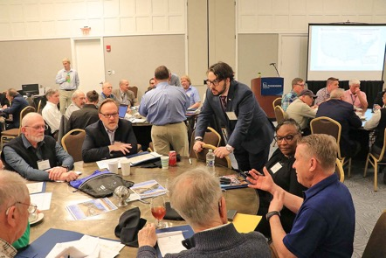
RPA Council of Representatives:
Our Special Forces on the Ground
  Unite local and national efforts to effectively advocate for passenger rail.
  137 Representatives from every state in the union.
  Advocate for passenger trains and transit in their states and regions
  Outreach to State and Congressional Legislators for passenger rail.
  Coordinate local efforts with our Federal Program
Rail Nation DC 2024 Spring Meeting
Notes:
The council plays a crucial role in uniting local and national efforts to effectively advocate for passenger trains and transit.
It consists of 112 State Representatives and up to 10 At-Large Representatives who represent local needs, address issues, and participate in formulating national policies related to passenger rail.

Slide 12
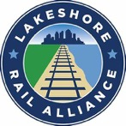
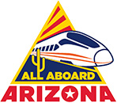
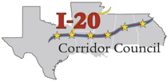




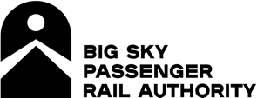
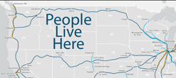
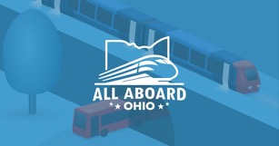


Mobilizing a grassroots network of citizen advocates in organizations across America
Our members work at the grassroots to bring more trains to their communities, states and regions.
Our coalition stretches across the map, aligning local passenger rail initiatives with RPA’s work in Washington.
Our Council meets twice a year to formulate a coordinated national effort under the guidance of our government affairs staff.
Notes:
I’ve traveled from Portland,OR to Portland, ME ; From Seattle to Schectady, Arizona to Ohio and Mississippi to Montana meeting with and getting to know the advocates who populate these groups. I’ve given keynotes at their summits and annual meetings and heard about their project initiatives, their challenges, their successes.

Slide 13

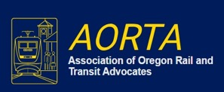
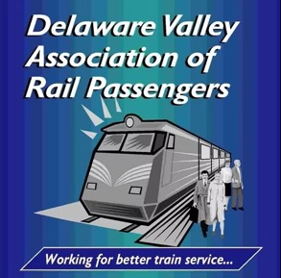
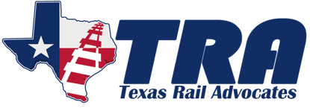


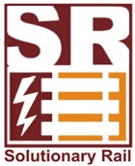
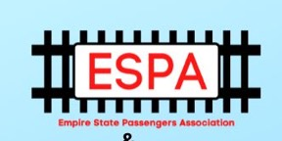
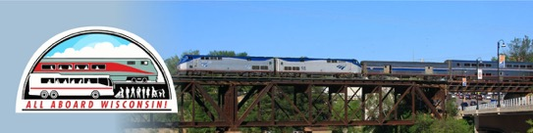
Mobilizing a grassroots network of citizen advocates in organizations across America
Notes:
All grassroots organized and maintained; in only a very few instances are there professionals running these groups.

Slide 14
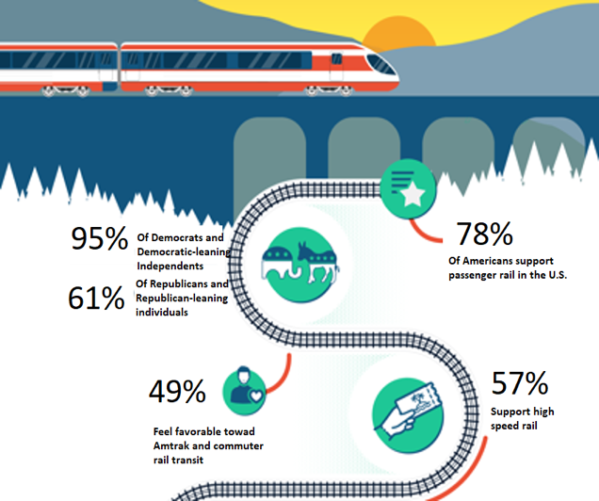
Truly Historic Public Sentiment:
Broadly Bipartisan Support For More And Better Trains
Rail Passengers / Change Research Poll Spring 2022
Notes:
Whether they vote Republican or Democrat, most Americans want more and better trains to more places for more people78% support U.S. passenger rail
95% of Democrats and Dem-leaning voters
61% of Republicans and Republican-leaning voters
57% support high-speed rail
60% would spend $100 billion or more improving passenger rail

Slide 15
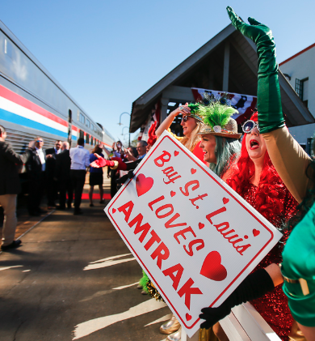
WHO WE ARE
The Rail Passengers Association:
Speaking For Grassroots Nationwide
We’ve mobilized a grassroots network of 127,000+ donors, members, and supporters nationwide!
Our goals are to improve and expand conventional intercity and regional passenger train services, support higher speed rail initiatives, increase connectivity among all forms of transportation, and ensure safety for our country's trains and passengers.

Slide 16
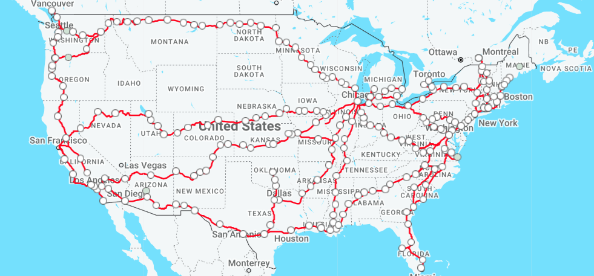
WHO WE ARE
The Rail Passengers Association:
Speaking For Grassroots Nationwide
Notes:
39 states are served by long-distance trains
• 23 states where long-distance trains are the only Amtrak service
Economic Engines for Growth
A Connected America is not only good for passengers but good for America’s cities and towns, where rail is a
proven economic engine in the communities it serves. Every Amtrak long-distance route creates a return on
taxpayers’ equity for the communities that have invested in it over the past few decades. And thanks to
rigorous economic-benefits modeling Rail Passengers has developed over the past three years, we have been
able to quantify that return in a way that hadn’t been done previously. Rail Passengers’ modeling suggests
that Amtrak’s interconnected services in the Northeast Corridor, the long-distance National Network and
the dozens of State-supported Amtrak routes together return between $7 billion and $8 billion each year
to our Nation’s GDP – four times what we typically invest in the service. These long-distance routes below
are just examples of the benefits long-distance trains can generate.
Amtrak’s National Network, with its 15 long-distance routes connecting a series of state-supported services,
has proved to be an essential transportation service to the 40 percent of the nation’s small and rural
communities that it serves, establishing a vital link between Small Town and Big City America. Rural Mobility in America
Connecting Millions with Appropriate Access to Public Transit
. 62 million people live in this so-called “flyover country,” a quarter of whom are veterans and another quarter are senior
citizens over the age 65.

Slide 17
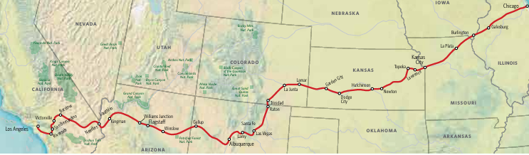
PROSPERITY ENGINES
Southwest Chief:
An Example Of Why Long-Distance Trains Grow Prosperity
Non-stop is not the point! Serving 31 stations means 496 different trip combinations are possible with each and every departure. This is maximum efficiency!
Notes:
To illustrate the concept, consider the 2,265 mile corridor between Chicago and Los Angeles. Critics claim that air travel has made such routes obsolete; that it would be cheaper for government to buy each passenger an airline ticket than to run trains on this route. If trains ran non-stop between these two cities, the critics might be right. But the trains do not and the critics are wrong. San Bernardino Riverside Needles Laughlin Garden City Lawrence 4 Amtrak, System Timetable, Effective May 7, 2012. Long Distance Trains: Multipurpose Mobility Machines 5
This route currently has just one train a day in each direction, the Southwest Chief, yet it attracts 355,000 passengers per year—466 per departure.5 Because it makes 31 intermediate stops, it provides a mobility choice for twenty five million Americans who live within just 25 miles of a station (31 million who live within 50 miles) for short, medium and long distance trips between 528 different city pairs with each and every trip.6
35 % of trips are more than 1,000 miles 31% of trips are 500 34 miles or less % of trips are 501– 999 miles The large metropolitan areas at each end point generate nearly three fourths of all traffic, but: • Only 8% travel the entire distance between Chicago and Los Angeles; • 64% travel between the one end point city and intermediate points; • 28% travel between intermediate cities; • 19% travel between city pairs where the passenger volume is less than one trip per day: markets so small that only trains with the multiple intermediate stops could economically serve.

Slide 18
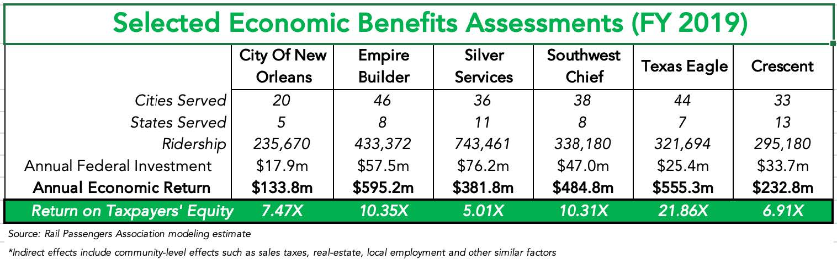
PROSPERITY ENGINES
Rail Is A Proven Economic Engine:
Economic Activity Represents Return on Taxpayers' Equity
Notes:
Economic Engines for Growth
A Connected America is not only good for passengers but good for America’s cities and towns, where rail is a
proven economic engine in the communities it serves. Every Amtrak long-distance route creates a return on
taxpayers’ equity for the communities that have invested in it over the past few decades. And thanks to
rigorous economic-benefits modeling Rail Passengers has developed, we have been
able to quantify that return in a way that hadn’t been done previously.
Rail Passengers’ modeling suggests that Amtrak’s interconnected services in the Northeast Corridor, the long-distance National Network and
the dozens of State-supported Amtrak routes together return between $7 billion and $8 billion each year
to our Nation’s GDP – four times what we typically invest in the service. These long-distance routes below
are just examples of the benefits long-distance trains can generate.
And thanks to rigorous economic modeling this Association has developed over the past year, we have been able to quantify that return in a way that hasn’t been done previously.”
Mathews drew the attention of the Committee to the route-specific studies Rail Passengers have done to quantify these benefits. These studies found the Empire Builder is worth $327 million every year to the economies of the states it serves; that the Southwest Chief brings $180 million in annual economic benefits to New Mexico, Colorado and Kansas; and that that

Slide 19
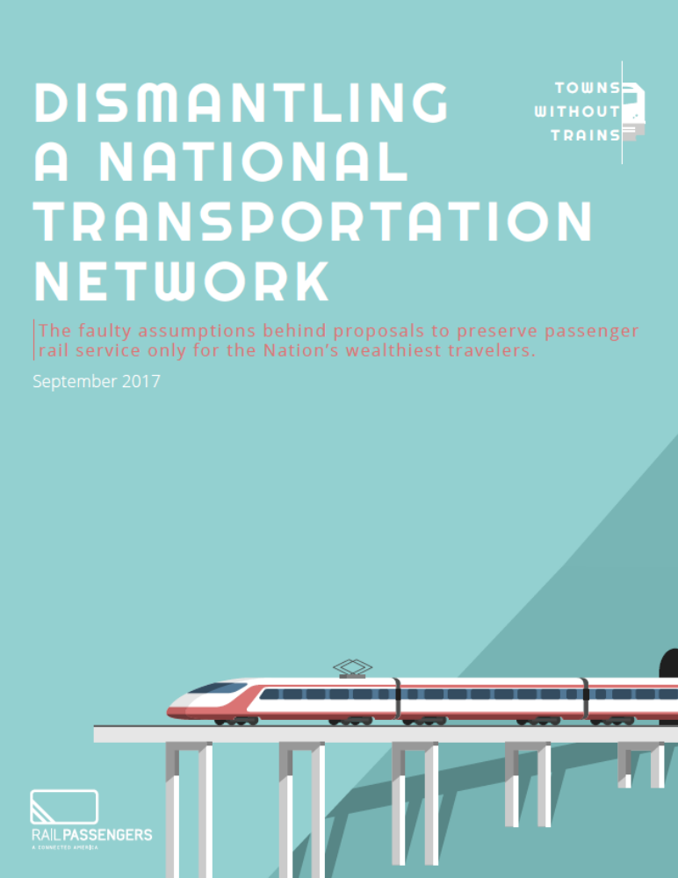
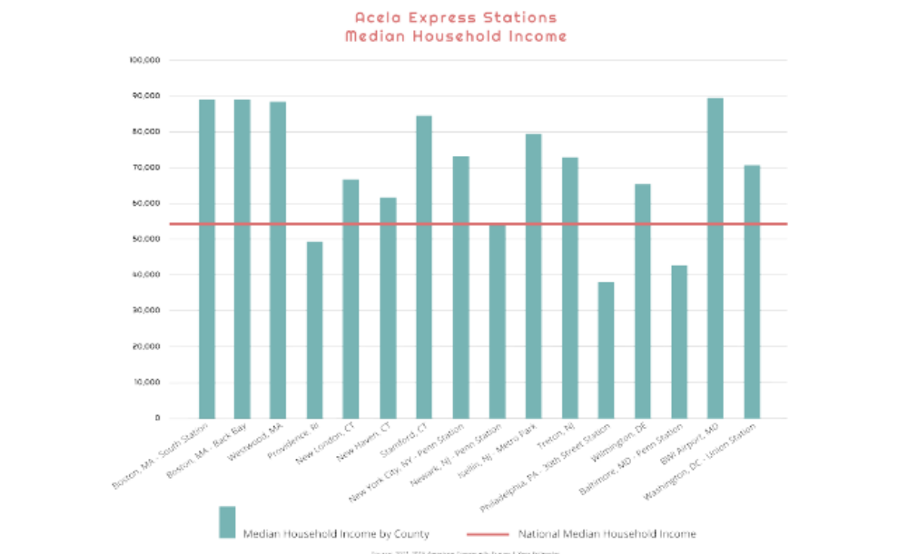
PROSPERITY ENGINES
Misguided 'Profit' Demands Hurt Rural Poor:
Only Wealthy Places Deserve Amtrak Service?
Acela Washington to Boston

Slide 20
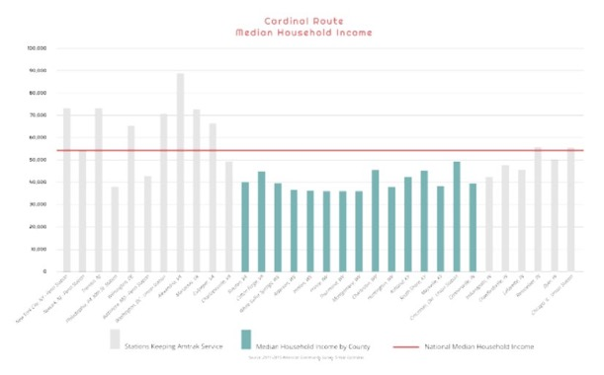
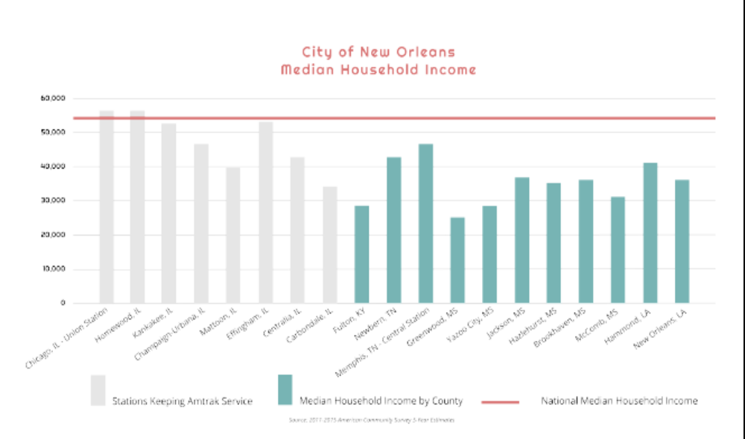
PROSPERITY ENGINES
Misguided 'Profit' Demands Hurt Rural Poor:
Only Wealthy Places Deserve Amtrak Service?
Cardinal Route: Chicago to New York
City of New Orleans: Chicago to New Orleans
Notes:
:Rail Service = Rural Mobility, Equity and Opportunity
The National Network provides economic opportunities to less affluent and less well-educated communities,
many of which fall below the national median income. Taxpayers support Amtrak’s National Network in part
because we want these towns to thrive and their citizens to have access to jobs and mobility. We all need the
economy to grow and be strong.
● Just 2 of the 19 stations served by the City of New Orleans route enjoy a Median Household Income
above the national average, while the entire route serves working class cities and towns with relatively
modest incomes.
● The Crescent serves 17 communities off Amtrak’s Northeast Corridor, 15 of which have incomes
below the national median income.
● Some 13% of the communities on Amtrak’s Silver services fall below the Federal poverty line.

Slide 21
2021: Rail Passengers Association is sought out to make major contributions to the IIJA
In 2021, the Rail Passengers Association played a meaningful role in developing the policy package that became the IIJA. Jim Mathews and Sean Jeans-Gail contributed to authoring major sections of the Rail Title of the Act, which allocated record amounts of funding for passenger-rail investment and introduced positive changes like revamping Amtrak's Board of Directors and doubling long-distance services by 2050.

Slide 22
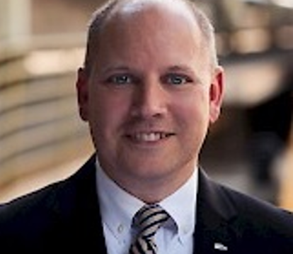
Jim Mathews
President and CEO
Working with Congressional Committees and Administration agencies, Jim led the RPA policy team alongside Policy VP Sean Jeans-Gail which helped to shape the Investing in Infrastructure and Jobs Act (IIJA), making substantial contributions to the Rail Title of the Act.

Slide 23
A REMINDER OF WHERE WE WERE
Truly Historic U.S. Passenger Rail Funding:
The Prior Five Years Versus The Present Five Years
Notes:
Just compare the levels of funding for passenger trains from the prior five years under the FAST Act, to the next five years under the IIJA.

Slide 24
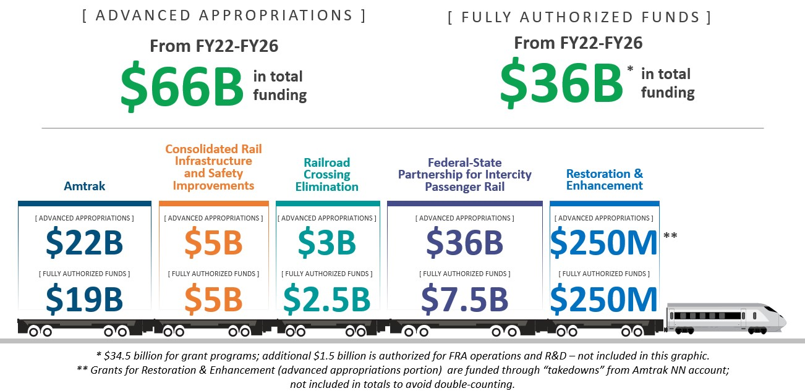
[Image via the White House]
Notes:
Rail money from the IIJA is already being put to work today, investing nearly $52 billion across 594 projects that will improve rail safety and expand passenger rail travel in 48 states. in direct response to a Congressional mandate to administer an influx of new rail funding—$66 billion in advanced appropriations for discretionary rail grant programs, with another $13 billion in rail funding provided through the annual Congressional appropriations process (Fiscal Year 2024 - 2025).
In 2021, Congress passed the Infrastructure Investment and Jobs Act (IIJA), sometimes referred to as the Bipartisan Infrastructure Law (BIL), which provided a historic level of federal investment in passenger and freight railroads. This funding is greater than all 50+ years of federal funding provided to Amtrak since our creation.
This is a once-in-a-generation opportunity for Amtrak and passenger rail to play a central role in improving how people move and securing our economic future. This historic legislation provides $66 billion for rail, including:
$22 billion directly to Amtrak over five years to repair or replace aging assets, modernize our fleet, improve station accessibility, and other capital projects and purposes defined under the law.
$16 billion for the National Network
$6 billion for the Northeast Corridor
$44 billion for Federal Railroad Administration (FRA) discretionary grants to support various improvements to passenger and freight railroads.
$36 billion for the FRA Federal-State Partnership grant program including $24 billion for Northeast Corridor bridges, tunnels, capital renewal, station, and other improvements, and $12 billion for corridor development and other improvements that are not on the NEC.
$5 billion for the FRA Consolidated Rail Infrastructure and Safety Improvements (CRISI) program, available to advance a broad array of improvements to freight and passenger rail.
$3 billion for the FRA Railroad Crossing Elimination program to support state and local governments to make grade separations and other related safety improvements.
To date, out of the $44 billion allocated to the FRA’s discretionary grant programs, $10.3 billion has been awarded to Amtrak. This funding supports projects such as the Frederick Douglass Tunnel, East River Tunnel, Susquehanna River Bridge, Gulf Coast Corridor Improvement and Chicago Union Station projects. $16.1 billion has been awarded to various other applicants, including Amtrak partners.

Slide 25
PROSPERITY ENGINES
IIJA/Bipartisan Infrastructure Law:
Investing in American Manufacturing and Jobs
● An investment of $1 billion in public transportation supports and creates 49,700 jobs (APTA)
● A 2024 report by the North Carolina Department of Transportation’s Rail Division found the state’s rail system contributes over $20 billion into the state’s economy and supports 88,000 jobs (NCDOT)
● $75.8 billion in total contribution to U.S. GDP by the railway supply industry in 2020 (RSI)
● 682,426 jobs in the U.S. supported by the rail supply industry in 2020 (RSI)
Notes:
:

Slide 26
PROSPERITY ENGINES
Attracting Private Capital And Growth:
Private Sector Gains From The IIJA
At a recent industry roundtable, Amtrak convened private-sector partners representing construction, manufacturing, and engineering—leaders working together to rebuild America’s railroad. With these investments:
• Over 100,000 American workers are engaged in rail infrastructure projects
• Bridges and tunnels dating back to the early 1900s are being replaced with modern, efficient structures
• 99% of procurements in FY24 were domestically sourced, strengthening American manufacturing
• New trainsets, locomotives, and long-distance railcars from facilities across dozens of states are entering service to meet record ridership demand
The impact of these projects is undeniable: They expand access, create jobs, and position passenger rail as a cornerstone of a world-class transportation network. The work being done today will shape the future of mobility for decades to come.
Notes:
Investing in the Future of Rail
Amtrak is delivering a new era of rail. We’re modernizing our fleet, bridges and tunnels, stations, and other infrastructure, while redefining the customer experience for the modern era. This investment is made possible through a combination of federal programs, including those funded by the Infrastructure Investment and Jobs Act, as well as Amtrak’s annual grants, state and local partnerships, and customer revenue.
Seizing the moment: Amtrak’s new era of rail is replacing, upgrading, and repairing iconic century-old bridges, tunnels, stations, and other critical infrastructure assets.
These structures date back to at least the early 1900s and were designed, built or opened primarily during the Presidencies of William McKinley, Theodore Roosevelt, and William Howard Taft.
Amtrak is also replacing a majority of its train fleet, which serves 500+ communities in 46 states and today averages nearly 40 years old, with some equipment dating back to Amtrak’s creation in 1971.
Collectively, these transformative projects are creating the largest boom in rail construction in company history, putting hundreds of thousands of skilled Americans to work and jump-starting American manufacturing like never before in company history.
As Amtrak ramps up its capital program, the company has continued its commitment to buy American products, with 99% of procurements domestically based in Fiscal Year 2024.
Amtrak is making progress on huge projects across multiple portfolios, thanks to strong partnerships with the private sector:
Introducing new state-of-the-art trains across the country, including 111 modern trainsets and 125 high-powered locomotives in production, as well as an upcoming contract award to replace hundreds of Long Distance railcars;
Building new bridges and tunnels that will remove major bottlenecks, including breaking ground on a megaproject to replace the 151-year-old B&P Tunnel, which opened when America’s 18th President, Ulysses S. Grant, was in office; and
Advancing the company’s biggest-ever station improvement program, improving accessibility at 380+ stations across the National Network, as well as restoring several major stations to their original glory.
In addition to major, once-in-a-generation projects, Amtrak is also conducting important annual renewal work through its state-of-good repair program, which maintains tracks, signals, power, and other important rail systems.

Slide 27
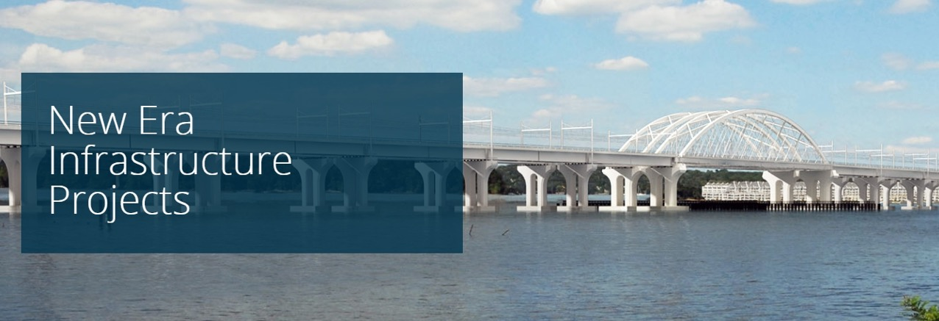
With record ridership and growing demand for passenger rail, Amtrak is working to replace and upgrade bridges, tunnels, tracks and electric systems across the country.
Notes:
Amtrak’s New Era of Rail
Amtrak, which was our government-supported rail operator before the pandemic has become a construction company responsible for managing tens of billions of dollars for building bridges, tunnels, stations, and more – with all the overhead in project-management staff and capital delivery that this entails. Construction contractors, engineering firms, and rail suppliers are laying track, boring tunnels, and building bridges, stringing catenrary like never before in our history.
Seizing the moment: Amtrak’s new era of rail is replacing, upgrading, and repairing iconic century-old bridges, tunnels, stations, and other critical infrastructure assets.
Amtrak is delivering a new era of rail. We’re modernizing our fleet, bridges and tunnels, stations, and other infrastructure, while redefining the customer experience for the modern era. This investment is made possible through a combination of federal programs, including those funded by the Infrastructure Investment and Jobs Act, as well as Amtrak’s annual grants, state and local partnerships, and customer revenue.
Collectively, these transformative projects are creating the largest boom in rail construction in company history, putting hundreds of thousands of skilled Americans to work and jump-starting American manufacturing like never before in company history
As Amtrak ramps up its capital program, the company has continued its commitment to buy American products, with 99% of procurements domestically based in Fiscal Year 2024.
Amtrak is making progress on huge projects across multiple portfolios, thanks to strong partnerships with the private sector:

Slide 28
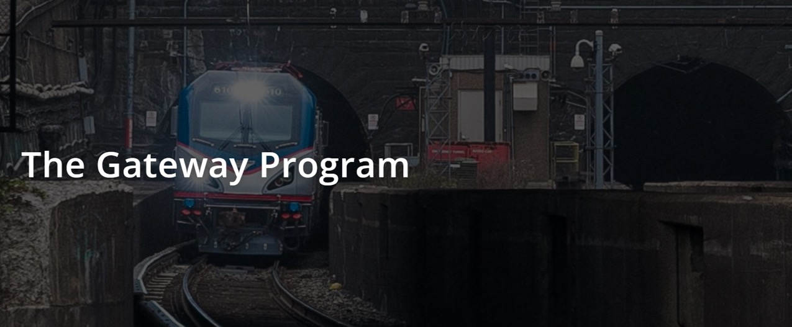
Modernize the most congested 10-mile section of the Northeast Corridor (NEC), Creating the capacity for a doubling of passenger trains under the Hudson River into New York Penn Station — the nation’s busiest rail facility.
Notes:
The Gateway Program will modernize the most congested 10-mile section of the Northeast Corridor (NEC), adding needed resiliency and creating the capacity for a doubling of passenger trains under the Hudson River into New York Penn Station — the nation’s busiest rail facility.
The Gateway Program will create four mainline tracks between Newark, NJ, and New York – Penn Station, where there are currently just two. This section of track serves approximately 200,000 Amtrak NEC, long distance and state supported service and NJ Transit trips on 450 daily trains.
There are 25 projects totaling more than $16.4 billion of federal investment across the NEC.
Two newly constructed two-track fixed bridges will replace the existing two-track moveable bridge, along with overhead power, signal, safety and security system modernization that will improve railroad efficiency on the NEC.

Slide 29
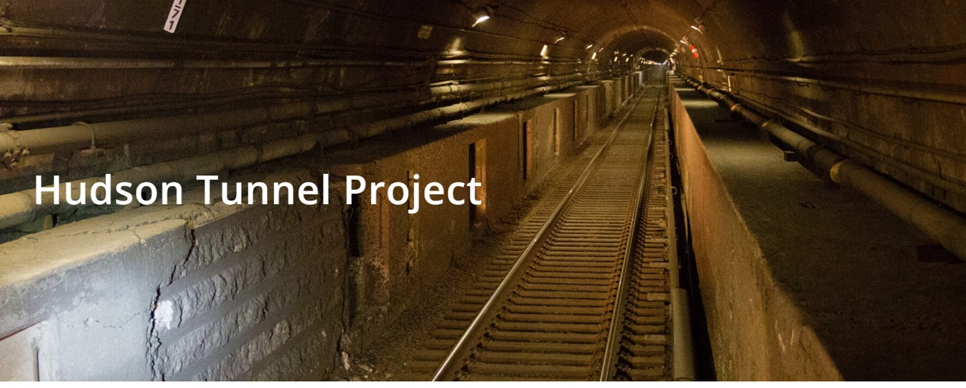
Construct a new, two-track Hudson River rail tunnel serving New York Penn Station
Repair the existing Superstorm Sandy-damaged North River Tunnel (NRT)
Notes:
The HTP will improve reliability, resiliency, and redundancy in this critical section of Amtrak’s Northeast Corridor (NEC). At present, approximately 450 Amtrak and NJ TRANSIT trains pass through the NRT on a typical weekday, servicing nearly 200,000 daily passenger trips across the Hudson River. With such a high volume of rail traffic, the operational flexibility the HTP will provide is crucial not only to rail service, but also to the mobility and economic vitality of both the region and the nation as a whole.
The NRT was built by the Pennsylvania Railroad and completed in 1910. The tunnel consists of two, single-track, electrified tubes, which serve as the only passenger rail connections between Manhattan and New Jersey and the rest of the NEC. In October 2012, the tunnel was inundated with millions of gallons of salt water during Superstorm Sandy, leaving behind corrosive chemicals which continue to degrade the concrete tunnel liner, bench walls, and other systems that support Amtrak and NJ TRANSIT train operations.
Pictured here:

Slide 30
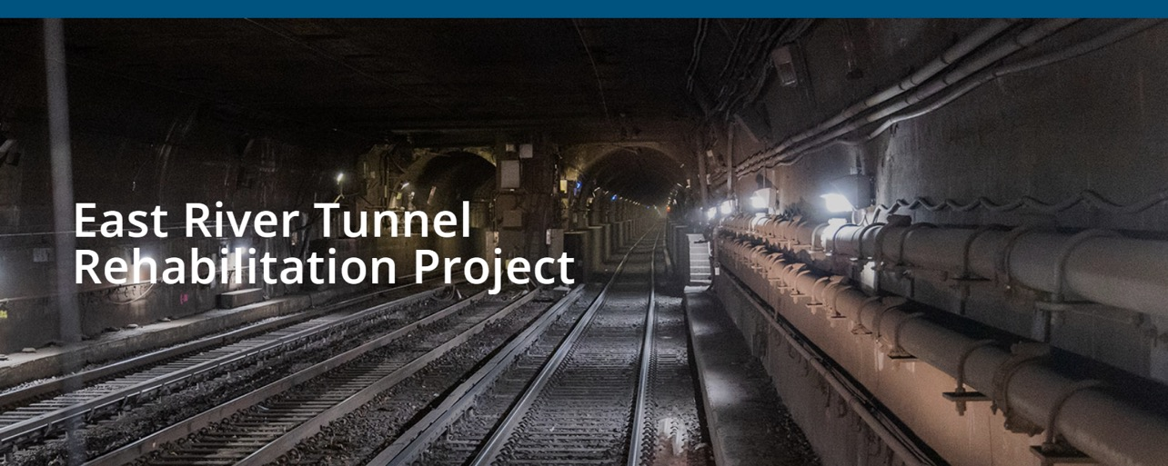
The East River Tunnel (ERT) consists of four tubes connecting New York City to destinations east, and is used by Amtrak, Long Island Rail Road (LIRR), and NJ TRANSIT trains.
Notes:
The tubes, which opened in 1910, require significant upgrades and comprehensive rehabilitation to modernize critical NEC infrastructure and improve reliability for a new era of rail. The ERT Rehabilitation Project will restore the two tubes that were damaged by Superstorm Sandy.
The work will modernize the tunnel infrastructure, improving safety, reliability, and security and bring the systems to a state of good repair. The project will involve demolishing the existing tunnel systems down to concrete liners, followed by reconstructing and modernizing all tunnel systems.

Slide 31
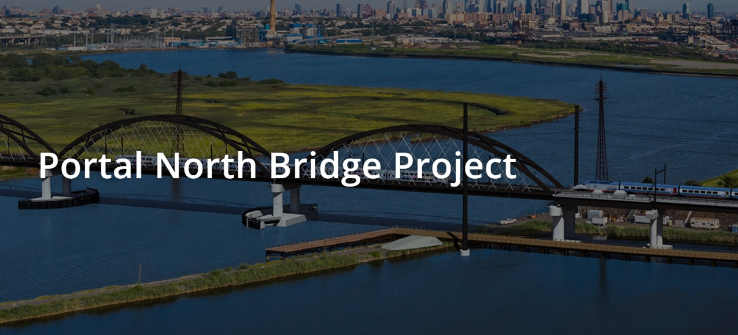
Replacing the 114-year-old Portal Bridge over the Hackensack River in Kearney, New Jersey with a taller bridge that will not have to open and close for river traffic.
Notes:
Portal North Bridge
NJ TRANSIT and Amtrak are replacing the 114-year-old Portal Bridge over the Hackensack River in Kearney, New Jersey with a taller bridge that will not have to open and close for river traffic.
The two-track, moveable span is a major bottleneck and source of delay, particularly when the aging bridge malfunctions during opening and closing for maritime traffic.
A two-track replacement bridge – Portal North – will replace this outdated relic with a modern, high-level fixed span that does not open or close, eliminating the movable components and risk of malfunction. The new bridge will rise more than 50-feet over the river and, including the approaches, span nearly 2.5 miles of the Northeast Corridor. Portal North Bridge is an important element of the broader Gateway Program to double rail capacity between Newark and New York.
Amtrak and NJ Transit continue to advance project construction and achieved approximately 75% completion in Fall 2024.

Slide 32
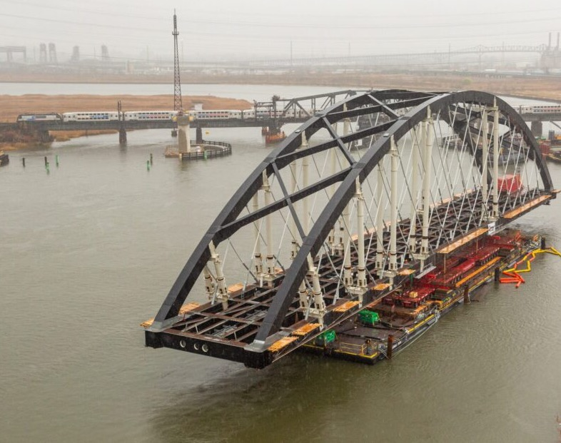
Portal North Bridge
Photo during construction.
Project about 75% complete.

Slide 33
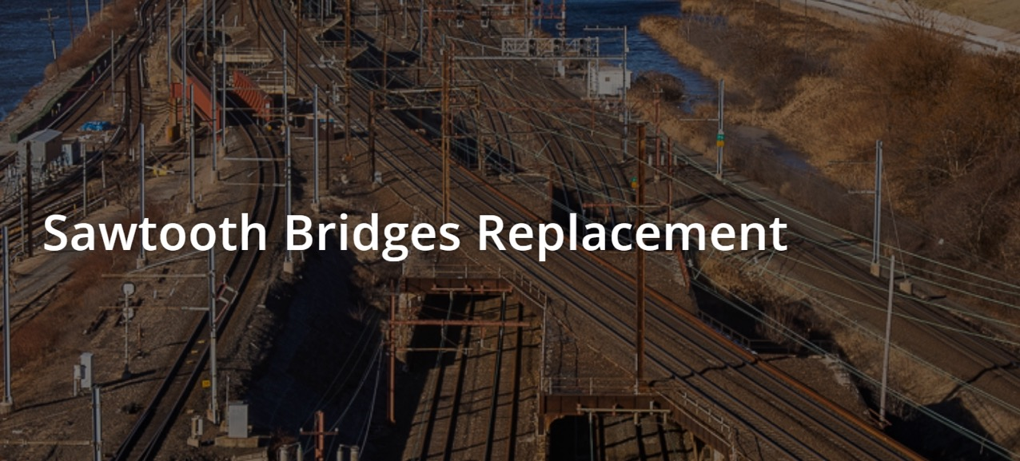
The Sawtooth Bridges, originally built in 1907, are located in Kearny, New Jersey between Newark Penn Station and Secaucus Junction and include an approximately 1.9-mile-long segment of right-of-way along Amtrak’s Northeast Corridor (NEC).
Notes:
The Sawtooth Bridges Replacement Project, a key element of the Gateway Program, will construct three new bridges:
Bridge #1, which will be built to realign NJ TRANSIT’s M&E Track 5 further north allowing construction of Bridge #2.
Bridge #2 will be built adjacent to the existing Sawtooth bridges for two additional NEC tracks.
Bridge #3 will replace the existing structures and carry the two existing NEC tracks.
By replacing the existing Sawtooth Bridges and introducing two additional tracks to this critical section of the NEC, the project will provide continuous, safe, reliable and resilient rail connectivity. The project will reduce service disruptions and restore maximum authorized speed to 90 mph. This improvement will not only enhance on-time performance but also elevate the overall customer experience. The project will help in increasing capacity along the NEC to meet current and future demand.

Slide 34
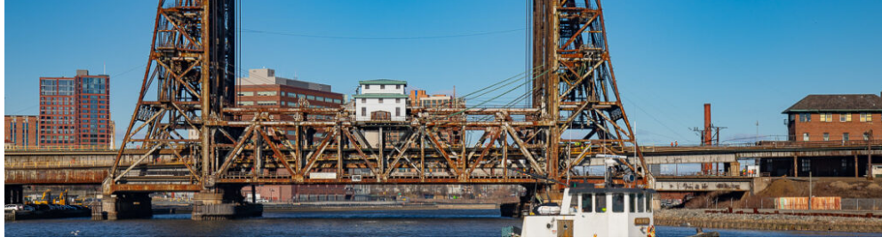
Dock Bridge Rehabilitation
Opened in 1935, Dock Bridge is a six-track, triple-span moveable lift bridge located along one of the busiest sections of the Northeast Corridor.
Notes:
Dock Bridge
Restoring Dock Bridge will address corrosion and maintain reliable operation for the safe passage of the hundreds of trains that cross the bridge daily.
The presentation at my first WARES meeting was about corrosion.
The bridge carries 720 daily Amtrak, Port-Authority Trans-Hudson (PATH), and New Jersey Transit (NJ TRANSIT) trains between Newark and Manhattan. As owner of the bridge, Amtrak is working with its partners to advance the Dock Bridge Rehabilitation Project as part of the larger Gateway Program, a series of infrastructure projects that will improve the overall efficiency, capacity and resiliency of the Northeast Corridor (NEC) — the busiest passenger rail route in the United States.
A major focus of the project is steel cleaning and painting to address corrosion across all segments of the bridge, including the installation of containment systems surrounding the steel to allow for collection and proper disposal of hazardous debris. With a permit from the U.S. Coast Guard, the project also involves converting the bridge to a fixed span by installing “straight rail” in place of the moveable “miter rails” that disconnect from each other when the bridge opens and reconnects when it closes.
The existing Dock Bridge carries six tracks that are used by Amtrak, PATH and NJ TRANSIT over the Passaic River. It entered revenue service in 1935.
Converting the moveable span to a fixed bridge

Slide 35
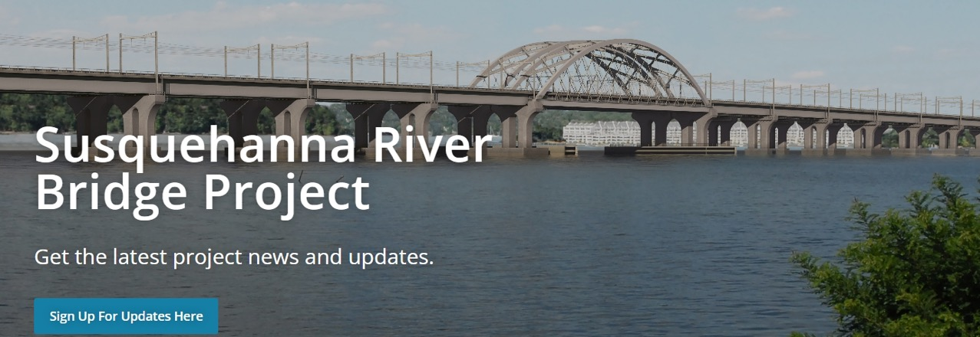
Amtrak’s Susquehanna River Bridge is a two-track, swing-span rail bridge that was built in 1906. This aging bridge is a bottleneck along a critical link of the Northeast Corridor

Slide 36
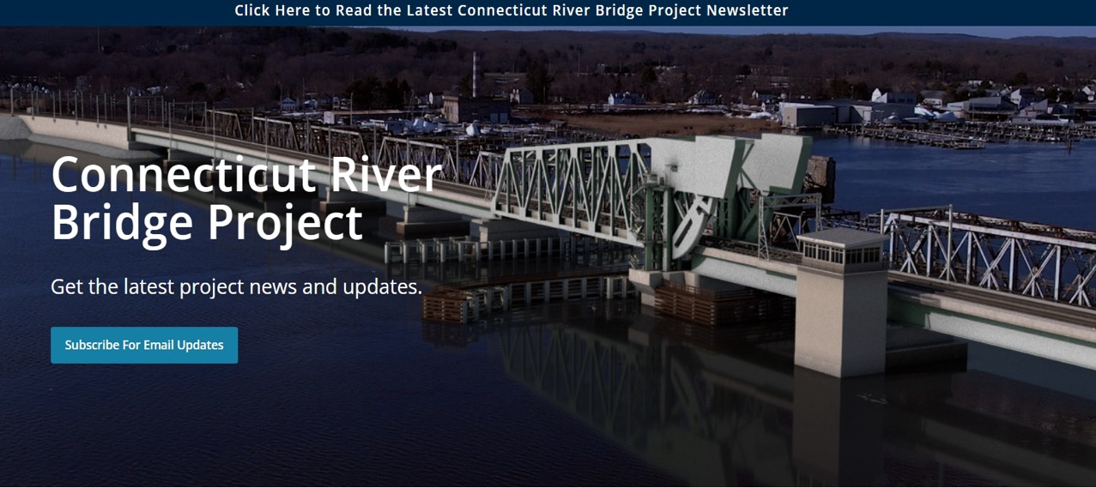
1907 Bridge will be reconstructed with two electrified tracks and be moveable
Notes:
The Connecticut River Bridge, originally constructed in 1907, is located on the Northeast Corridor (NEC) between the towns of Old Saybrook and Old Lyme and is used by Amtrak, CTRail’s Shore Line East, and freight trains. The upcoming Connecticut River Bridge project entails constructing a two-track, electrified, and movable bridge equipped with new track, signal, catenary, power, communication, controls and security features. This new bridge structure, expected to have a useful life of 100 years, will replace the existing two-track Connecticut River Bridge.
The new bridge will enhance reliability, resiliency and reduce delays for all users of the bridge. It is designed to support a maximum operating speed of 70 mph, a 55% increase from the current maximum speed of 45 mph. Maritime navigation and safety will also improve due to the increased vertical clearance compared to the existing bridge.

Slide 37
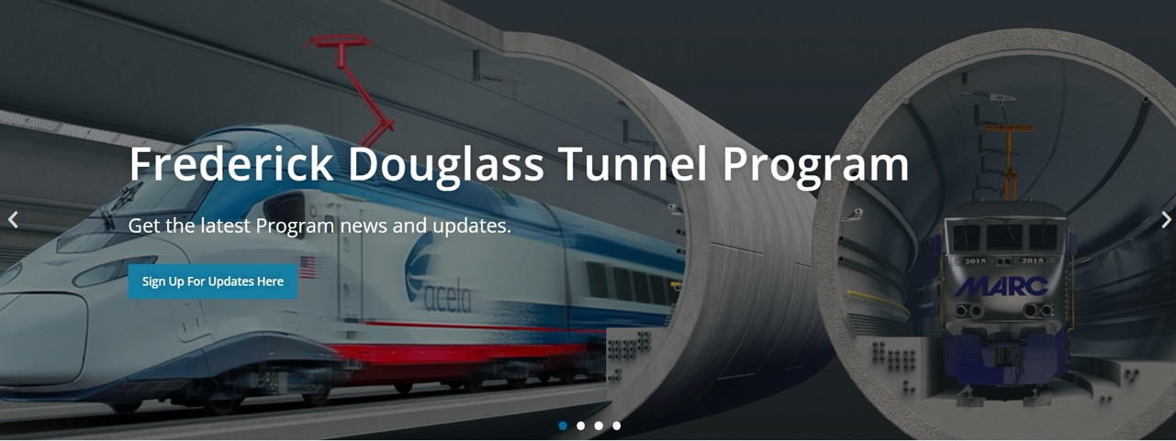
More than 150-years old, the B&P Tunnel dates from the Civil War era. It is also the largest bottleneck on the Northeast Corridor (NEC) between Washington, D.C. and New Jersey.
Notes:
Building new bridges and tunnels that will remove major bottlenecks, including breaking ground on a megaproject to replace the 151-year-old B&P Tunnel, which opened when America’s 18th President, Ulysses S. Grant, was in office; and
The Baltimore & Potomac (B&P) Tunnel is the oldest Amtrak tunnel and a single point of failure for the 14 million MARC and Amtrak customers who rely on it. This 1.4-mile tunnel, connecting Baltimore’s Penn Station to Washington D.C. and Virginia, suffers from a variety of age-related issues such as excessive water infiltration, a deteriorating structure, and a sinking floor. The existing tunnel cannot be updated with modern fire and life safety systems and excessive costly maintenance is required. The tunnel is at capacity, and its tight curvature requires trains to reduce speeds to 30 mph. These issues create chronic delays — more than 10% of weekday trains are delayed, and delays occur on 99% of weekdays. Without replacement, these issues will persist and the risk to travel along America’s busiest passenger rail corridor will continue to grow.
Amtrak’s Frederick Douglass Tunnel Program will resolve these challenges, unlocking this major NEC bottleneck, enhancing connectivity in the Baltimore-Washington region, and creating tens of thousands of jobs throughout construction.
Early construction activities are now underway for a series of investments that will upgrade and modernize this 10-mile section of the NEC, including a new, modern tunnel to replace the B&P Tunnel. The new 2-mile Frederick Douglass Tunnel will serve electrified passenger trains and support travel speeds up to 100 mph, more than three times faster than today.
The centerpiece of the FDT Program is a new tunnel named in honor of Maryland native, abolitionist, and civil rights leader Frederick Douglass.
Stay up to date on important news during Frederick Douglass Tunnel construction.
Amtrak's Community Investment Program
We are committed to investing $50M in the West Baltimore community.
Investments will be made through community grants and direct investments, with projects covering six categories:

Slide 38
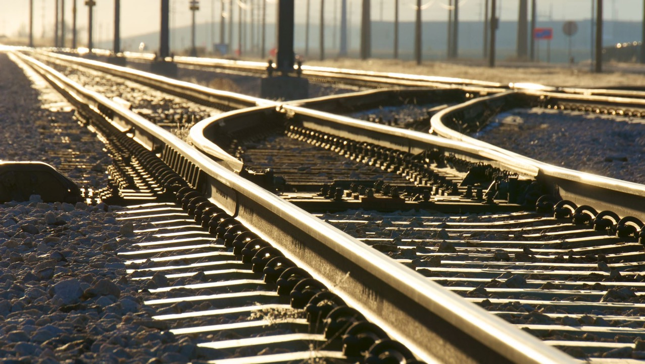
NEW ERA Of RAIL: STATIONS
Notes:
Advancing the company’s biggest-ever station improvement program, improving accessibility at 380+ stations across the National Network, as well as restoring several major stations to their original glory.

Slide 39
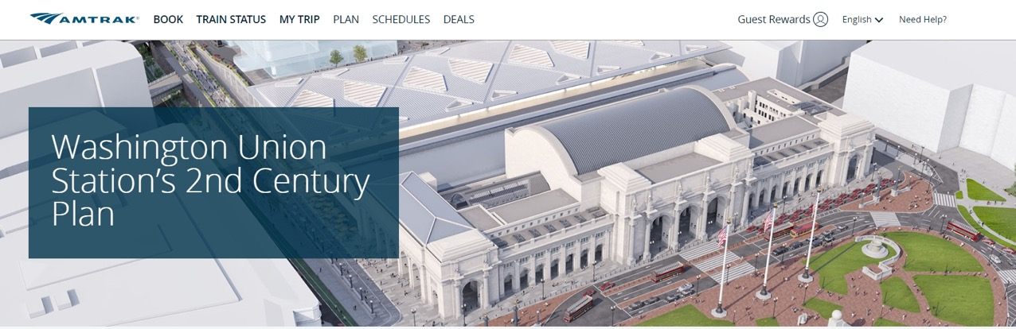
Washington Union Station's 2nd Century plan is a comprehensive improvement initiative comprised of multiple projects that seek to triple passenger capacity and double train capacity by modernizing and expanding station facilities over the next 20 years.
Notes:
The 2nd Century plan is informed by the 2012 Master Plan which set a vision for both near- and long-term growth goals for the station. As many as 37 million passengers, tourists, and shoppers pass through this station every year — making it the third most visited tourist destination in the world. With its success has come challenges as the station has reached its capacity at peak travel times, resulting in long departing queues, overcrowding and visible passenger frustration. In addition, the station’s platforms do not meet modern designs standards.
To address these issues, the project seeks to expand and modernize the multimodal transportation facilities at Washington Union Station by incorporating:
Re-built and expanded Claytor Concourse
Additional passenger concourses
Additional points of access and egress to and from platforms
Wider platforms
Longer tracks for double-berthing of trains
New entrances and exit points to surrounding street network
Better integrated multi-modal facilities
Improved ADA access
These improvements are an attempt to address the expected increase in rail traffic throughout the northeast due to future expansion and growth through 2040. Unlocking capacity constraints at Union Station is critical to operations along the Northeast Corridor as it is the busiest station for MARC commuter service and Metro riders and the second busiest for Amtrak, and VRE.
The 2nd Century plan accommodates a new transit-oriented urban neighborhood known as the Burnham Place project. This three million square-foot mixed-use development over the existing rail yard will be developed by Akridge. The development will be a vital economic driver for the DC region as it will reconnect the urban fabric of the station’s adjacent neighborhoods including NoMa, Capitol Hill and the H Street Corridor. Burnham Place will feature retail, hotel, office and residential space — all interspersed with open public spaces.
In addition to these two projects, design and construction are underway to deliver several critical, near-term improvements to the passenger experience and rail facility. These improvement projects are advancing simultaneously with ongoing environmental review and long-range planning studies. The Federal Railroad Administration (FRA) is currently leading an Environmental Impact Statement that will ultimately lead to a record of decision on a preferred alternative.

Slide 40
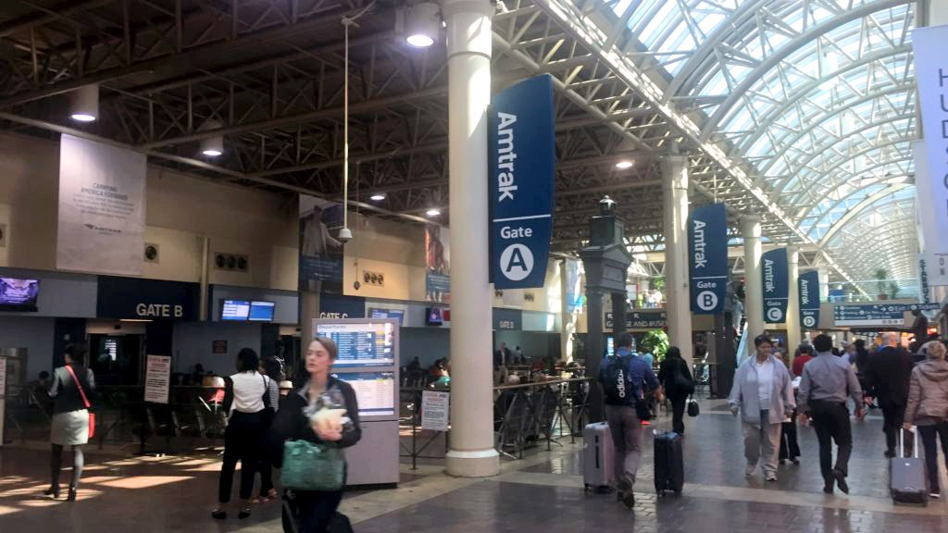
Notes:
Partners
Amtrak
Union Station Redevelopment Corporation (USRC)
Maryland Transit Administration (MTA)
Virginia Railway Express (VRE)
Washington Metropolitan Area Transit Authority (WMATA)
District of Columbia Department of Transportation (DDOT)
Federal Railroad Administration (FRA)
Akridge

Slide 41
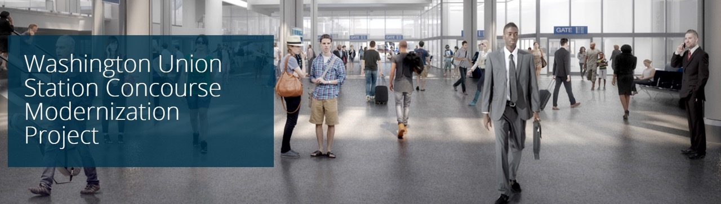
Amtrak’s second busiest train station, capacity at the Washington Union Station concourse will double by 2026.
Notes:
While Union Station has served the region well for over a cen­tury, it is now operating beyond its capacity, particularly during rush hours and peak travel times. Over 37 million people pass through Washington - Union Station each year, making it one of the busiest intercity and commuter rail stations for Amtrak, MARC and VRE commuter service and Metrorail service. Ridership has soared, resulting in long and crowded queues of de­parting passengers that routinely impede the public concourse, blocking flows and diminishing a fluid travel experience.
The Claytor Concourse, Union Station’s intercity and commuter concourse, will be modernized and reconfigured to alleviate congested conditions, doubling its present capacity. The Concourse Expansion Program will enhance passenger comfort and accessibility, while enlivening the space with new architectural finishes and natural light. In addition to the expansion of the concourse, improvements by WMATA for a new Metrorail staircase and new First Street entrance will bring a consolidated set of passenger improvements to the western portion of the concourse.
The planned improvements will complement the introduction of the NextGen Acela fleet which is accompanied by more frequent service. The Concourse Modernization Project advances in parallel to other 2nd Century Plan projects including the Federal Railroad Administration’s Environmental Impact Statement (EIS) for the Washington Union Station Expansion Project, a comprehensive expansion and redevelopment of the station complex.
Virginia Railway Express (VRE)
Partners
Amtrak
Union Station Redevelopment Corporation (USRC)
Maryland Transit Administration (MTA)
Washington Metropolitan Area Transit Authority (WMATA)
District of Columbia Department of Transportation (DDOT)
Federal Railroad Administration (FRA)
Akridge

Slide 42
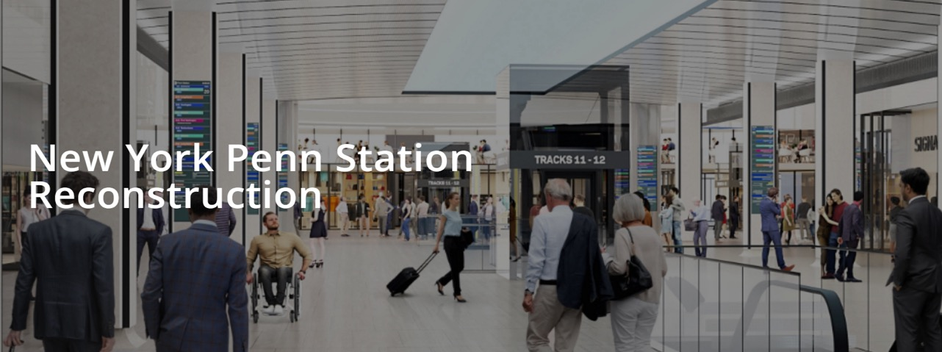
Amtrak, MTA, and NJ TRANSIT are jointly advancing the Penn Station Reconstruction Project, with the purpose of improving safety, railroad operations, and the customer experience within the existing facility.
Notes:
Penn Station is overcrowded, outdated, and in need of continued investment to enhance safety and operations and secure Penn Station’s status as a world-class transportation hub.
Greater train capacity at New York Penn Station is needed to accommodate existing and anticipated passenger demand. The Penn Station Capacity Expansion project will boost capacity and expand services for passengers in New York by adding new tracks, platforms, concourses, and amenities. The result will accommodate projected demand and capitalize on the additional capacity enabled by the Gateway Program.
Status: The FRA awarded the project a Federal State Partnership grant in November 2024 to complete planning and engineering.
Key elements of the Penn Station Capacity Expansion Project could include:
Additional tracks and platforms to increase rail capacity and train service;
New concourses, amenities, and services for customers (such as ticketing, waiting areas, restrooms, and retail space);
A new station building over the additional track and platform area to provide a visible civic presence, as well as new entrances and concourses that accommodate passenger flows and connect the entire Penn Station complex;

Slide 43
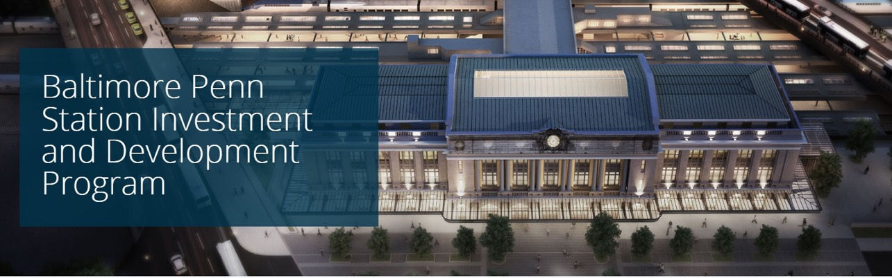
Baltimore Penn Station is a major multimodal transportation hub serv­ing the greater Baltimore region and is a vital link along the busy Northeast Corridor.
Notes:
With its classic Beaux-Arts architecture, the his­toric station was built in 1911 and anchors the Charles North Dis­trict in Baltimore City. As the 8th busiest station in Amtrak’s national system, Penn Station serves Amtrak’s high speed Acela, Northeast Regional and long-distance train services. In addition, the commuter operations of MARC’s Penn Line, the city’s light rail and bus service can all be accessed via the station.

Slide 44
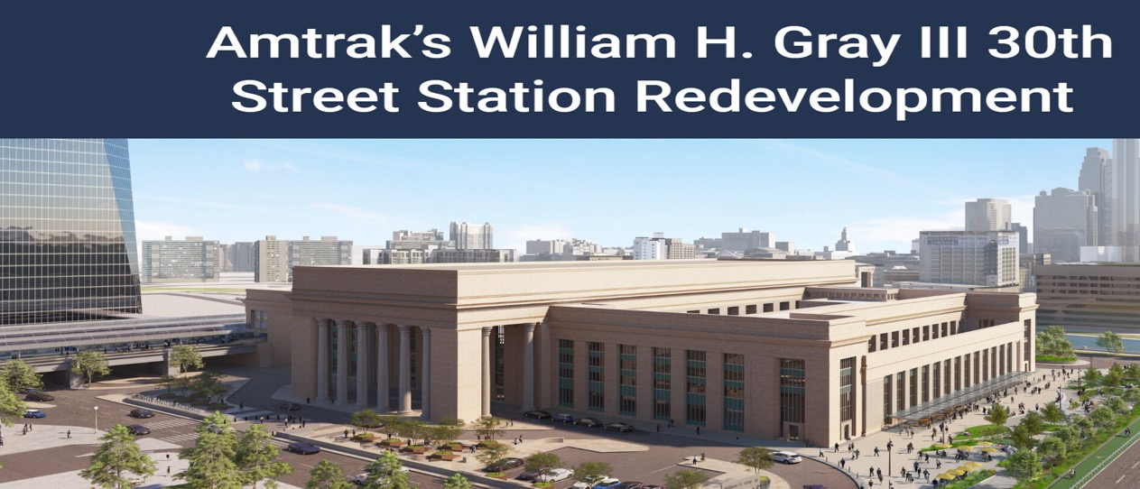
A large-scale restoration and renovation at Philadelphia’S 30th Street Station.
Notes:
The project will enhance the station’s functionality and improve the customer experience for Amtrak, SEPTA and NJ TRANSIT customers.

Slide 45

The Chicago Hub Improvement Program (CHIP) will transform regional and intercity passenger rail in Chicago and the Midwest.
Notes:
Chicago Union Station is the third busiest rail terminal in the United States, serving 120,000 passengers daily. Despite its importance, the station and surrounding rail infrastructure have not kept pace with increasing demand. This has led to significant bottlenecks, delays, and safety concerns that hinder the station and surrounding infrastructure from functioning efficiently and meeting future growth needs.

Slide 46

Chicago Union Station Modernization
Upgrades to the concourse, mezzanine, and entrance pavilions will enhance passenger flow, accessibility, and safety. The project transforms Union Station into a vibrant transportation hub that graciously welcomes travelers, commuters, and residents.

Slide 47

Denver Union Station
Notes:
A case study in transformational investments in historic downtown station. Original 1881 Station now the centerpiece of a new transit-oriented mixed-use development built on the site's former railyards. The historic station house reopened in the summer of 2014, hosting the 112-room Crawford Hotel, restaurants and retailers.

Slide 48

The Virginia-led initiative, called Transforming Rail in Virginia (TRIV), is a $3.7 billion investment to improve passenger, commuter and freight rail in Virginia.
Notes:
Virginia Passenger Rail Authority (VPRA) is acquiring railroad track and right-of-way, and adding significant infrastructure improvements to the northern end of the line, including a new Long Bridge for passenger rail trains over the Potomac. TRIV will add capacity and begin to provide separation between freight and passenger operations, improving the reliability of both. Future phases will enable expanded Amtrak service to Raleigh and Charlotte, NC, which is significantly shorter and faster than Amtrak’s current route to Raleigh. In addition, Amtrak’s partnership with Virginia will more than double Amtrak service in Virginia (with an additional seven round trip trains daily), extend Amtrak service to Christiansburg, VA (in the New River Valley), and enable Amtrak dispatching of the passenger rail tracks between Richmond and Washington as freight-passenger rail separation occurs.
Get more information about Transforming Rail in Virginia
Virginia: A Case Study for A Decade of Growth + Prosperity
By investing in a significant boost to Amtrak service, Virginia has more than doubled its intercity rail ridership
since 2003, removing 600 million vehicle-travel miles from the Commonwealth’s highways:
● $1.4 billion in annual economic returns to Virginia versus $64 million in Federal support.
● Created or sustained 1,400+ jobs each year.
● Ridership in 2023 was a record 1.32 million passengers, a 29.8% year over year increase.

Slide 49


Slide 50


Slide 51


.
Notes:
Amtrak is also replacing a majority of its train fleet, which serves 500+ communities in 46 states and today averages nearly 40 years old, with some equipment dating back to Amtrak’s creation in 1971.

Slide 52


Slide 53

Notes:
Amtrak is also replacing a majority of its train fleet, which serves 500+ communities in 46 states and today averages nearly 40 years old, with some equipment dating back to Amtrak’s creation in 1971
Equipment manufacturers have invested billions of private sector capital to upgrade their U.S. facilities to produce state-of-the-art rail cars.

Slide 54


Slide 55


Slide 56


Refresh and Upgrade the Superliners for LD routes
Notes:
Refresh and Upgrade the Superliners for LD routesAmtrak is modernizing the interiors of over 400 bi-level Superliner cars—with new seating cushions and upholstery, carpet, LED lighting, tables and curtains. The scope of the project includes four Superliner car types: Coaches, Sleeping Cars, Dining Cars and Sightseer Lounges. Amtrak has invested $28 million in this refresh, which extends the useful life of passenger cars that were delivered in the 1980s and 1990s.
As of summer 2023, over 100 Superliner cars have been refreshed and are now in revenue service. More information can be found in the Long Distance Service Improvements fact sheet
Amtrak’s Long Distance fleet procurement is a once-in-a-generation investment, reaffirming a commitment to upgrade and modernize the network. A formal procurement request made at the end of 2023 started the process of reequipping a fleet that provides vital train service from coast to coast with funding provided by the Bipartisan Infrastructure Law. Amtrak has already received more than three dozen of a total of 125 ALC-42 Long Distance locomotives, the most energy-efficient in the industry, aimed to reduce emissions and consume less fuel while reaching a top speed of 125 mph. A $28 million investment is providing upgrades to Superliner and Viewliner cars. The Superliner project will enhance nearly 400 passenger cars, over 200 refreshed bi-level cars.
A newly designed ADA accessible bathroom is being added to 23 Superliner I Coach cars. These new rooms accommodate larger wheelchairs and include a changing room. The first Viewliner II Sleeping Cars were introduced in 2020. They offer improved luggage
Amtrak is accelerating the restoration of fleet in need of repair. Over a dozen Long Distance cars have re-entered service with a total of 63 projected to be restored by the end of 2024

Slide 57

They continue to be the lifeline of passenger rail in America.
Notes:
The Federal Railroad Administration (FRA) is nearing the conclusion of the Congressionally mandated Amtrak Daily Long-Distance Service Study, which will deliver to Congress a series of recommendations for where and how to introduce 15 new daily passenger train service across the nation.
The FRA Long-Distance Route Study is a study conducted by the Federal Railroad Administration (FRA) to evaluate the restoration of daily intercity passenger rail service and the potential for new Amtrak long-distance routes123. The study is required by the Infrastructure Investment and Jobs Act of 202112. The study aims to create a long-term vision for long-distance passenger rail service and identify capital projects and funding needed to implement that vision3.
In the Infrastructure Investment and Jobs Act, Congress directed FRA to consider how to improve access for rural and economically disadvantaged communities to essential services and economic opportunity.
Rail Passengers has literally been in the room and at the table with members of our staff board and Council attending all 18 regional workshops, and we are confident that implementing FRA’s preferred enhanced network would be a huge step forward in creating a more connected America.

Slide 58


Slide 59


Slide 60

THE WAY FORWARD
FRA-Led Long-Distance Study:
Restoring Routes, Growing Service To 45+ Million People
Rail Passengers Association participated heavily in this work
  Study is part of the Jobs Act/Bipartisan Infrastructure Law
Enhanced Network Map would create dramatic growth in service nationwide
  19 million more urban residents, 9 million more rural residents, 2 million more students, 600 more educational institutions, 75 National Parks, 82 additional Medical Centers
Rural and underserved states get particular attention in study’s route designs – two more states, 102 new stations in small communities
43% increase in rural access to long-distance service
22% increase in higher education institutions served
18% increase in access to National Parks
16% increase in access to major medical centers
Sources: Federal Railroad Administration, Rail Passengers Association

Slide 61
THE WAY FORWARD
Recent Wins and Challenges:
Our Strategy And Plans For 2025 And Beyond
Most recently worked extensively with Senatore Markey’s office on Rail Electrification Bill and brought organizations with expertise and advocacy to the table with them.
We were able to get a mostly good new Amtrak Board seated just before the holiday.
We are working to maintain support in Congress by informing new members, reinforcing our existing support.
We are mobilizing our network of passenger rail advocates to engage their representatives.
We generated over 4,000 letters to the White House almost overnight earlier this year.

Slide 62


THE WAY FORWARD
Recent Wins and Challenges:
Our Strategy And Plans For 2025 And Beyond
Project to build station facility for port of Mobile Ala for South Coast Rail Restoration (NOLA to Mobile)
Borealis Second Frequency (Chicago-St. Paul)
Notes:
Gulf Coast Service Restoration: A study done by Transportation for America and the Southern Rail Commission found that restoring
passenger rail between Mobile and New Orleans would produce $216 million in annual economic
benefits for Mississippi, Louisiana and Alabama.
Borealis: A Rail Passengers’ economic analysis found that a second Amtrak train between Chicago and
Minneapolis/St. Paul would generate $47 million in annual benefits to Minnesota, Wisconsin and
Illinois—a return on investment of better than seven-to-one.
● The impact is even greater for smaller communities. In 2018, the Empire Builder carried 2,400
passengers to Cut Bank, Montana (pop. 3,002), bringing $378,725 in value to the community.

Slide 63

THE WAY FORWARD
Recent Wins and Challenges:
Our Strategy And Plans For 2025 And Beyond
Feet on the Ground! Rail Nation: DC Four "waves" of advocates during two full weeks of visits to Capitol Hill!
Main Objectives:
Workshops for intensive preparation
Dozens of visits to Congressional offices from home constituents
Regionally focused messaging for Districts and Congresspersons
Bipartisan / House & Senate
Targeting key leadership and Committee members
Notes:
Feet on the Ground! This year, our Spring RailNation:DC events will expand to include two full weeks of visits to Capitol Hill, and we need you to stand up and be counted! Visits, along with workshops to help you prepare, will take place over a two-week period from March 24th to April 3rd and will be broken into sessions for nine regions around the country.
This is something we do every year. But this year we’re quadrupeling it.
Something we’’ve never experienced before: Constituents are calling their Congessional offices and being told “No. We will not see you.”
Our strategy will have to be ensuring that members of Congress know how much their districts are benefiting from passenger rail generally and from BIL investments specifically.

Slide 64
Congressional Targets
Key Leadership + Committee Members – Northeast + Mid-Atlantic

Slide 65
Congressional Targets
Key Leadership + Committee Members
Senate Committee on Appropriations
House Committee on Appropriations
Senate Committee on Commerce, Science and Transportation
House Committee on Transportation & Infrastructure

Slide 66
Surface Transportation Reauthorization

Slide 67
Sec. 1 - Reauthorize Core Rail Programs
(A) Reauthorize Existing Rail Programs
Amtrak Operations
Federal-State Partnership for Intercity Passenger Rail Program (FSP)
  Stipulate that no more than 40 percent of the FSP funding in any given year may be awarded to projects located on the Northeast Corridor;
  Direct the FRA to publish a full list of grant applicants for each FSP NOFO, along with internal scoring used for determining grant awards; and
  Direct FRA to include FSP applications not awarded funds into its annual CID Project Pipeline.
Consolidated Rail Infrastructure and Safety Improvements (CRISI) Program
Corridor Identification (CID) Program
Restoration and Enhancement (R&E) Grant Program
Railroad Crossing Elimination Grant Program
Next-Generation Equipment Committee
Northeast Corridor Commission (NECC)
State-Amtrak Intercity Passenger Rail Committee (SAIPRC)

Slide 68
Sec. 1 - Reauthorize Core Rail Programs
(B) Extend Funding at Current Levels
(C) Establish a Source of Dedicated Funding or Utilize Advance Appropriations for Discretionary Rail Grants
(D) Formula Distribution of Rail Funds to States
(E) Repeated Rail Planning Cycle

Slide 69
Sec. 2 - Implementing the FRA’s Amtrak Daily Long-Distance Service Study
(A) National Long-Distance Rail Service Commission
(B) Daily Long-Distance Service Study and the Corridor Identification and CID Program
(C) Addressing Complications Arising From The 750-mile Long-Distance Definition

Slide 70
Sec. 3 Planning, Construction, and Procurement Policy Reforms
(A) Streamline Environmental Review, Assessments and Planning
(B) Leverage Flexibility Under Current Law
(C) Standardize Project Elements
(D) Prioritize Expertise Over Lowest Bid
(E) Creation of a National Equipment Pool
(F) Mandate Formalized Cost Transparency

Slide 71


Slide 72
THANK YOU!
Next Meeting:
May 7, 2025
CSXT – Brandon Knapp
If you have any questions about membership or are interested in presenting - please come talk with one of the officers!

Slide 73
The following slides are from our 2024 Scholarship Recipients

Slide 74
Thomas Scanlon
Rail Transportation Engineering Junior
Penn State Altoona
2025 WARES Scholarship Recipient
Notes:
Joined by Mary Ann Amato and Shuai Yu

Slide 75
Thomas Scanlon
Bio
  Year: Junior
  Grew up in Western NY; began attending Penn
  State Altoona in the fall of 2022
Favorite class:
  Railroad Signaling
Most challenging coursework:
  Rail Traffic Controller (RTC)
Current and Upcoming Professional Work:
  Maintenance of Way Intern with Norfolk Southern out of Cresson, PA
  Currently work at the Railroaders Memorial Museum
  in Altoona, PA
    Work alongside volunteers to repair and restore historic railroad equipment, including a steam locomotive that’s over 105 years old
Next steps:
  Continue working for NS after the summer internship (currently leaning toward either the transportation or mechanical departments)

Slide 76
Garret Blum
Rail Transportation Engineering Senior
Penn State Altoona
2025 WARES Scholarship Recipient
Notes:
Joined by Mary Ann Amato and Shuai Yu

Slide 77



Garret Blum
Favorite Class
  RTE 404 Mechanical Practicum
Most Challenging Class
  MATH 251 Differential Equations
Internships
  Burlington Northern Santa Fe Railway
  Wheeling and Lake Erie Railway
  Western Maryland Scenic Railway

Slide 78
Kristen Barna
Civil Engineering Senior
University of Delaware
2025 WARES Scholarship Recipient
Notes:
Joined by Mary Ann Amato and Shuai Yu

Slide 79




Kristen Barna
Civil Engineering – May 2025
Interested in Traffic and Transit
Favorite Classes
  Railroad Derailment & Engineering
  Urban Transportation Planning
Most Challenging Class
  Structural Analysis
Internships
  Colliers Engineering and Design
  Summer ‘24 and Winter ’24/’25
  Responsible for Traffic Impact Studies and Roadway Design/Concepts
  Plan to return full-time after graduation

