Slide 1

Welcome!
January 2025 Meeting
January 21, 2025
Attitude Adjustment Hour
Announcements
Presentation
  Welcome Amtrak & MARC!
    Luigi Rosa
    Sariah Tambre Leigh
    Dean Del Peschio

Slide 2
Announcements
Upcoming Events:
  ***NEW 2025 EVENT SCHEDULE***
    January 21, 2025 (Balt.)
      Amtrak – Frederick Douglass Tunnel
    March 2025 (DC)
      Rail Passenger Assoc. – Expansion of Pass. Rail
    May 2024 (Balt.)
    September 2025 – Golf Outing at Musket Ridge
    November 2025 (DC)
News!
  Exclusive Firm Memberships
    Tiered memberships with great incentives
    Increase networking and marketing exposure
    Support the Scholarship Fund!
  Periodic Newsletter
    Highlighting members, projects, companies, and more
  Become a 2025 sponsor through membership
  Come present to WARES!
    Availability for May and November 2025

Slide 3
A Look Back at 2024
Sponsorship
  Supporting our Rail Engineering Scholarships
  Raised $12,500 in 2024
    Thank you Sponsors!
Scholarship Update
  Rail Engineering Program Scholarships
  $7,500 total per year
  PSU Altoona / U. Delaware
  Congratulations to this year’s recipients!
    Calvin Spector (PSU) – joining us today

Slide 4
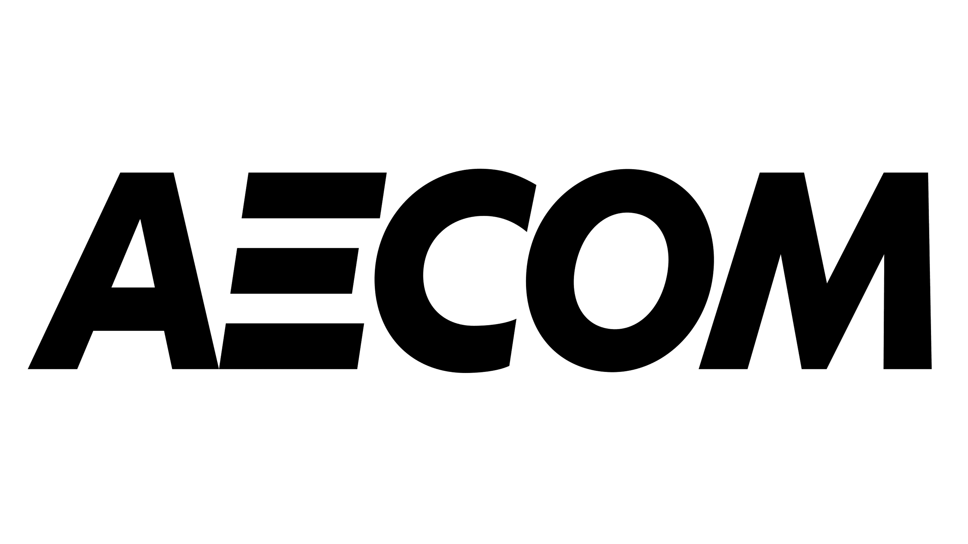
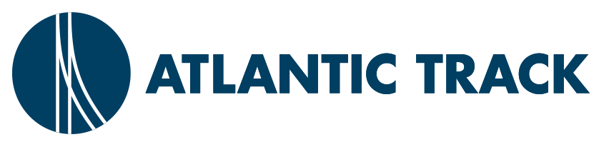
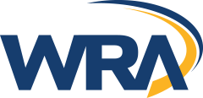
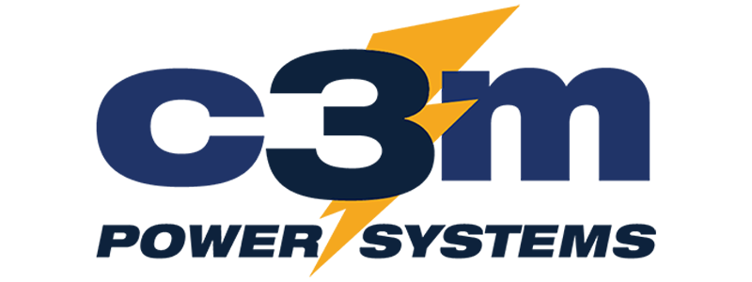
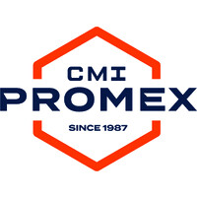
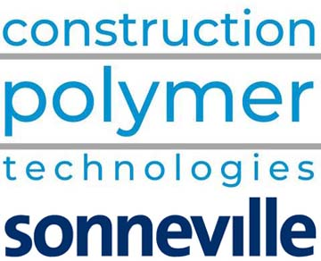



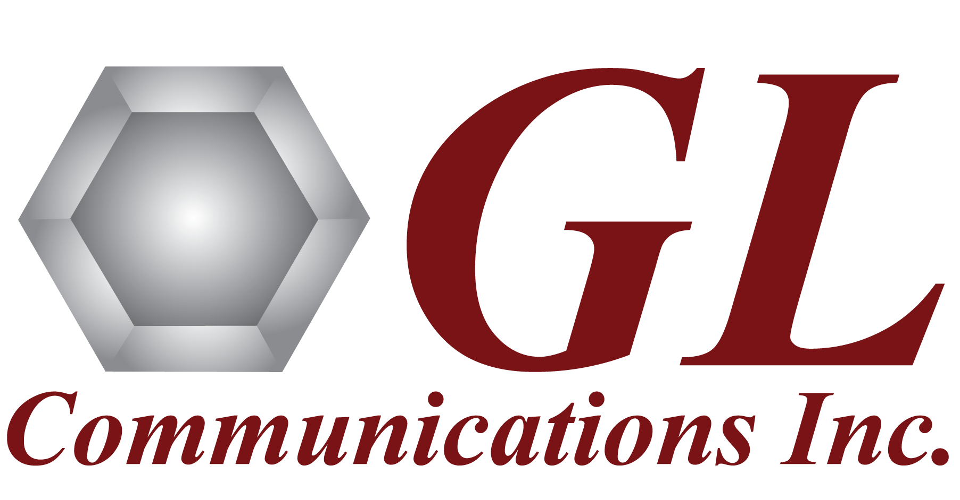

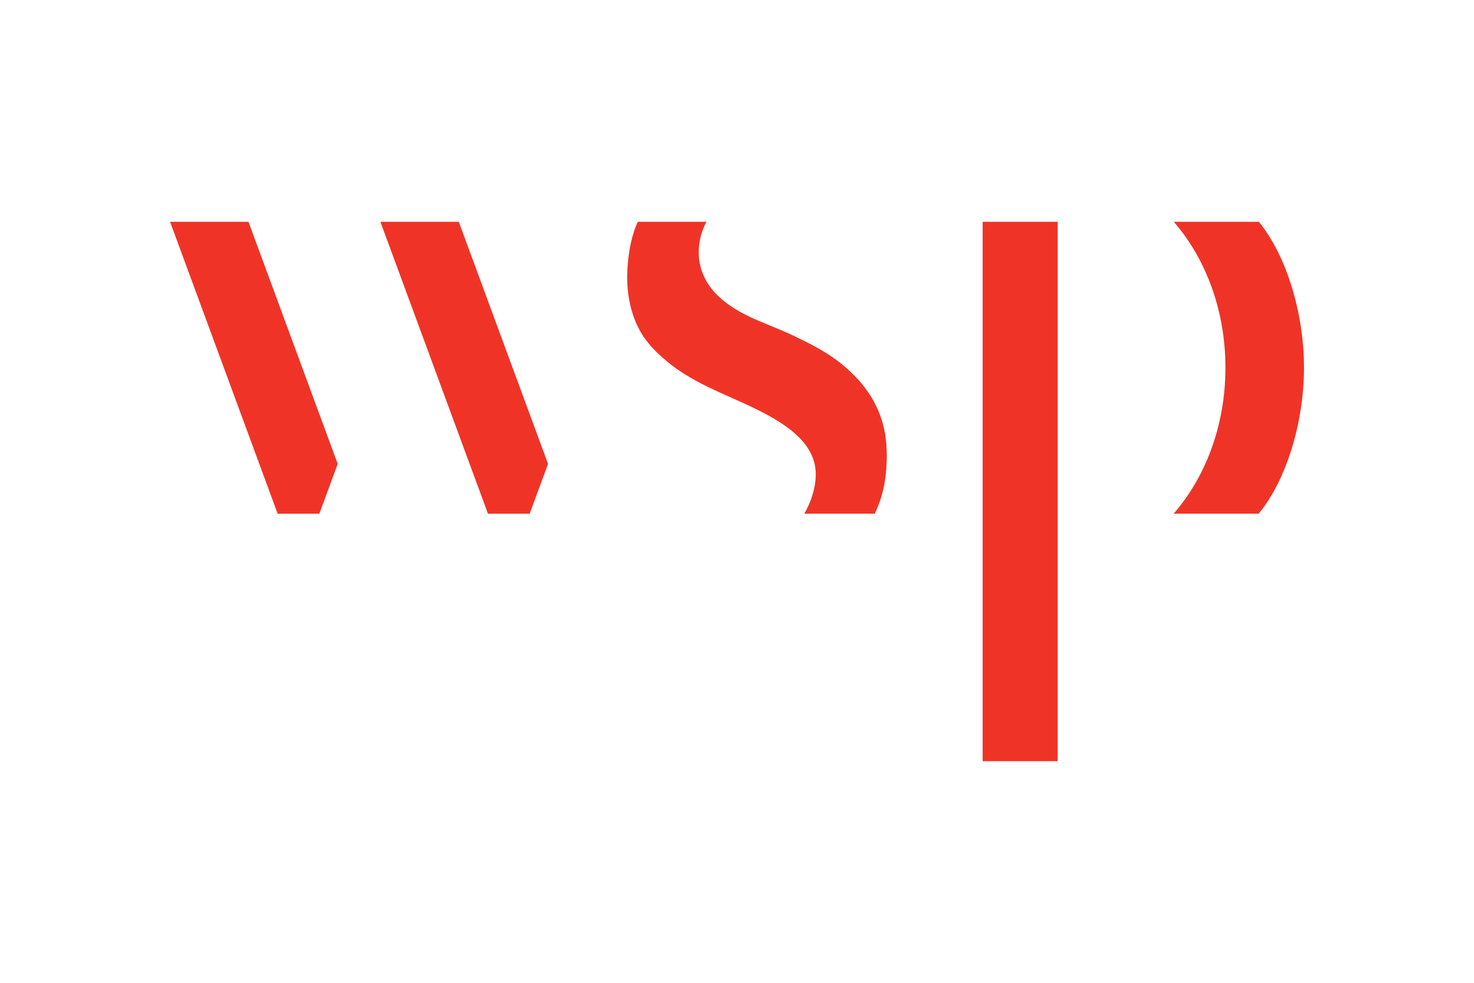
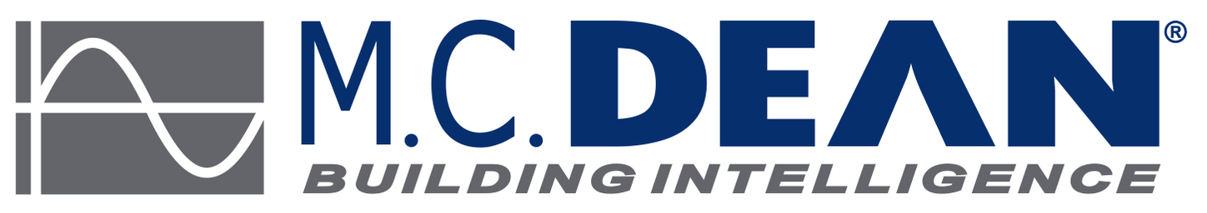
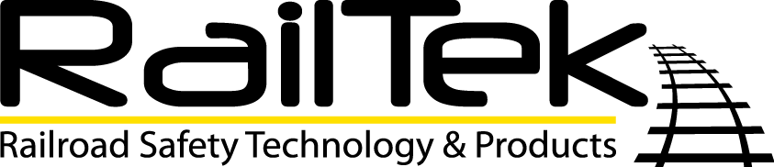

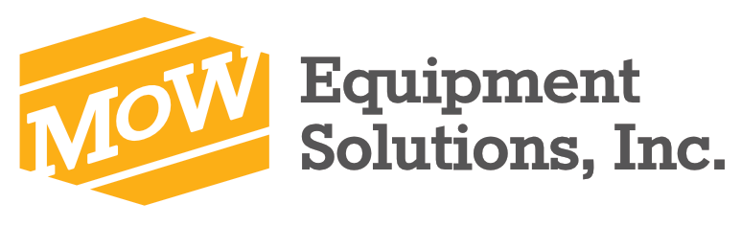
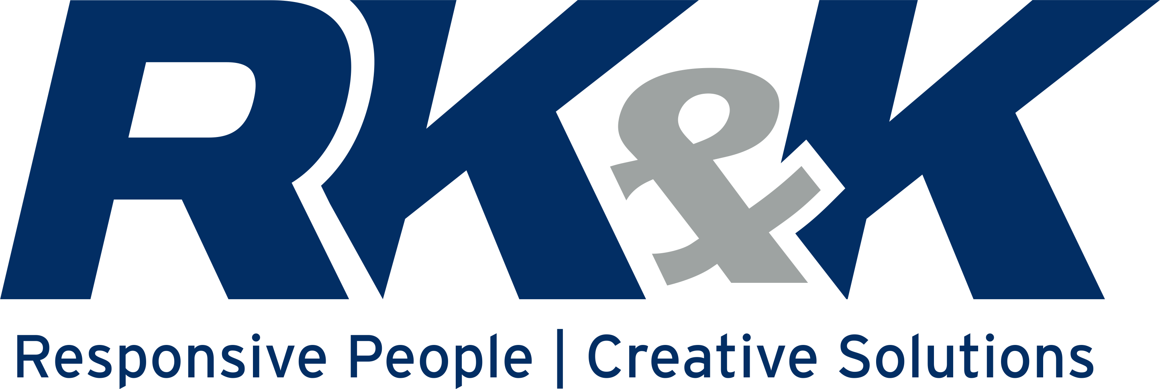


Thank you to our 2024 Sponsors!

Slide 5
Membership
2025 and Beyond
Gold
  $1500 annually
  Includes:
    Sponsorship of WARES for calendar year (2025)
      Goes toward Scholarship funds
    2 passes to each presentation event
      (Jan, Mar, May, Nov)
      Member pricing for additional attendees from sponsoring firm/agency
    Prominent firm/agency logo in newsletter, sponsorship distributions, and at events
    Acknowledgement on WARES website
    Opportunity for Ad/ Project Spotlight space in newsletter
    Option to host an informational table during pre-presentation social hour (*subject to space availability)

Slide 6
Membership
2025 and Beyond
Silver
  $1000 annually
  Includes:
    Sponsorship of WARES for calendar year (2025)
      Goes toward Scholarship funds
    1 pass to each presentation event
      (Jan, Mar, May, Nov)
      Member pricing for additional attendees from sponsoring firm/agency
    Firm/agency logo featured in newsletter, sponsorship distributions, and at events (w/ Silver sponsors)
    Acknowledgement on WARES website with Silver sponsors

Slide 7
Membership
2025 and Beyond
Bronze
  Suggested donation of $500 annually
  Includes:
    Sponsorship of WARES for calendar year (2025)
      Goes toward scholarship funds
    Firm/agency logo featured in newsletter, sponsorship distributions, and at events (w/ Bronze sponsors)
    Acknowledgement on WARES website with Bronze sponsors
Non-Member Attendance
  Option to still purchase single passes to presentation events at full price (pass prices subject to vary based on event venue)
Half-price for all public agency employees

Slide 8
Calvin Spector
Rail Transportation Engineering Senior at Penn State Altoona
2024 WARES Scholarship Recipient
Notes:
Joined by Mary Ann Amato and Shuai Yu

Slide 9
Introduction
Personal Bio
  Born and raised in Southern Rhode Island
  High speed rail peaked my interest as a child
  Attended NRHS Railcamp East in Newark, DE
Penn State Altoona
  Started in 2021
  Graduating in May 2025
  B.S. in Rail Transportation Engineering

Slide 10
Classwork
Rail-Related Courses
  Railroad Track Practicum – Most interesting
  Structures – Most challenging
General Courses
  Fluid Dynamics – Most interesting
  Electricity and Magnetism – Most challenging

Slide 11
Internship
Amtrak
  Hired in May 2023 as a Construction Management Intern.
  Given the opportunity to continue working remote throughout my Junior year.
  Will continue working until graduation.
  Planning to transition to full time within the same group.

Slide 12
Internship Projects
Construction Management
  Daily site visits
  Nightly tracking of overnight track outages
  Monitor site safety for contractor work
  Develop and review Site Specific Safety Work Plans
  Coordinate with Amtrak’s Third-Party Extension of CM Staff
Project Management
  Force account resource demand tracking
  Financial tracking
  Development of force account estimates and estimates to complete.

Slide 13
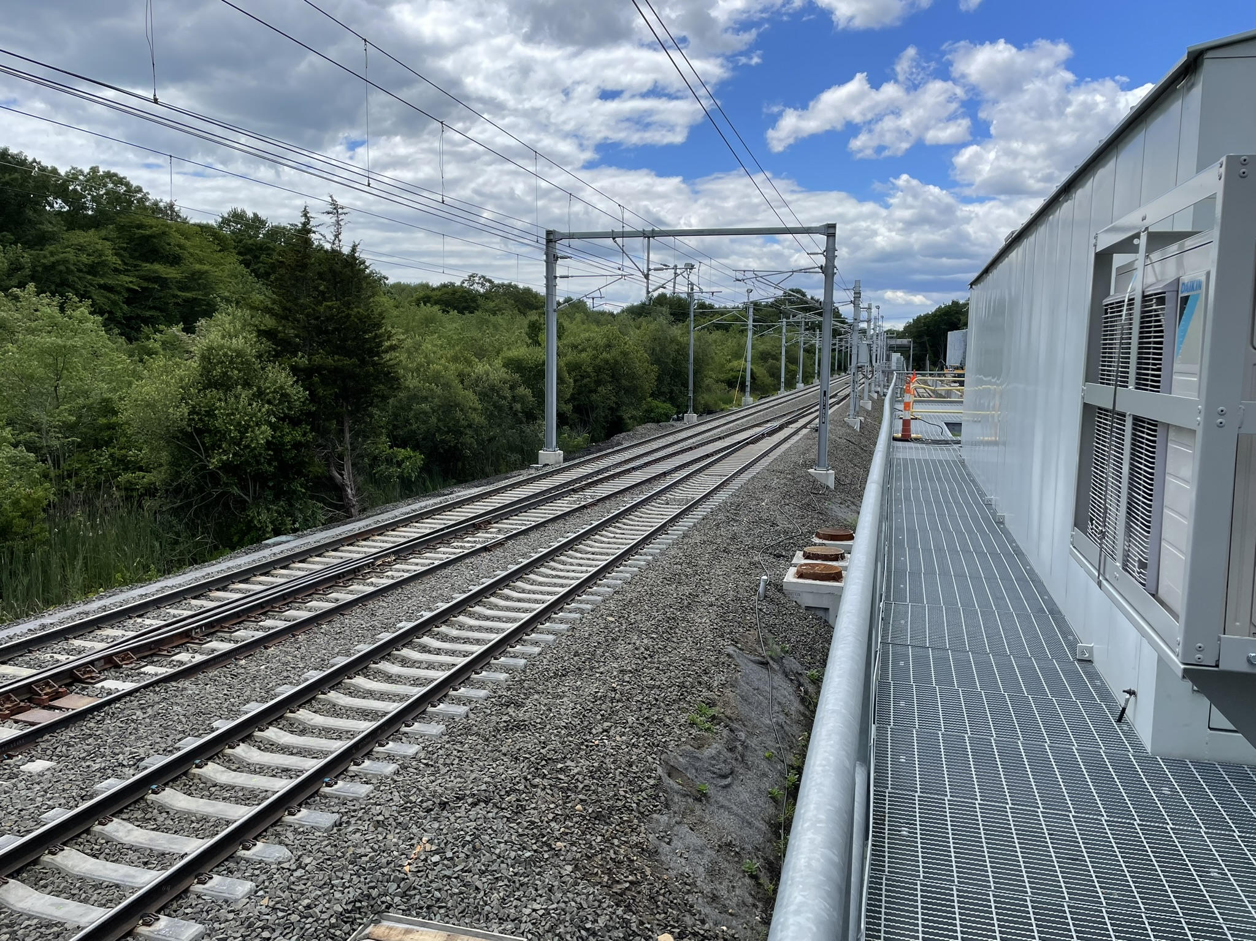
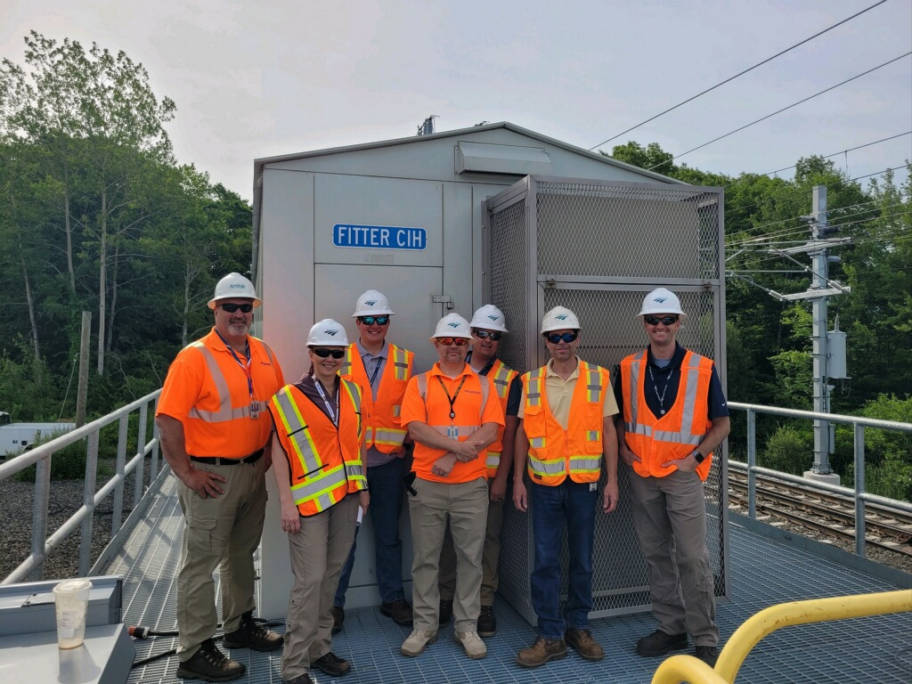
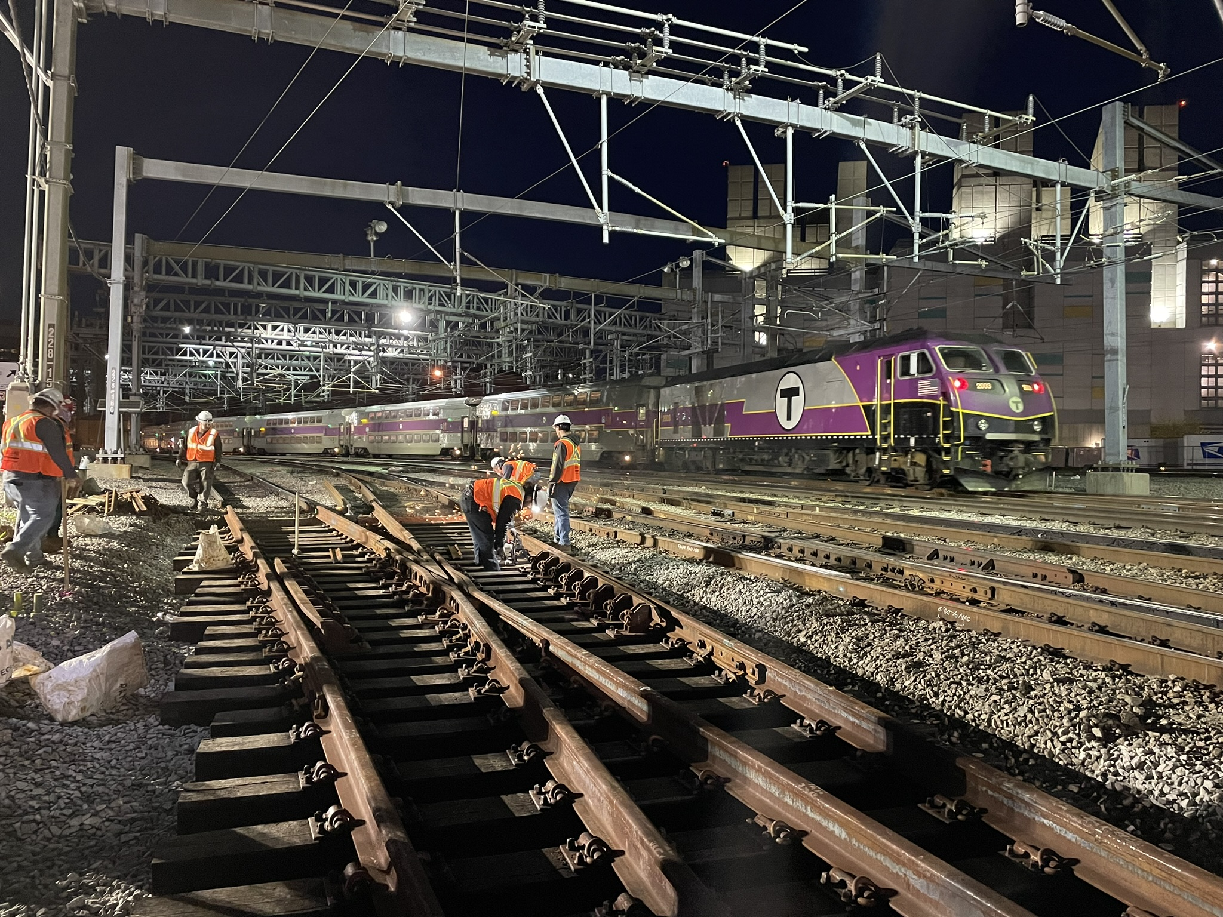
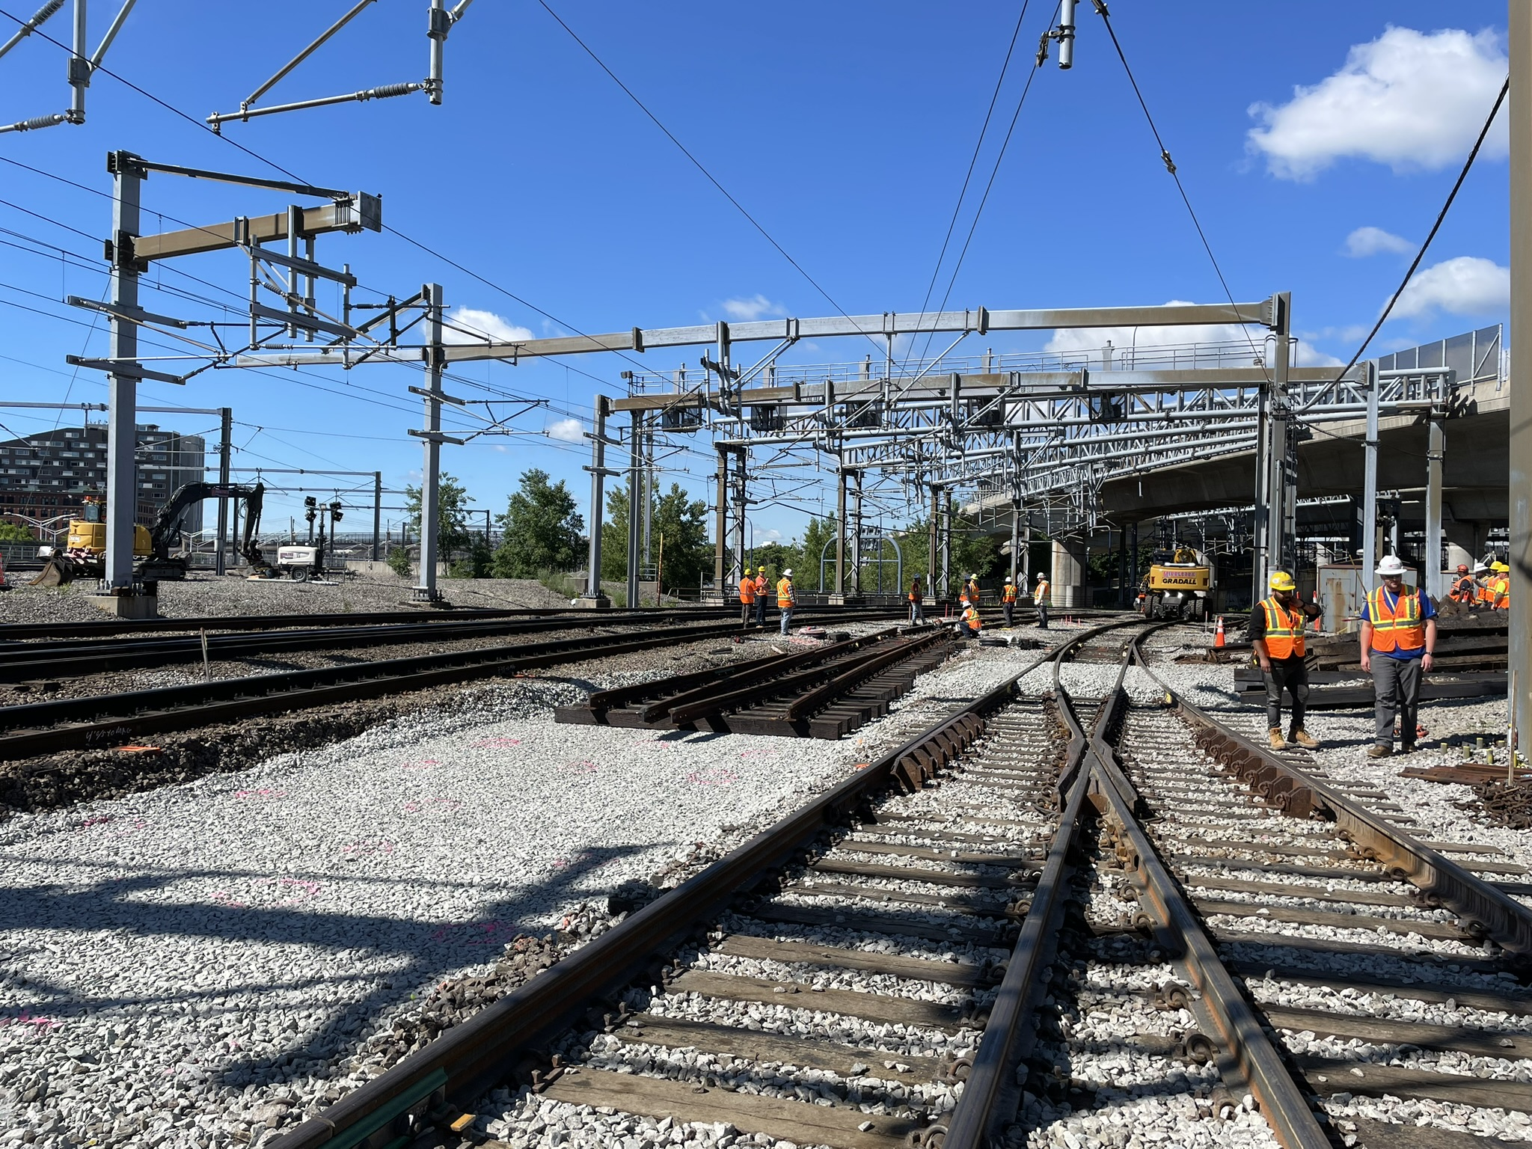
Internship Photos
New “Fitter” Interlocking
“Tower 1” Interlocking Renewal

Slide 14
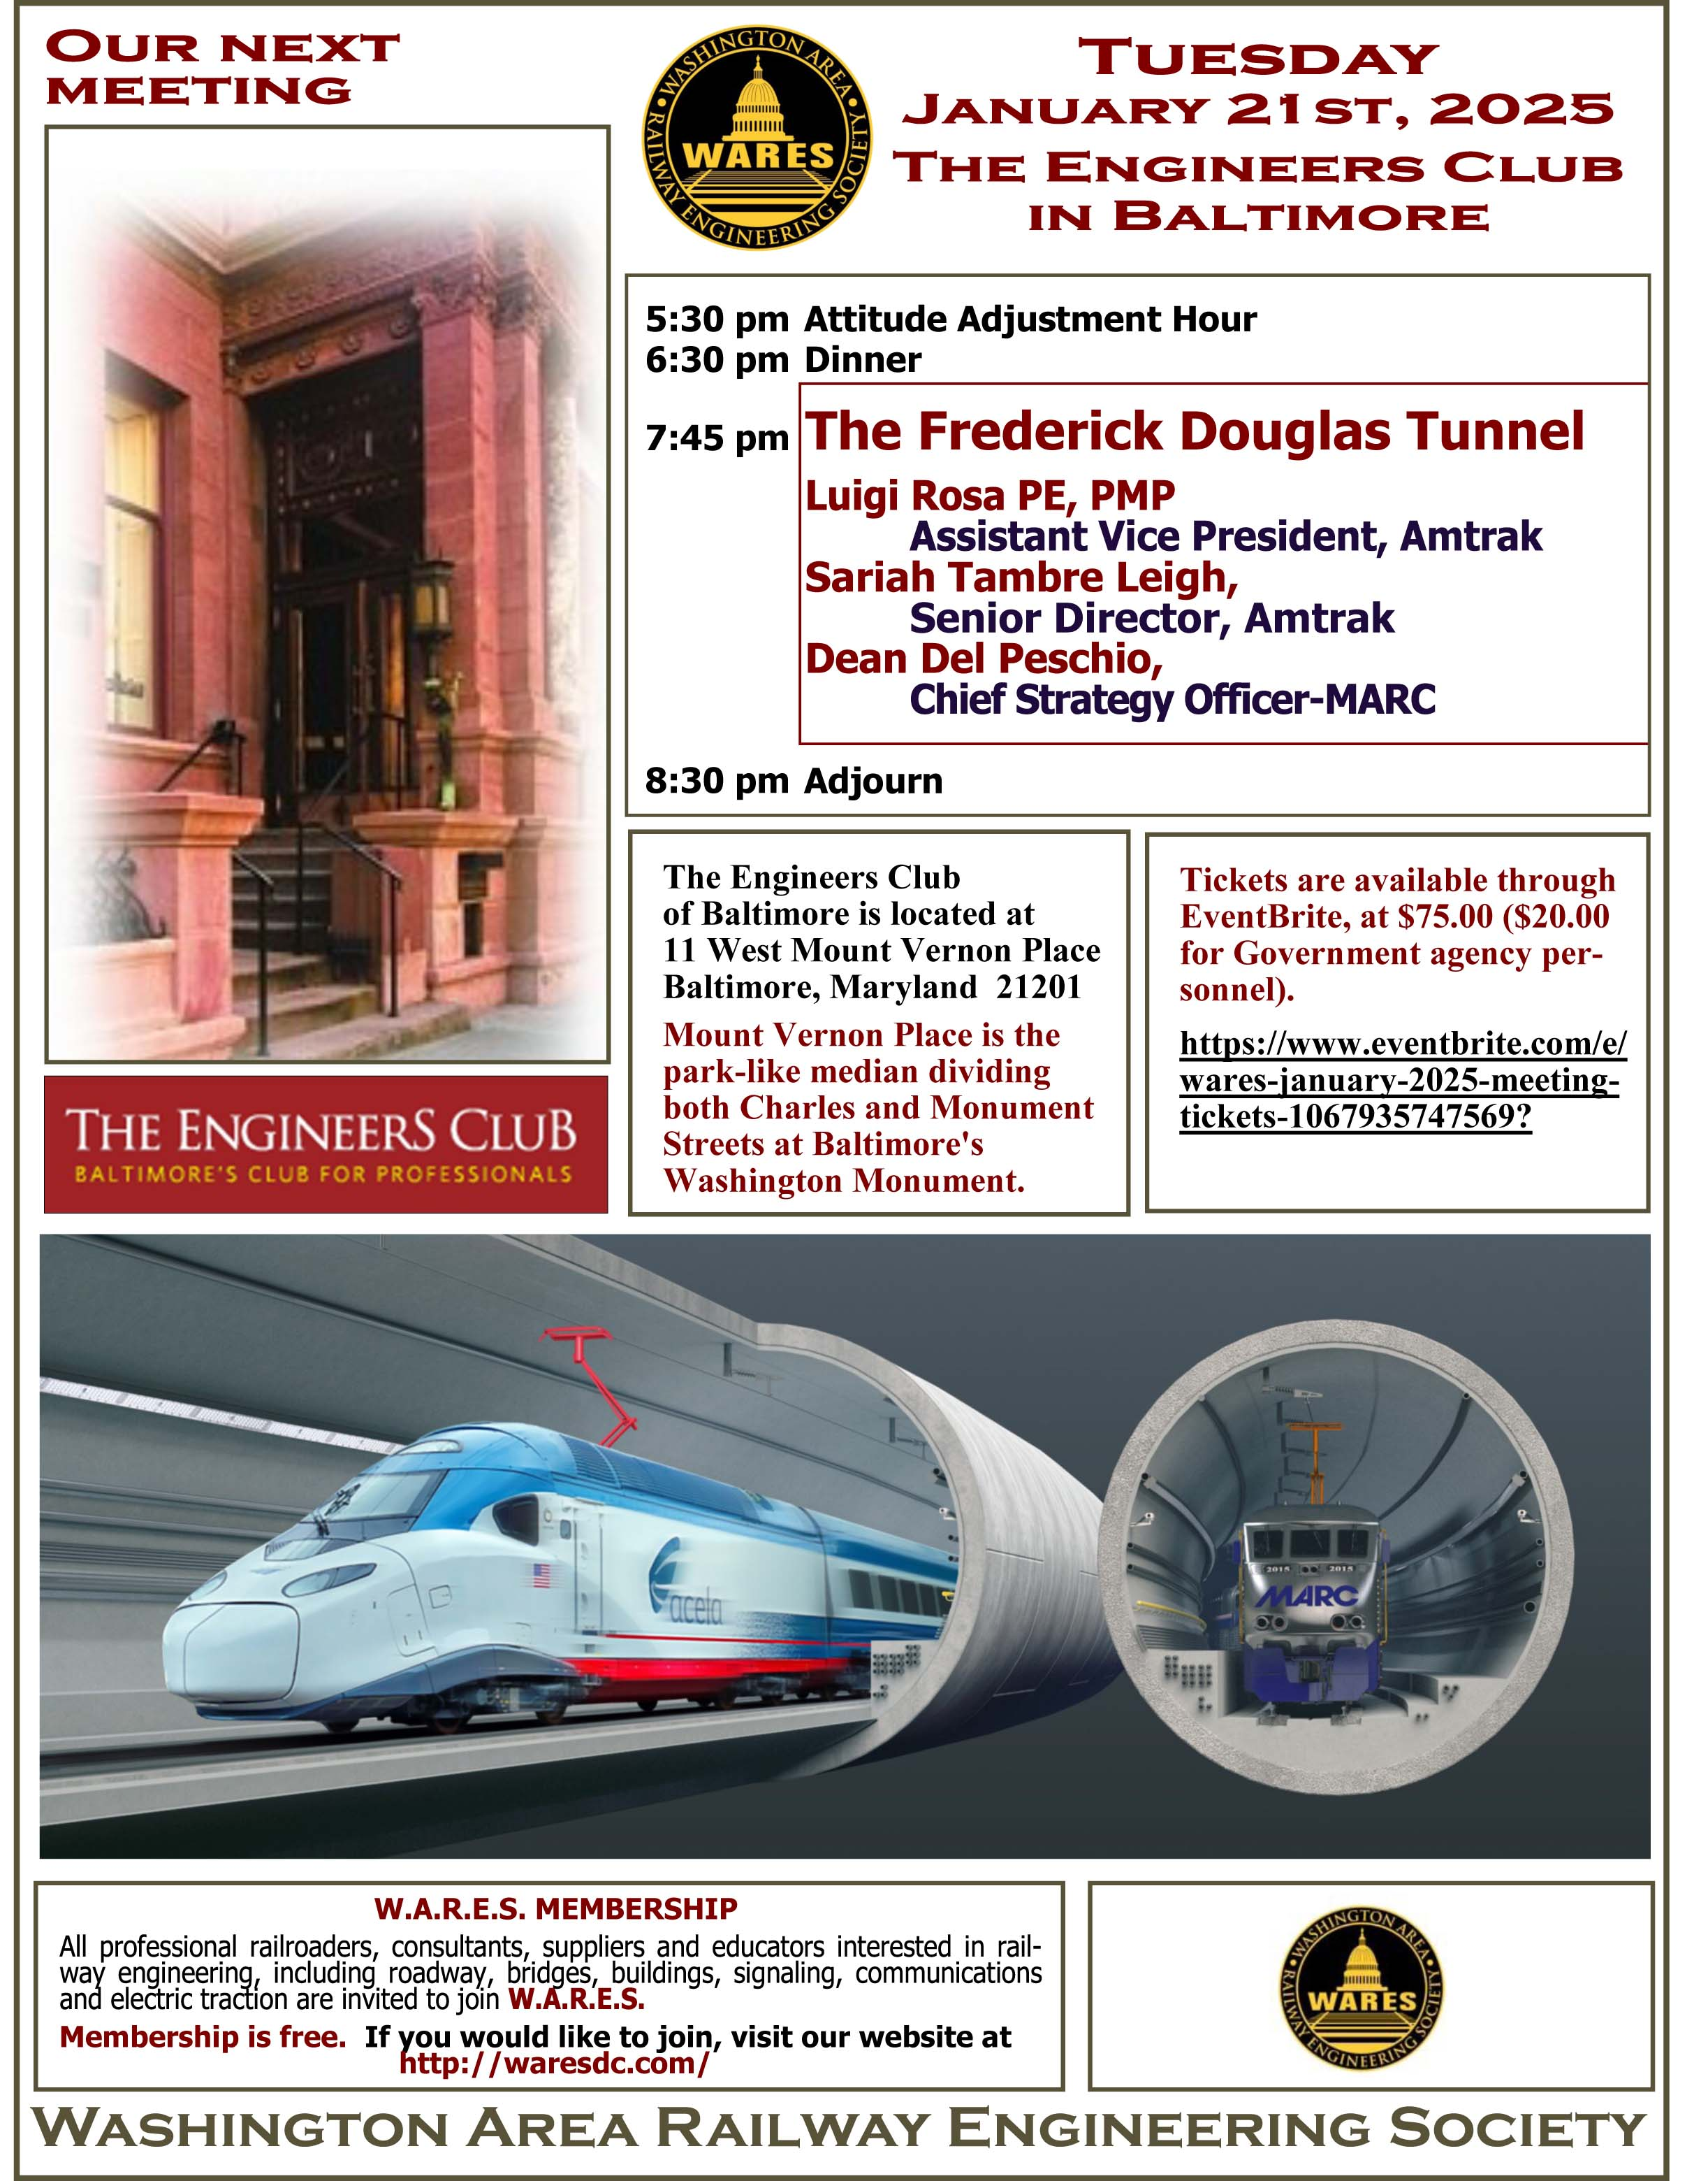
Agenda – Frederick Douglass Tunnel
Luigi Rosa, PE, PMP
    Assistant Vice President, Amtrak
Dean Del Peschio
    Chief Strategy Officer, MARC
Sariah Tambre Leigh
    Senior Director, Amtrak
Presenting on:
    Frederick Douglas Tunnel Program

Slide 15
Amtrak and MDOT MTA
Frederick Douglass Tunnel Program
WARES
January 2025
Connecting More People and Places

Slide 16
Luigi Rosa
Amtrak - AVP FDT Program

Slide 17
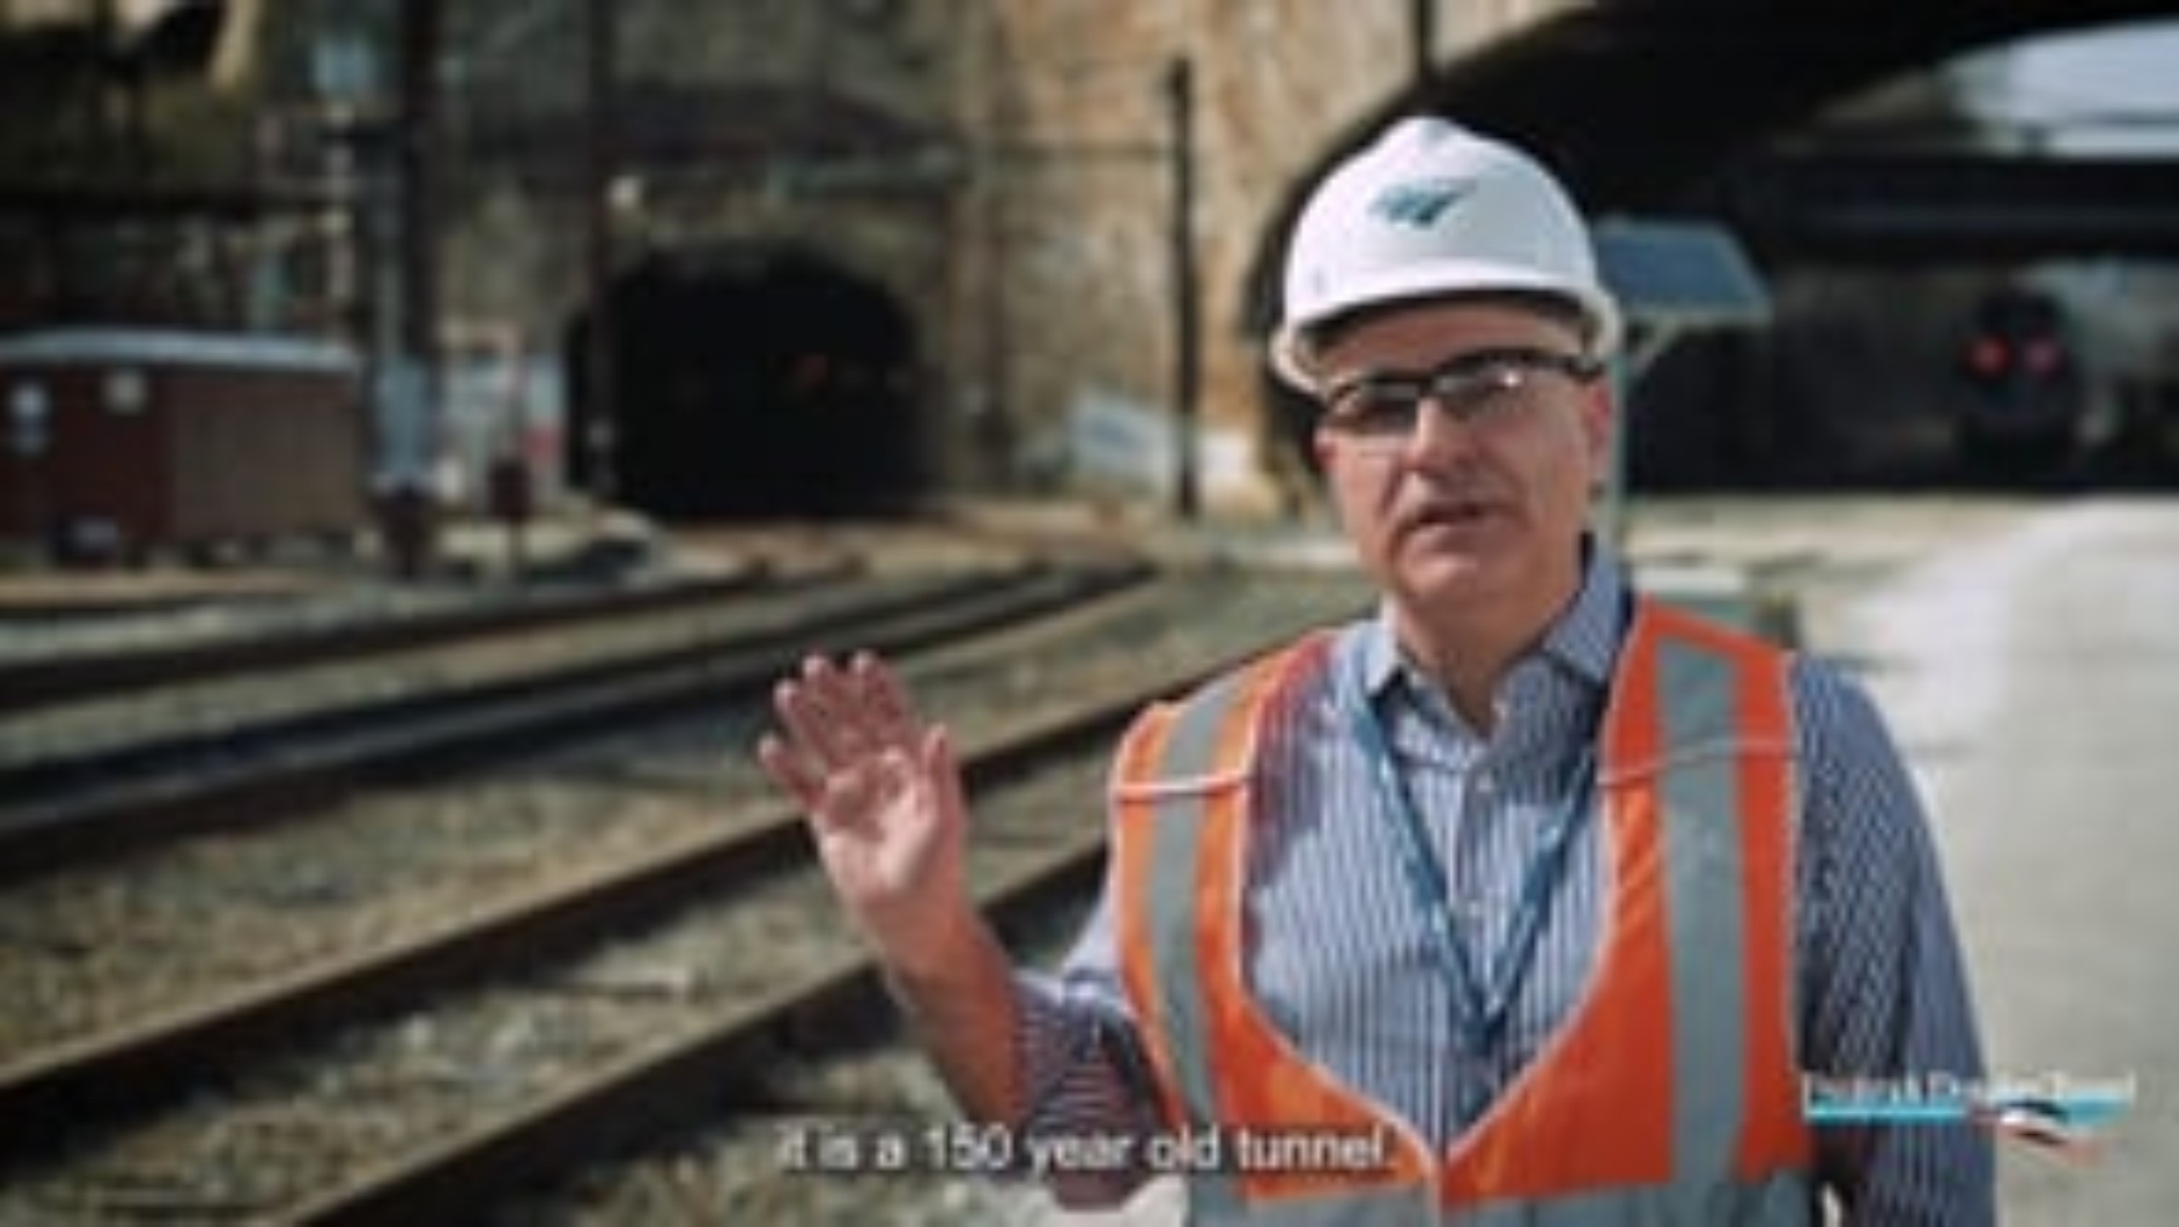
FDT Overview Video

Slide 18
Bold Vision for the Northeast Megalopolis and FDT
Continue to grow and thrive Building a modern, safe, resilient and reliable railroad Improve mobility and connection Create economic opportunity Support desirable and more livable cities and communities Towards a sustainable future increasing America’s ability to compete in the world | Attract new talent, resources and tourists Replacing aging infrastructures (1873), addressing a huge backlog of SOGR projects Regional connectivity (Amtrak/MARC/Bus) Baltimore Workforce Hub and Community Investment Program TOD, private support Equity, sustainability, access to opportunities

Slide 19
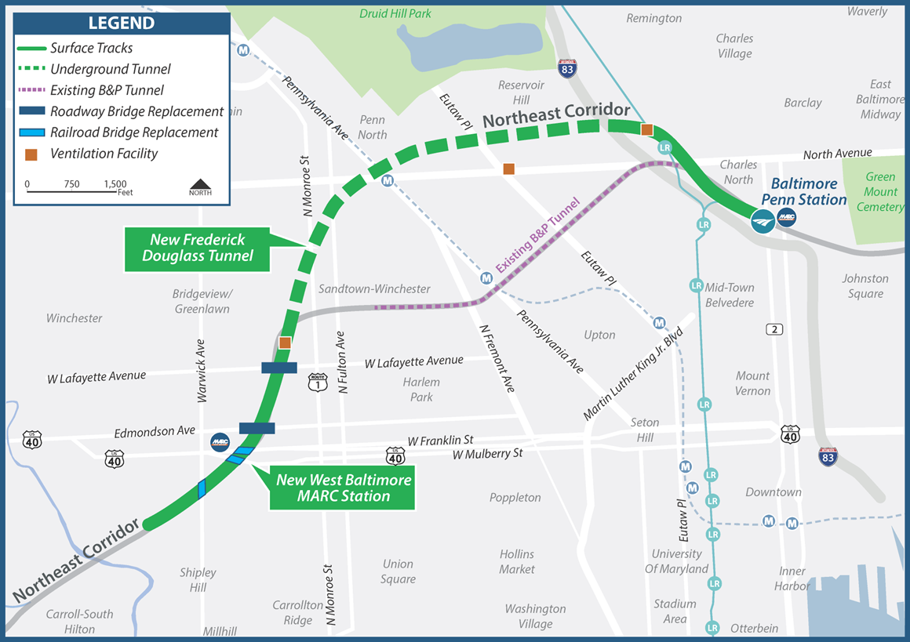
FDT Overview and its Significance
10 miles of rail improvements along the NEC
~2 miles of new tunnel per bore in West Baltimore (two tunnel bores)
New and improved railroad infrastructure
New ADA-accessible West Baltimore MARC Station
State-of-the-art modern fire/life safety systems
5 Bridge replacements in Baltimore City (2 roadway, 3 railroad bridges)
11 Baltimore City roadway modifications

Slide 20
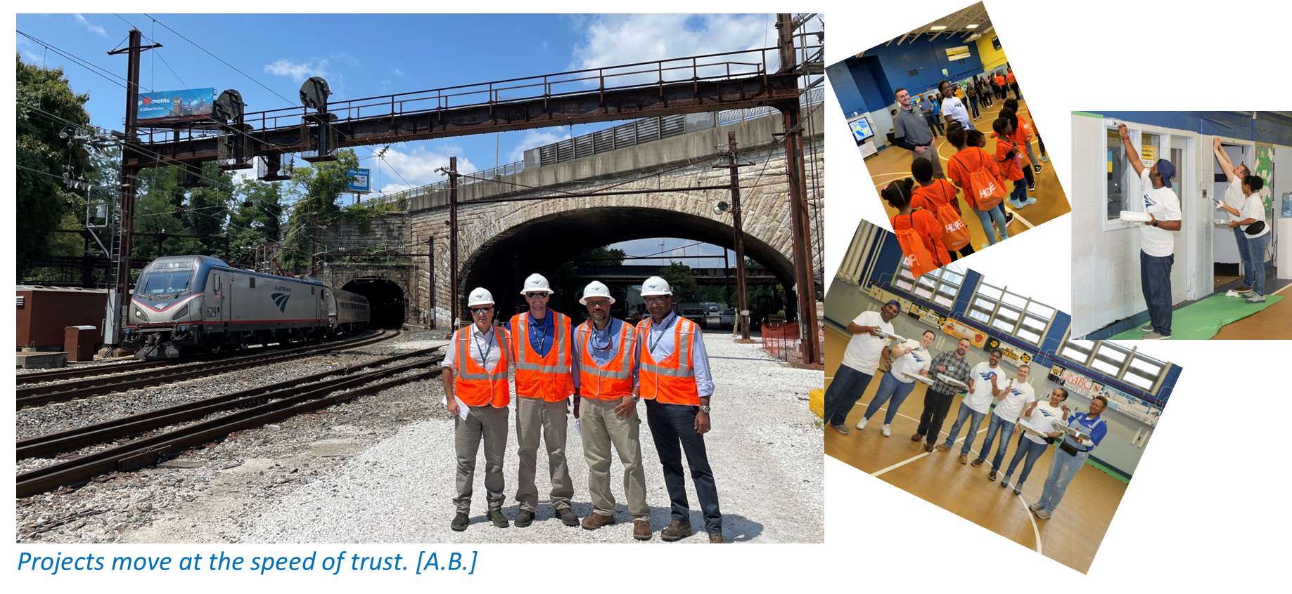
Frederick Douglass Tunnel - The People

Slide 21
Frederick Douglass Tunnel - The Team
Designer (WSP-Parsons)
South Approach / WBAL MARC Station (CMAR JV Clark Construction – Stacy Witbeck)
FDT Tunnel (CMAR JV Kiewit – Shea)
Systems (TBD)
Amtrak Force Account
Demo Contractors (K&K Adams / Delaware Cornerstone Builders)
Community Outreach (Assedo Consulting)
Amtrak / Delivery Partner (AECOM-Jacobs)
FRA / MDOT MTA
City of Baltimore / BGE
Baltimore Entities (Salvage Materials / Property Management)
HNTB (Planning/Demo CM)
RKK (Environmental)
ICE (Patrick Engineering – RINA)

Slide 22
Dean Del Peschio
MDOT MTA
Chief Strategy Officer MARC

Slide 23
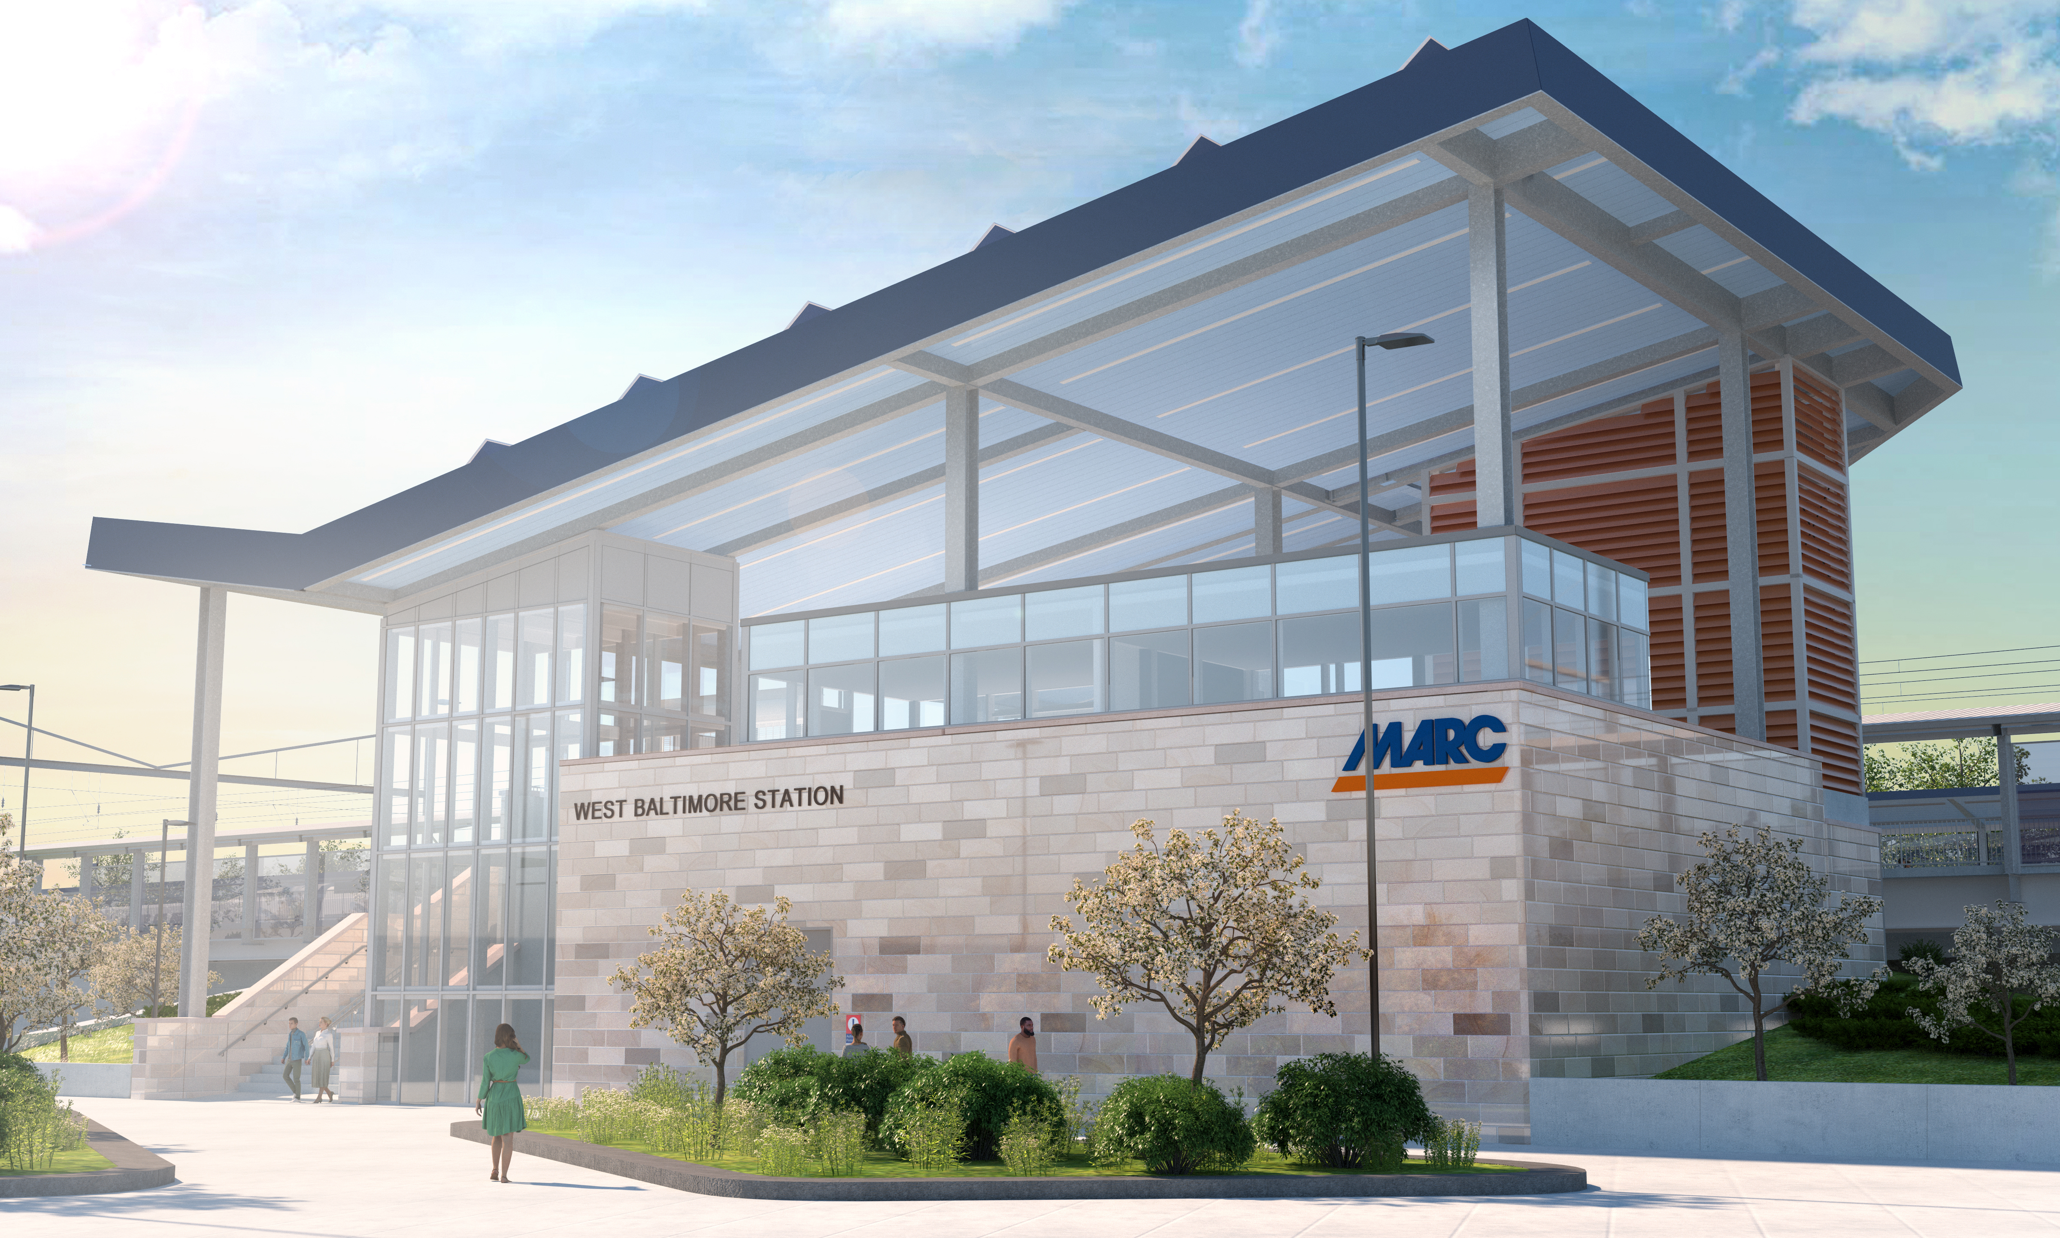
Future West Baltimore MARC Station

Slide 24
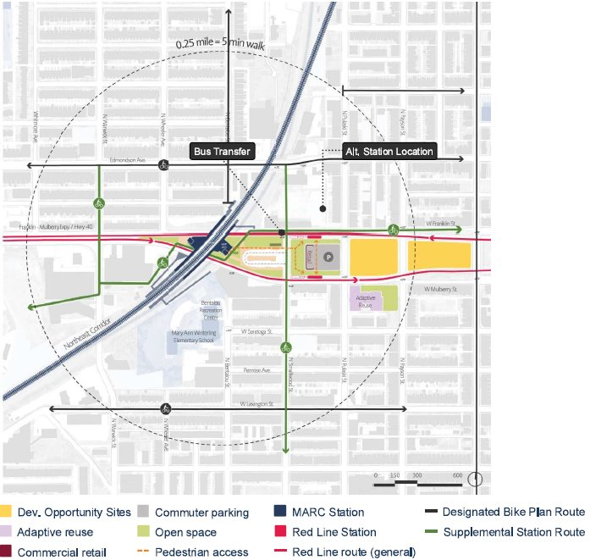
Cornerstone for the Community
Cornerstone and catalyst for future investment in West Baltimore
Design coordinated with MTA bus service and future Red Line LTR Station: multi-modal transit hub
Station layout preserves surrounding areas for future coordination with:
  West Baltimore United
  TOD
  Redevelopment of "Highway to Nowhere" - City of Baltimore was recently awarded $85.5M in federal funding to advance

Slide 25
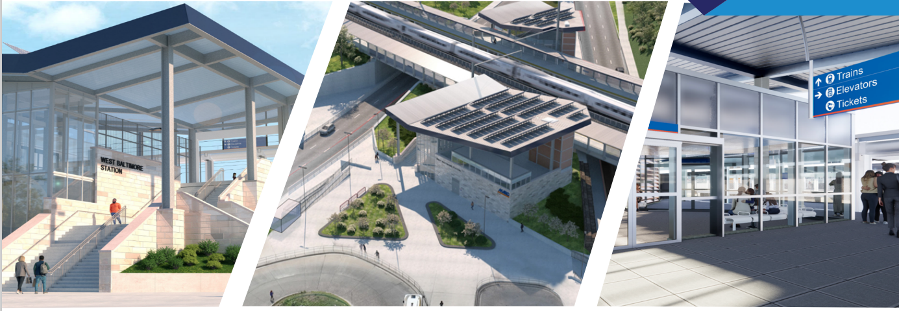
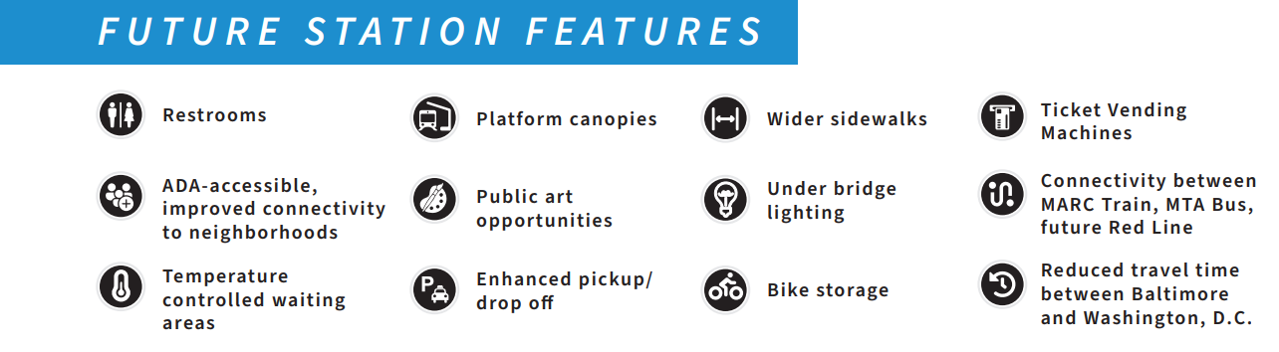

Slide 26
MARC Penn Line Commitment to Electric
MDOT MTA has committed to transitioning to 100% electric propulsion for MARC Penn Line service upon opening of FDT.
MARC currently operates six (6) HHP-8 electric locomotives on the Penn Line, which are reaching the end of their useful life.
MDOT MTA is actively planning for the replacement of the MARC HHP-8 electric locomotives, with considerations for:
  Dual mode operation (some combination of electric and diesel, battery, etc.) to support potential future MARC run-through service into Virginia, as there is no overhead catenary south of Washington, DC.
  Potential upgrades required at MARC layover and maintenance facilities to support 100% electric propulsion on the Penn Line.

Slide 27
Sariah Tambre
Amtrak
Sr. Director FDT – Tunnel Package

Slide 28
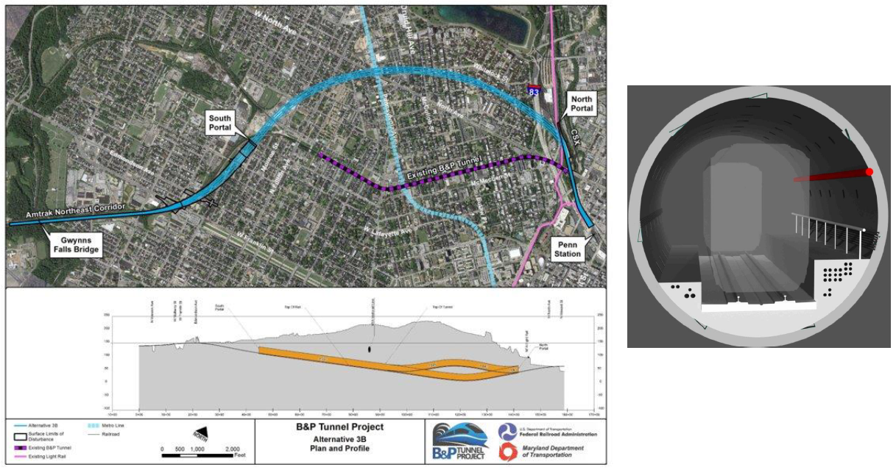
Tunnel Section

Slide 29
Selection of Tunneling Type
Geotechnical goal from NEPA planning phase: “Maximize tunnel placement in bedrock to minimize the amount of soft ground and mixed face mining required.”
The alternatives process considered numerous environmental, engineering and operational factors.
One key factor that helped distinguish between alternatives was the depth of each proposed tunnel alignment. A tunnel alignment that travels deep below the surface allows for greater use of a tunnel boring machine (TBM) which minimizes surface impacts from construction.
A shallower tunnel requires cut-and-cover construction, resulting in greater surface impacts above the tunnel.

Slide 30
TBM Tunneling and the Community
TBM tunneling itself has a low impact on surrounding communities compared to cut and cover operations.
Critical aspects of TBM Tunneling operations with respect to community interaction:
TBM Installation and Assembly
Slurry Plant Operations
Conveyor System Operations
Muck Removal
Segment Delivery
TBM Removal

Slide 31
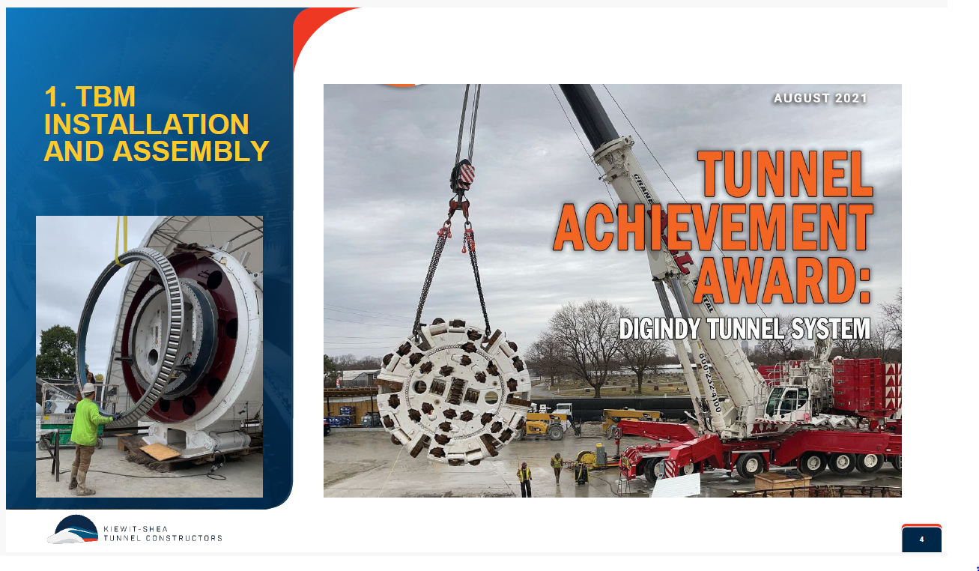

Slide 32
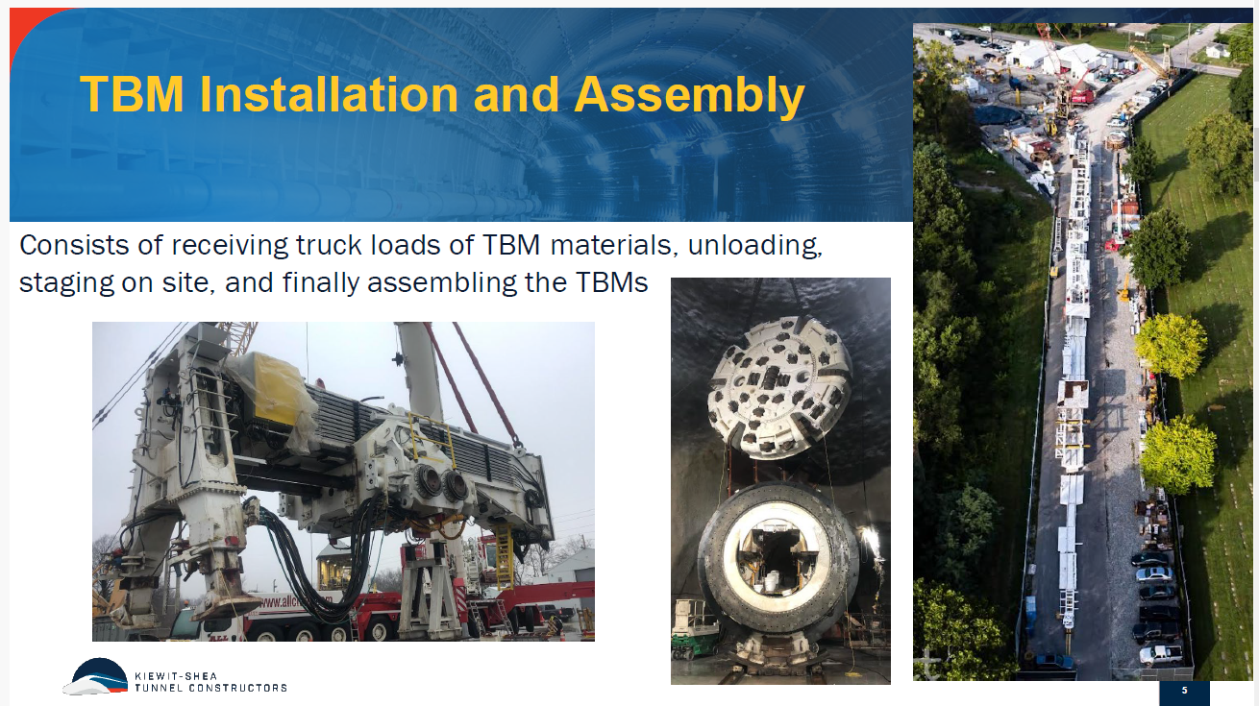

Slide 33
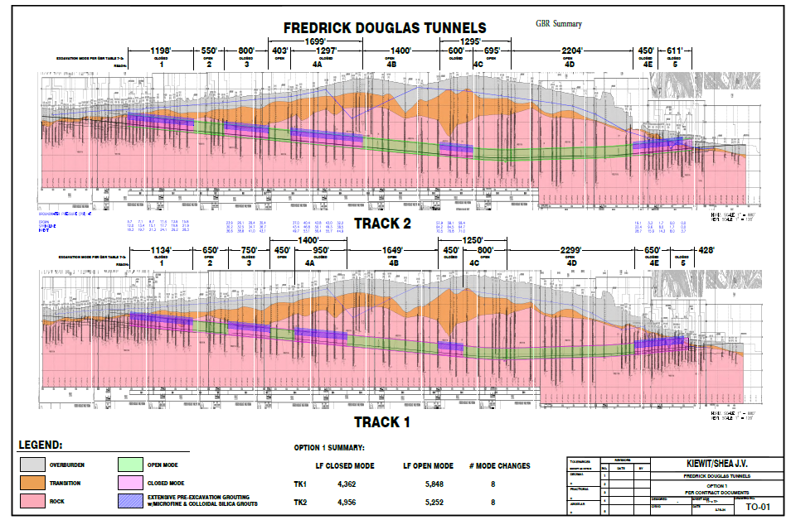
Tunneling Profiles with Reaches

Slide 34
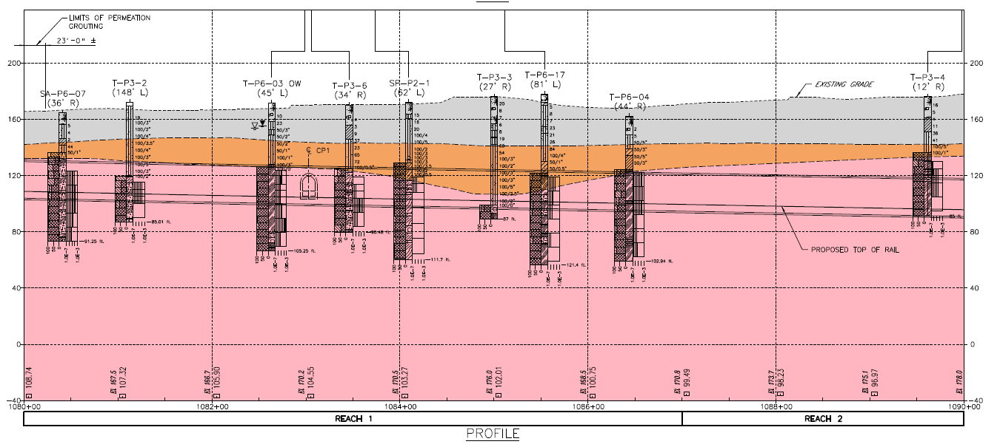
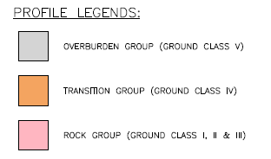
Tunneling Profiles with Reaches
Reach 1
Reach 2

Slide 35
Tunneling Details
TBMs
  Hybrid (aka multi-mode); first in the US; capable of open and closed mode tunneling; specified because of variable range of conditions including mixed face
    Open shield type (aka single shield) - typically faster
    Closed shield type (aka double shield) - typically slower, use when needed for front face stability and water control. Close pressure system supports the excavation face
  Closed types: EPB (earth pressure balance) or slurry type (slurry selected by Contractor)
  Herrenkneckt (HK) of Germany is the selected manufacturer
Precast tunnel lining – 6 segments per ring
26’ finished inside diameter

Slide 36
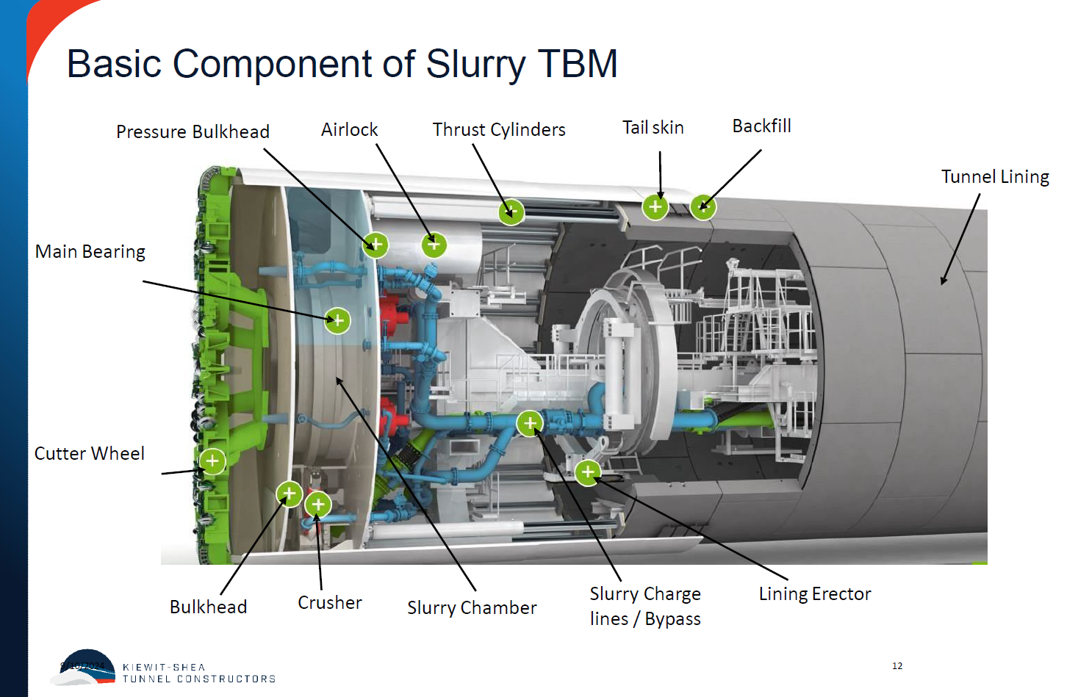

Slide 37
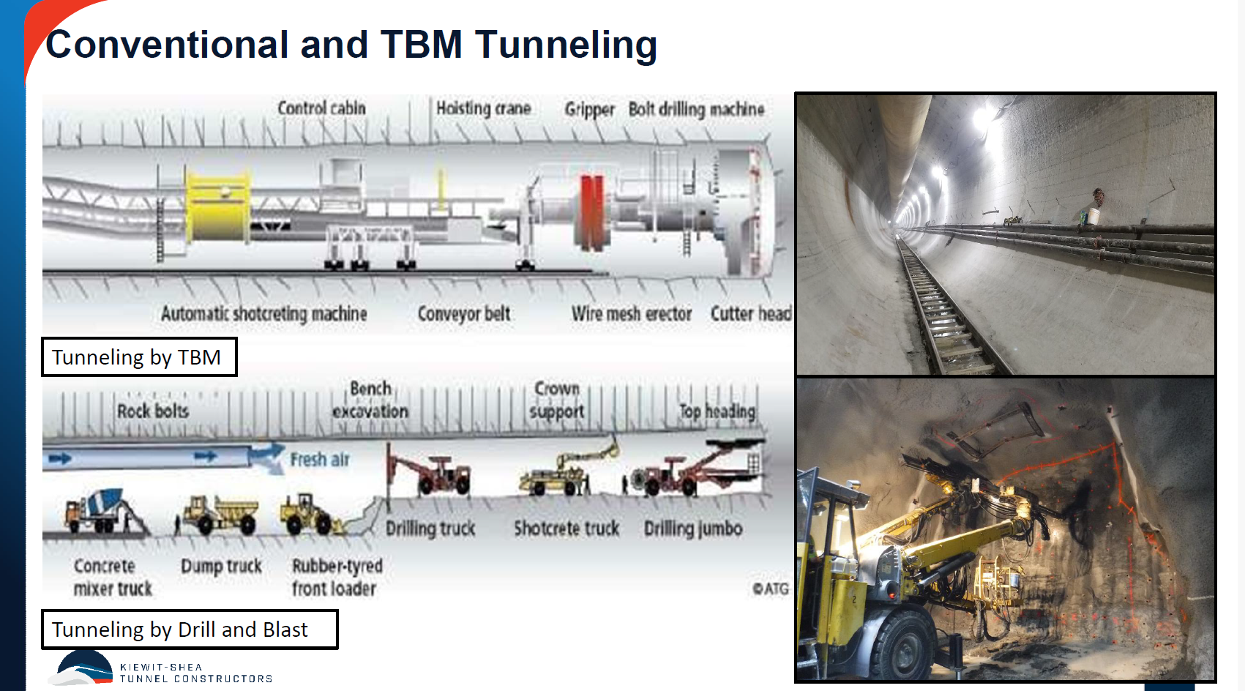

Slide 38
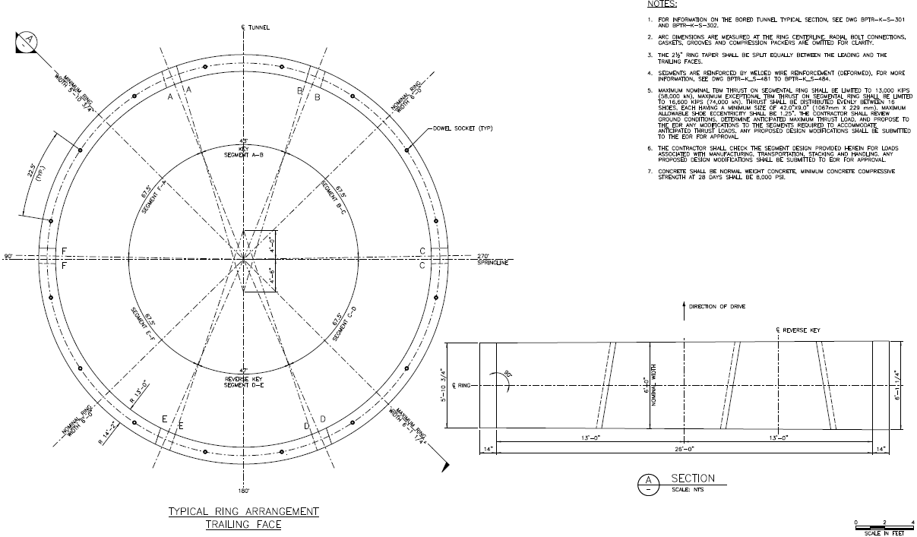

Slide 40
THANK YOU!
Next Meeting:
March 2025
Rail Passenger Association
If you have any questions about membership or are interested in presenting - please come talk with one of the officers!

